Slide 2
What is ESG?
Overview of ESG: Environmental, Social, Governance
Importance of ESG in the modern world
Growing relevance in ICT management

Slide 3
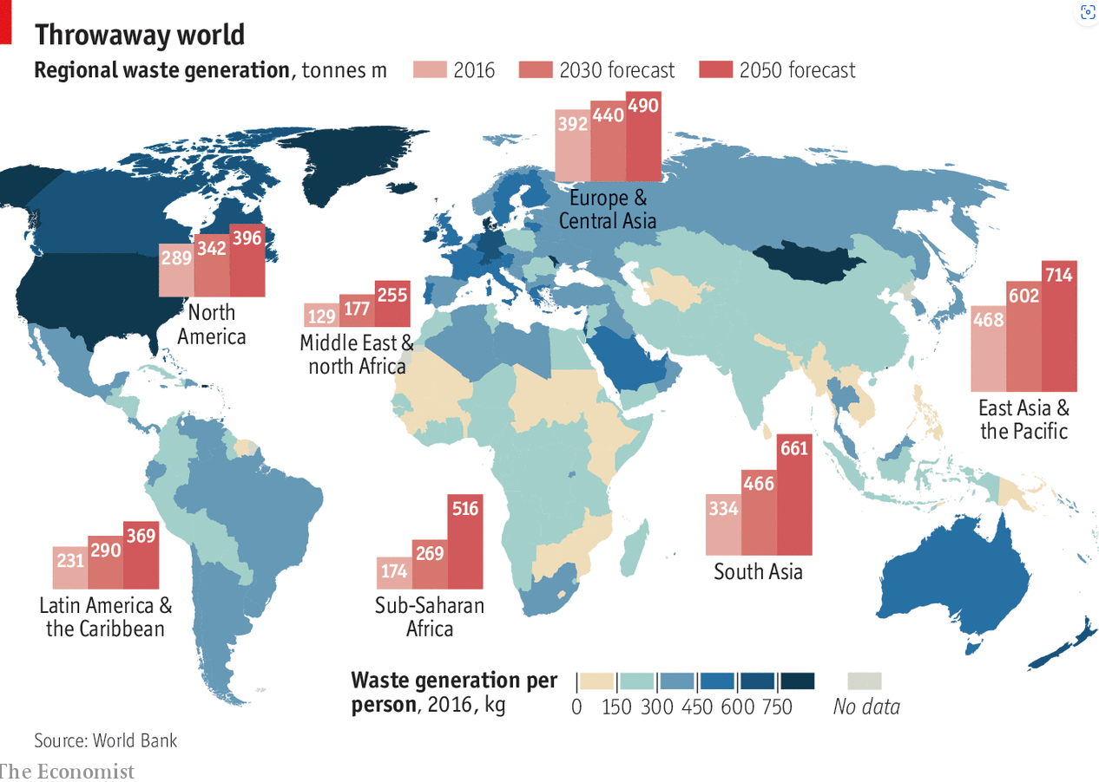
The E-Waste Problem in ICT
Global e-waste statistics
Environmental and social impact of ICT equipment disposal
Role of higher education institutions (HEIs) in tackling e-waste

Slide 4
The Journey from E-Waste to E-Wisdom
Defining "E-Wisdom": responsible use, repurposing, and recycling of ICT
Moving beyond waste management to sustainability in digital ecosystems
Source : https://www.epfl.ch/

Slide 5
Green Public Procurement in ICT
What is green procurement?
How universities can drive demand for eco-friendly ICT solutions
Examples of best practices in green ICT procurement

Slide 6
Digital Transformation and ESG
Digitalisation as an enabler of ESG in ICT
Energy-efficient data centers, cloud solutions, and remote work options
Case studies of universities leading digital transformation with ESG
Source: https://www.digital-adoption.com/digital-infrastructure/
Source: https://manusis4.com/

Slide 7
Reducing the Carbon Footprint through ICT
Implementing energy-efficient ICT services focusing on high energy use e.g. Data Centres
Using smart technology to reduce campus energy use (IoT, automation)
Role of cloud computing and virtual services in reducing emissions

Slide 8
Social Responsibility in ICT
Ensuring fair labour practices in ICT supply chains
Promoting digital inclusion and equity
Educating students and staff on sustainable ICT practices

Slide 9
Governance and Ethical Use of ICT
Robust policies for data protection, privacy, and responsible ICT use
Transparency in ICT procurement and disposal
Building an accountable, transparent ICT governance framework
Source: https://www.dreamstime.com/

Slide 10
From E-Waste to E-Wisdom: The Future
Vision for a sustainable, digitally empowered future
The role of HEIs in leading global ESG best practices in ICT
Call to action:
Adopt, Adapt & Advance
THANK YOU

