Slide 1
Crusade to Campus Contingency:
Maynooth University's journey to a centralised and automated backup solution
Charlene McGoohan & Thomas O'Brien

Slide 2

Introduction
About us
Why now?
Project planning
Why Veeam?
Journey through:-
  Phase 1: Hardware/storage set up, and software installation/configuration
  Phase 2: Converting of discs to allow incremental disc backup and setup of backup jobs
  Phase 3: Installation of Veeam agents for application-aware processing and database transaction log backup
Future Plans and Benefits
c
C

Slide 3

About Us
Charlene McGoohan
Has worked in IT for over 12 years - in IT Services, Maynooth University, as an ICT Project Manager for 6 years, projects include:
Backup Upgrade
Firewall Replacement
Network Upgrade to 802.1x
Managed Support Desk
MFA for Staff
Security Operations Improvements
On-prem File Storage Migration
Data Centre Storage
HEAnet ICT Security Services
c
C

Slide 4

About Us
Thomas O'Brien
Has worked in IT for 8 years largely in Managed Service Providers and is currently working as a Systems Administrator in Maynooth University.
Some of my areas of expertise include:
Infrastructure
Virtualization
Storage
Backup
Cloud
Identity
Cybersecurity
T
T

Slide 5
Why now?
Support contract on existing backup expiring
Renew backup solution architect cyber security model
Enable targeted storage for backups
Immutable storage for use in cyber recovery
Control all backups from centralized service
Update MU backup policies inline with implemented best practices
c
C

Slide 6
Initial Project Milestones
Phase 1 – Software installation and storage set up
For completion January 2024
Phase 2 – Convert discs to allow incremental disc backup
Phase 3 – Targeted backup for databases and agent based backup
For completion March 2024
Project Close
For completion April 2024
April 2024
Critical Dependency:
Getting downtime of key business systems for disc conversion
c
C

Slide 7

Initial Timeline
c
C

Slide 8

Actual Timeline
c
C

Slide 9
Milestones & Project Delivery Team:
Phase 1
Phase 2
Phase 3
Hardware/storage set up, and software installation/configuration
Converting of discs to allow incremental disc backup and setup of backup jobs
Installation of Veeam agents for application-aware processing and database transaction log backup
Project Close
Infrastructure Team
Information Systems Team
Vendor
Vendor
c
C

Slide 10

Why Veeam?
HEAnet Frameworks –
  Storage framework
  Managed ICT Security Services DPS framework
Universal Licensing
Software only solution
  Bring your own storage and compute
Flexibility
  Support for Physical, Virtual, On-prem, Cloud, Databases, O365, etc.
  Single, centralised and automated backup solution for the entire MU estate
Data protection features
  Immutability
  Ransomware
  Integrity Verification
T
CT

Slide 11
Phase 1 - Objectives
Procurement of new server to install Veeam backup and recovery software
Requirements analysis
Install new storage system
Configuration of Veeam software
Backup Veeam configuration to cloud
c
CT

Slide 12
Phase 1 Journey
Planning stage was accelerated by an audible alarm coming from a comms room; a failed disk of old solution
Physical install of two components
Cherry (compliance box) configuration
  Domain Controllers
  Students Records System
  Academic Database
  Timetable
  Virtualisation Hosted Engine
Based on MU business criticality.
c
C

Slide 13
Phase 1 Journey
For compliance, we started with small volumes and short retention schedules for testing
  Started with 14 daily snapshots
We increased based on efficiency after testing
14 snapshots in total, oldest one gets automatically deleted when newest one created:
  7 dailies
  4 weekly
  3 monthly
Retention schedules based on ransomware dwell times and the potential of malware/ransomware not being detected before daily snapshot becoming corrupted.
Veeam configuration itself was backed up to cloud
  Extremely important
  API token issue with Veeam
c
C

Slide 14



Storage Solution
Two NetApp SANs
  Cherry (Compliance)
    FAS2820 – 29TB
  DogRose (Disaster Recovery)
    FAS2820 + DS460C Expansion – 230TB
Immutable for cyber contingency
Contingency for ICT infrastructure major incident
T
T

Slide 15





Logical
VBR
ReFS
Console
iSCSI
HyperV
vSwitch
vSwitch
Storage
Datacentres
25GB SET
10GB SET
T
T

Slide 16
Phase 2 - Objectives
Commission new storage infrastructure and software
Recording of backup and restore times
Migration from the old environment to new environment
c
CT

Slide 17
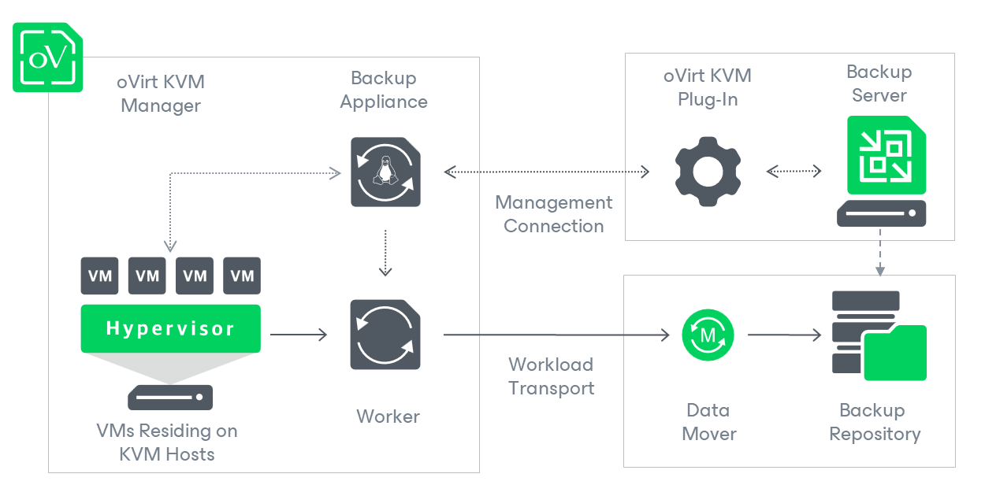
Hypervisor Integration
Source: Solution Architecture - Veeam Backup for Oracle Linux Virtualization Manager and Red Hat Virtualization
T
T

Slide 18
3-2-1 or 3-2-1-1-0?
3-2-1
3 Copies – Production + 2 Backups
2 Media Types
1 Offsite
3-2-1-1-0
3 Copies – Production + 2 Backups
2 Media Types
1 Offsite
1 Offline, or Immutable
0 Errors
T
T

Slide 19
Implementation
Create scheduled jobs
Criticality assessment to determine frequency (RPO)
Retention built up slowly
  Determine storage efficiencies
  Monitor network utilisation
Backup Methods
  Initial Active Full backup
  Subsequent Incremental backups
  Weekly/Monthly Synthetic Full backups
  Health Checking – Synthetic Full backups
Backup copies to immutable blob storage (1 Copy Offsite + Immutable)
SureBackup – integrity checking and malware checking (0 Errors)
T
T

Slide 20
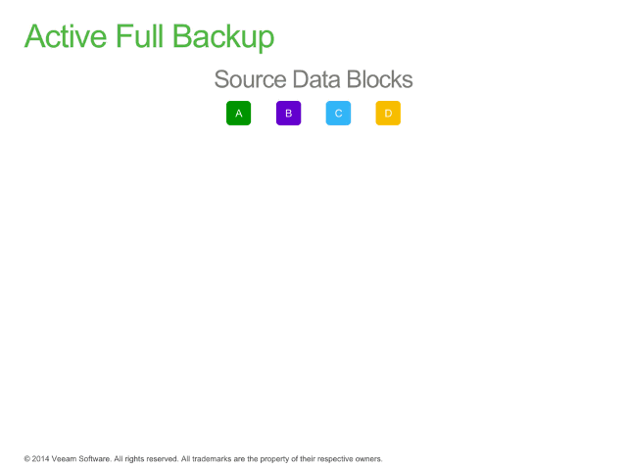
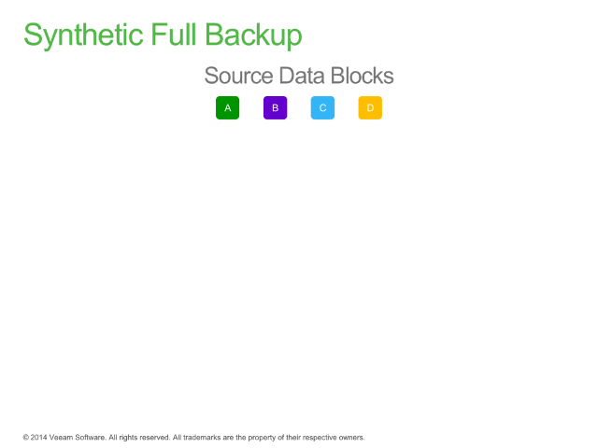
Backup Methods
Source: KB1932: Forward Incremental – Animation of Method and Retention (veeam.com)
T
T

Slide 21
KVM Storage Formats
RAW
Direct access to underlying storage
Higher Disk IO performance
Larger storage footprint
Limited snapshot/backup functionality
QCOW2
QEMU Copy-On-Write Version2
Efficient storage
Supports feature like compression, snapshot and thin provision
Slight lessened performance
T
T

Slide 22
Conversion Planning
MU Infrastructure largely in Raw format
Not compatible with Incremental backups
186 VMs
Disks 236 Raw vs. 51 QCOW2
T
CT

Slide 23
Progression of Conversion Methodology
236 disks to be converted between formats
First Method: Veeam
  Backup and restore in QCOW2 format
  Initial full backup complete but slow, storage intensive, occasional failures
Second Method:
  RHV API (Postman)
  Faster, less storage intensive and less prone to failure
T
CT

Slide 24
Phase 2 Journey
The original timeline estimated on technical tasks and resource availability
Managing communication and coordination proved more complex than executing the technical implementation
  Stakeholder analysis
  Communication plan
  Academic timetable
  Conflicting priorities between business function and ICT infrastructure stability
The big difficulty:
Downtime!
c
C

Slide 25
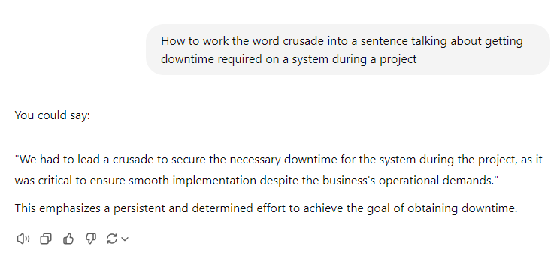
c
C

Slide 26
Phase 2 Journey
Systems | Timeline | Considerations
All ICT Infrastructure disks | March, April
Campus Services owned systems | April | Windowmaster and weather
All core business test environments | May | This informed downtime required for production systems
Student Record System | 13-14 May | Longest downtime required
Health Centre | June | Waited for students to leave for the Summer
Card system | June
Timetabling | July
Academic Database | July
Campus Security Radios | July | Waited until campus was quiet and missing radios was low risk
Website | August | Conversion completed as part of Cloudflare implementation
Disks relating to in-house developed applications | October | These serve specific functions of various applications, high impact, to be completed in first semester after all registration.
c
C

Slide 27
Phase 3 Objectives
Targeted backup for databases and agent-based backup
Testing and Recovery documentation
Backup Policy updated and published
All Azure VMs backed up via Veeam
c
C

Slide 28
Agent Deployment
RHV – no support for application-aware processing
  Veeam Agent for Windows/Linux to perform this function
Databases – Active Directory, Oracle, SQL, PostgreSQL
Installation via Protection Groups
  Windows - Agent pushed from VBR
    Local Firewall configuration
    Connection to VBR to install agent
  Linux – Certificate based deployment
    RPM and temp certs generated on VBR
    Deployment installation on client server
    Connection to VBR to complete setup
    No credentials required!
Database user permissions
T
T

Slide 29
Approach
Set up schedule for DB backups
MU support vendor was consulted for best practices relating to DB and log backup
    Backup Mode - Chose differential backup rather than cumulative, as it gives more control on actions user might need to take
    Channel Allocation - 4 channels recommended more than enough
    Frequency - Backing up and deleting old archive/redo logs every 15 mins
Test environment of key business systems first and took lessons learned before production environments:
  Archivelog mode must be turned on
  Veeam server had to be added to firewall on individual servers, for restores
Monitored for four days, before implementing in production
Backup Copy to Cloud File Share (Blob not supported)
Backup policy and procedure documents
T
CT

Slide 30
Future Plans and Benefits
Veeam Backup for Microsoft Azure
Refinement of our regular DR invocation testing
  Required by cyber insurance
Throughout Phase 2, decommissioned VMs that were no longer in use
Future infrastructure hypervisor platform
  Veeam supports multiple and varied platforms
Veeam Backup & Replication on Linux
CT
CT

Slide 31
Thank you, questions?
CT

