Slide 1
Forces of Change & IT Transformation
Dearbhla O’Reilly Head of IT Operations IT Services
Maynooth University
HEAnet 2024 - Presentation

Slide 2
Overview
About me & Why this talk?
IT Changes
Digitisation, Digitalisation & Digital Transformation
Forces of Change, Tipping Points
Shared Services?
Future of IT Department
Questions

Slide 3
My background
Majority of working life - HEI IT Departments
Programmer, DBA, Support, Telephony, Sys Admin, Networking - now responsible for infrastructure, service delivery/user support & cyber
Worked through moving from on-premise to cloud, numerous email migrations, IT for research, ITSM, shared services, data centre builds, technology & buildings etc…
Very little unseen
Notes:
Staff who have never seen or racked a server

Slide 4
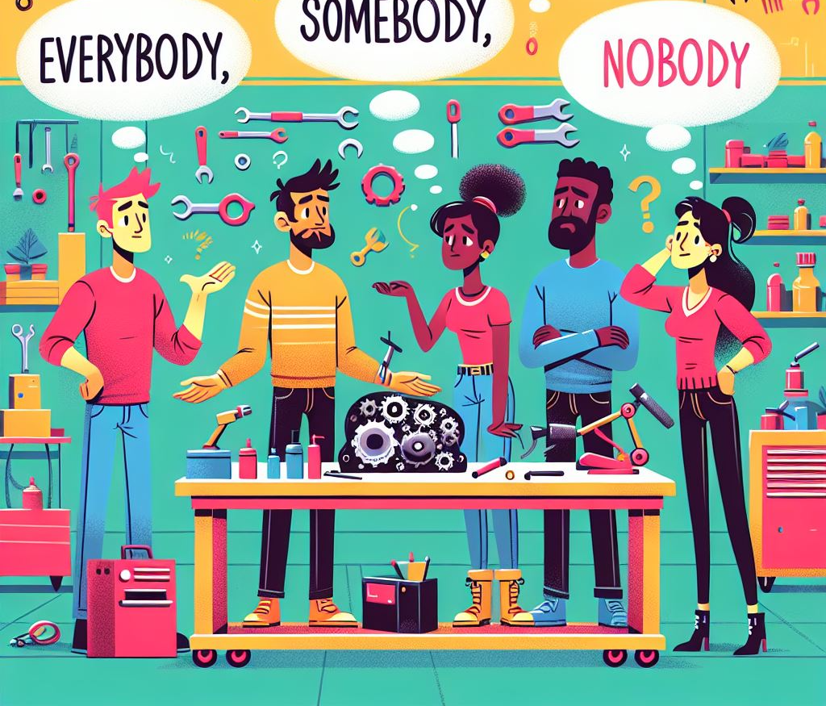
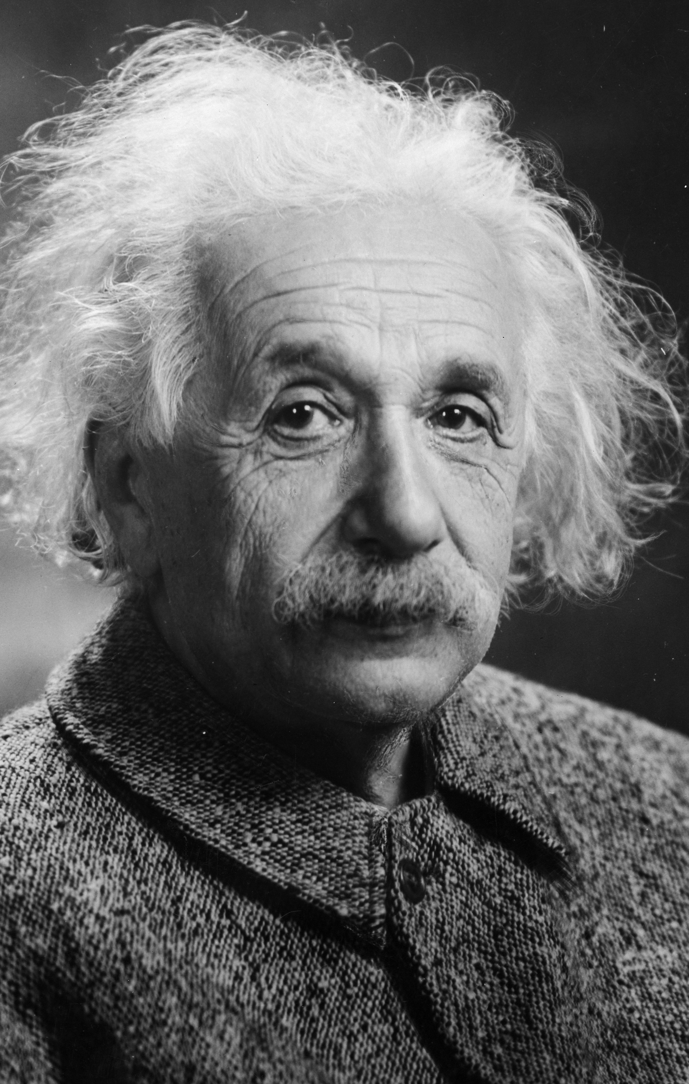
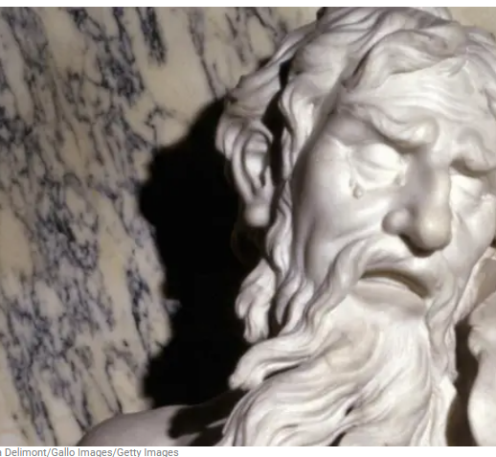
Why this talk?
'The world as we have created it is a process of our thinking. It cannot be changed without changing our thinking.’ Einstein
‘Only constant is change.’ Heraclitus
UCISA Leadership 2024 – debated predictions for the future of Higher-Ed Tech (SOAS University)
World of change - IT people & technology - create & maintain motivation, be innovative and avoid dreaded cynicism

Slide 5
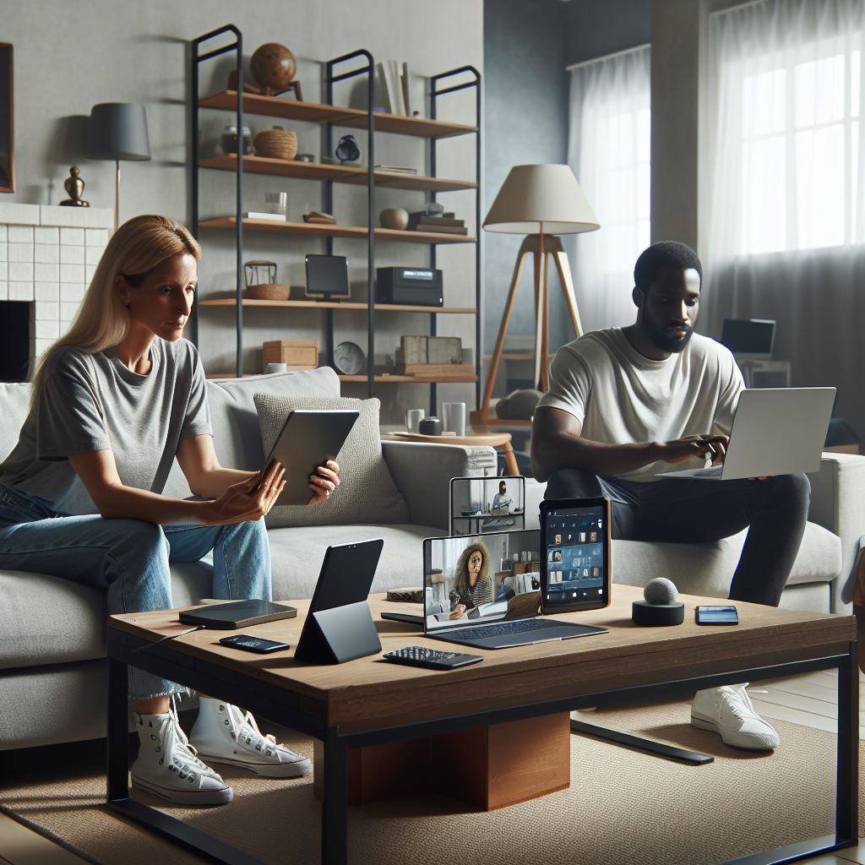
IT Changes
Waves of technology change - Internet, Mobile, IoT, AI
McKinsey (2021) – March to September 2020, decade of accelerated technology adoption and ‘progress’

Slide 6
IT Changes
Cyber incidents - changed focus and priorities - governance and compliance
Workplace changes - hybrid working - shared workspace - organise by service/product
Changes today - Digital (Transformation), Cloud, IT People, AI
NCSC: Guidelines on Cyber Security Specifications (ICT Procurement for Public Service Bodies) June 2023

Slide 7
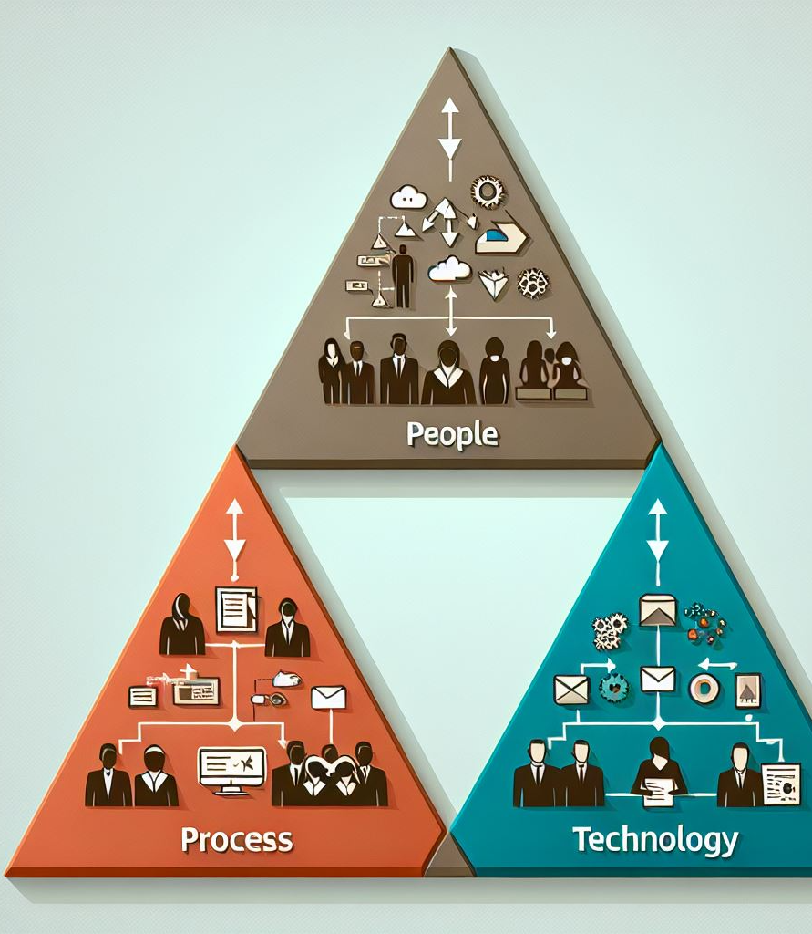
Digital/IT - people, process, technology
Digitisation – analog to digital - Scan paper to storage
Digitalisation – change organisation operations - Collaboration platform, reports dashboard, CRM system

Slide 8
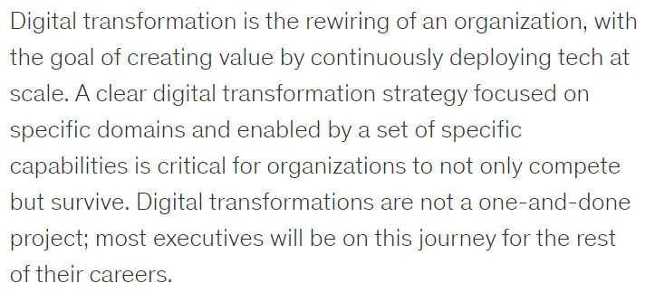
Digital Transformation
McKinsey 2024, HBR 2021, Accenture 2024, Gartner 2024, EDUCAUSE 2020

Slide 9
My Digital Transformation!
Organizational change driven by digital technologies. e.g. Redesign experiences, leveraging data analytics & AI
A change so fundamental, it is only possible to move forward (or there is no going back).

Slide 10
Forces of Change: Cloud
In all its as-a-service forms, cloud has changed IT Departments - Scaled down data centre facilities - Changing to SaaS delivery - Software on continuous update - Changed user expectations - 3rd party integration to core provision - Is shadow IT now normal IT?

Slide 11
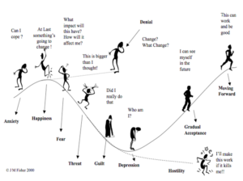
Forces of Change: IT People
Multi-generational and diverse workplace. Need for value set, recognition of individual styles of working
Generalists or specialists? What does an IT career look like?
What are the expectations of people in your IT Department and why?
Where does the 70.20.10 learning & development model fit?
All change has a real impact
Kubler-Ross

Slide 12
Forces of Change: AI
Much focus of assessment of students and the 'essay'
Futures in AI for learning, capabilities, engagement and possibilities?
LLM vs real AI?
Learn how to engage with these tools
Where do the many tools and dashboards fit?
Impact to working practices, productivity & role of automation
Which of our roles will not be impacted by AI? What will our new roles be?

Slide 13
Forces of Change: Communication
Massive changes in how tools are used and provided. - Device connectivity (Wi-Fi) - Email/collaboration - Fixed line telephony
What was our role in IT? - Planned elements - Significant pieces unplanned
Are we more reacting to culture and societal change?

Slide 14
Tipping Points & Obsolescence
Tipping point – point where a significant and often unstoppable effect or change takes place - Motors and trains for blacksmiths and canals. - Covid19 for technology adoption At what stage are we recognising the tipping points that impact our IT Departments?
Obsolescence - process of becoming obsolete or outdated and no longer usable - Tape backups, OS versions, applications, self-managed devices Are we able to address this quickly enough?

Slide 15
Forces of Change: Cory Doctorow & 'Enshittification'
Typified by massive cost increase and a reduced service following a period of growth. Providing valuable services that we can't be without.
What has just happened? - Virtualisation software - Collaboration tool storage - Database software
Are tools, services & products used exclusively by education immune?

Slide 16
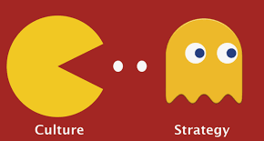
Forces of Change: Strategy & Shared Services
Should there be a national IT/Technology strategy for HEI?
Any service or transformation is best supported by a strategy or vision.
Experience – can that not be unique to the culture of your HEI?

Slide 17
Globalisation or Monopolisation?
Technology vendors merge. MU thought we had a multi-vendor campus network – a deliberate decision. We no longer do.
Acquisitions. MU now have the same ‘group’ for campus network support and firewall. That, was never the intention.

Slide 18
IT Department in a changed world
Roles of CIO, CISO, CDO, CTO etc?
Product management and integrated with business?
Significant compliance role – data and cyber
IT People Skills – Be adaptive, understand AI, innovative, collaborative, focus on customer experience, lifelong learning for technical skills
Finance IT Ops & costs role – complexity of OpEx models
Growth of configuration management and tailored experiences. Decline of development
Low Code, No Code approach
Is it illusion of control, are IT reacting to external forces?
Are organisations reacting also and at what pace?

Slide 19
How do we survive? Change!
Library. Changed and new services
Banking/Finance. Branches, services, customer interactions and experience
Post Offices. Pivot to other services and parcels
Music Stores. Niche market
Netflix vs Xtravision
…
It is possible, will & ideas has to come from us IT people
‘how do we do this without a crystal ball’

Slide 20
Suggested Debating Topics
Email is to letter writing what Teams is to Email?
In 10 years will all software be delivered on the same platform?
Are some of our technology suppliers too big to go bad?
Are we planning, reacting or responding?

Slide 21
Thank you for listening and Questions
MU Microcredential – Digital Transformation
NCSC Guidance - https://www.ncsc.gov.ie/guidance/
Café Wall Illusion
Cory Doctorow https://craphound.com/bio/ The ‘Enshittification’ of TikTok | WIRED

