Slide 3
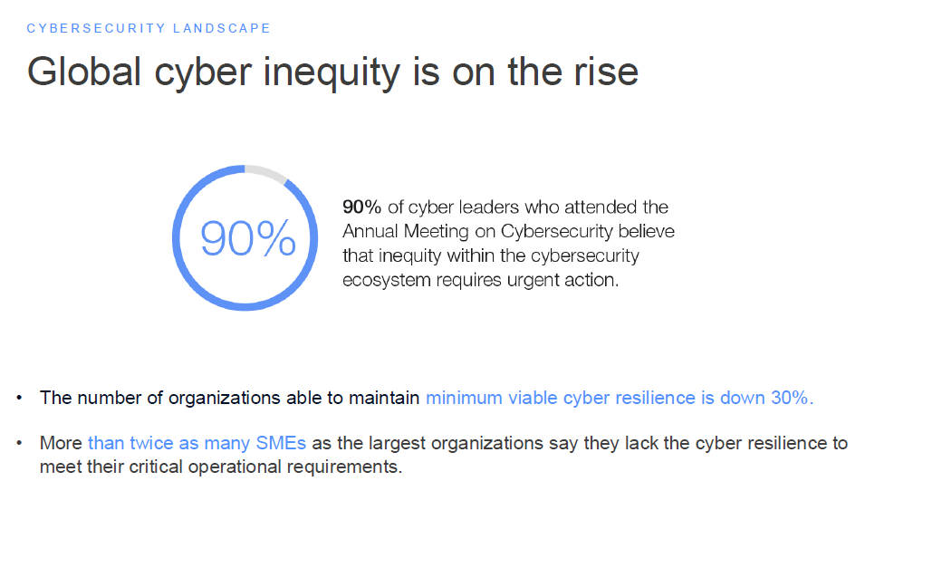

Slide 5
Source: WEF Cybersecurity Global Outlook 2024

Slide 6
Source: WEF Cybersecurity Global Outlook 2024

Slide 7
Notes:
We know Ireland is recognised as an international hub for technology MNCs, but we are also becoming a European leader in cyber security operations. And we have all the ingredients required, including:
Top MNC cyber security “pure-play” companies based here”
Over 50 Irish cyber security companies exporting internationally
A strong talent pool of approximately 30,000 people with cyber security skills.
We are neutral country and geopolitically stable.
We are one of 2 English-speaking countries in the EU, the other is Malta.
Our central timezone is an advantage for global security operations.

Slide 8
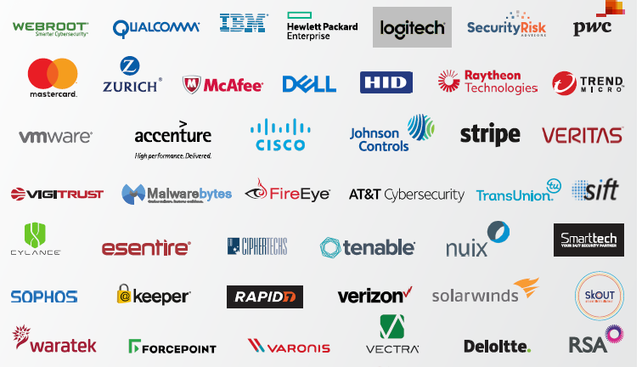
Multi-National Companies Cybersecurity Operations

Slide 9
Irish Cybersecurity Companies
Data Security
& Security
Automation
Governance,
Risk, &
Compliance
Threat
Detection & Response
MSSP &
Advisory
Services
Application
Network
& Cloud
Security
Identity Access Management
Data
Privacy

Slide 10
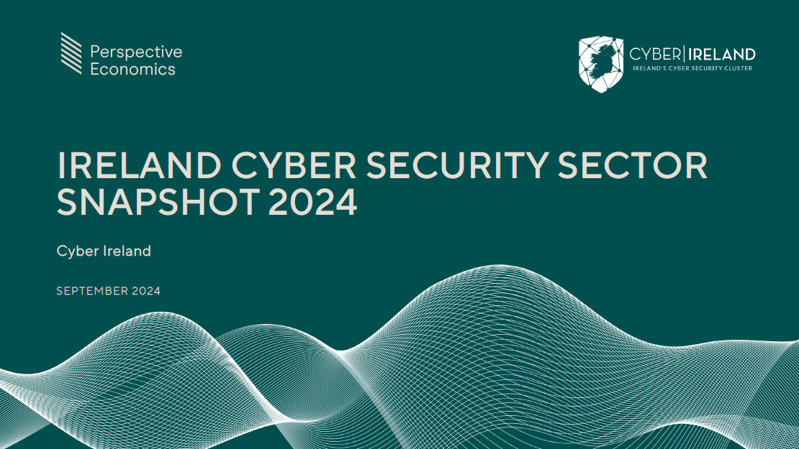
Notes:
The “Ireland Cyber Security Sector Snapshot 2024” report launched in September this year provides an update on the baseline report from 2022 on the size, operations and economic contribution of the cyber security sector in Ireland.

Slide 11
Notes:
Firm & employment growth: Over the last two years, Ireland’s cyber security sector has shown significant resilience and robust growth during a global technology sector downturn that particularly impacted Ireland. The number of firms in the sector grew to 535, an increase of 9%. These firms employ almost 8,000 individuals, an increase of 8% since 2022.

Slide 12
Notes:
Economic contribution: Cyber security related revenue from firms in the sector is approximately €2.7bn, which is up by €600m in 2 years, or 29%. Gross Value Added, a measure of productivity, for 2023 is estimated at €1.2bn, an increase of €120m or 11% over two years.

Slide 13
Notes:
Office Locations: We now have over 750 cyber security offices nationwide. The geographical spread of cyber security firms across Ireland is a testament to the sector’s nationwide impact and promotes both regional economic development and strengthens the cyber security resilience of organisations nationwide.

Slide 14
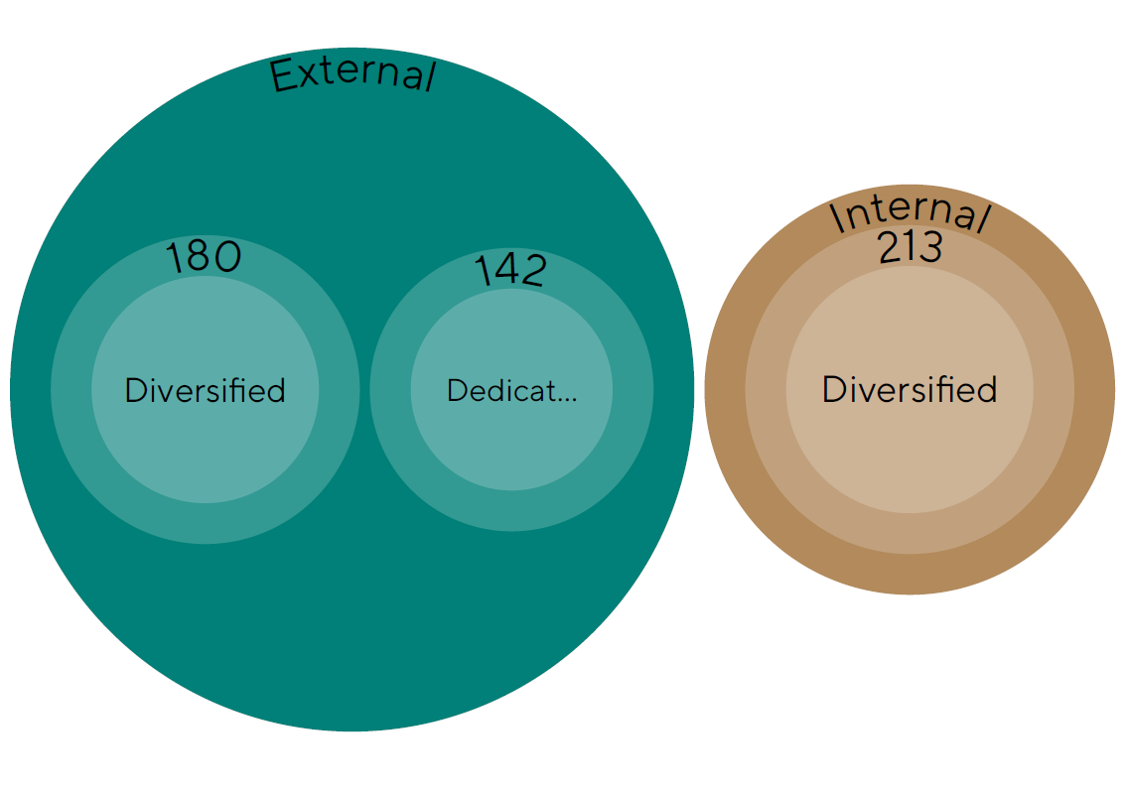
Cyber Security Operations
We define three types of cyber security offering within Ireland:
External-facing: There are 322 providers that sell cyber security products or services externally.
180 - ‘diversified’ firms that sell cyber security products or services as part of a wider company offering,
142 - ‘dedicated’ or ‘pure-play’ firms that only focus on cyber products or services.
Internal: There are 213 firms with internal cyber security capabilities.
Notes:
We’ve done further analysis to define the cyber security operations of firms:
‘External’ firms provide cyber security solutions externally, there are 322. Within this there are ‘dedicated’ firms that only focus on providing cyber security solutions (142), and ‘diversified’ firms that provide cyber security solutions as part of a wider offering (180).
‘Internal’ firms, of which there are 213, provide cyber security solutions internally to a large or multi-national (MNC) company.
These 3 distinct categories of firms are all part of the sector and have different needs, defining them allows for specific strategies to support these firms.

Slide 15
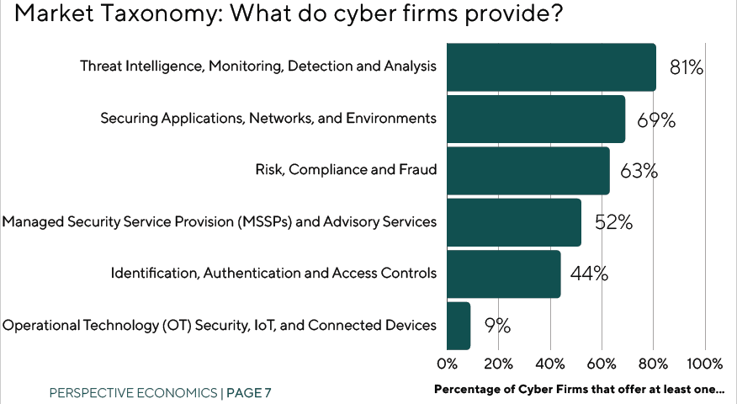
Market Taxonomy: What do cyber firms provide?
Notes:
Market Taxonomy: We know the types of solutions that these cyber security firms provide: the majority are in Threat Intel (80%), Securing applications, networks & environments (70%), Governance Risk and Compliance (60%) and managed security service providers (50%), Identity and Access Management (45%) and finally OT security (10%).

Slide 16
Notes:
Diverse firm composition: Of the 535 firms in the sector, 47% are Irish businesses and 53% are from outside Ireland.
On the sizes of firms, about 60% are either micro-enterprises or small companies sized with under 50 employees, which are primarily Irish-owned.
Conversely, 27% of firms are large, with over 250 employees globally, the majority of which are US firms.

Slide 17
Notes:
FDI: Ireland continues to be an international hub for multinational companies cyber security operations.
The majority of these being from the US (33%), 8% from the UK and 7% from the rest of Europe.
This points to the need for a twin track approach: 1) to support Irish companies to scale to become internationally competitive, and 2) to continue to support FDI as a key driver of the sector for both dedicated and diversified firms.
Developing distinctive supports for each cohort of firms along with broader sectoral supports is critical in driving growth across the sector.

Slide 18
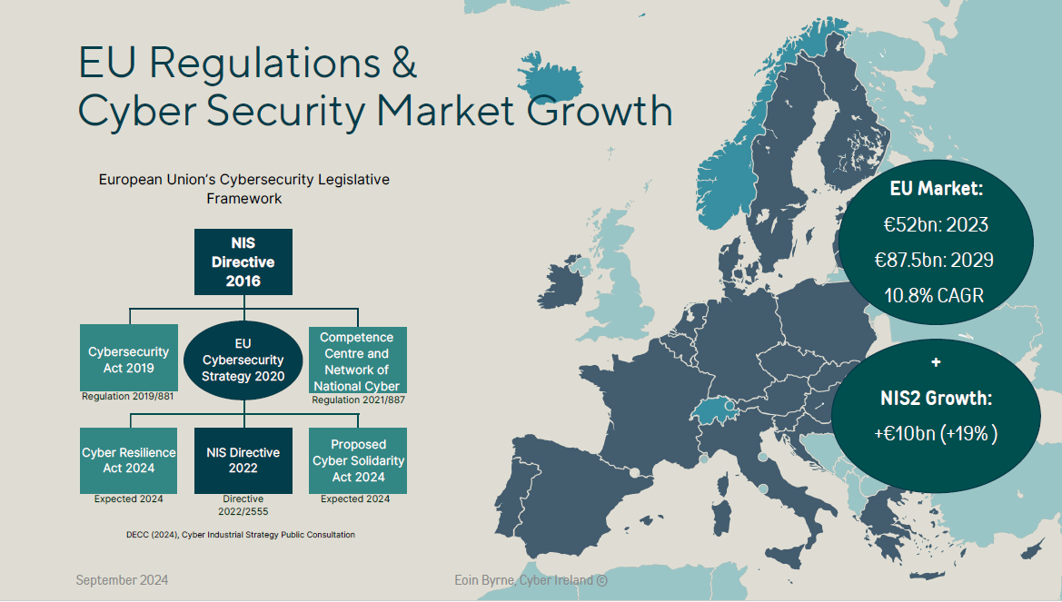
Notes:
EU Regulations & Market Opportunities:
The European Union is taking an increasingly central role with new regulations for cyber security, including the NIS2, DORA, the Cyber Resilience Act, among others. Across the EU, thousands of businesses will become regulated entities under NIS2. In Ireland alone, it will expand from approximately 70 under NIS1 to over 4,000 regulated entities under NIS2 according to initial estimates. Across the EU this is estimated to be over 180,000 companies. Furthermore, it will impact their third-party suppliers, potentially impacting millions of companies — not just large enterprises but small and medium-sized enterprises (SMEs), which are the backbone of Europe’s digital economy.
The cost to companies will also be significant with research predicting the estimated cost of NIS2 at €32 billion per annum across the EU.
The regulations aim to improve the EU’s cyber resilience, safeguarding our communications and data, and keeping the online society and economy secure. It will require increased investment, resources and prioritisation of cyber security across sectors and regulated entities. This will require innovative cyber security solutions and even more people with cyber security skills. Therefore, we believe that cyber security companies have a critical role to play in proactively supporting the adoption and implementation of these regulations, supporting skills development and providing the solutions required.
Cyber security companies in Ireland can not only support regulated companies across Ireland with these regulations but have the opportunity to assist companies across EU countries also.
It should also be noted these regulations will bring increased competition from cyber security providers in Europe targeting the Irish market, which we have already seen where EU companies have won tenders to provide cyber security solutions and services to the Irish government.
A significant challenge we’ve identified is the European Union’s focus on ‘technological sovereignty’, resulting in restrictions on EU public funding, R&D and tenders being provided to non-EU entities. This poses some challenges for Ireland, where foreign companies make up 50% in the cyber security sector, the majority of which are US-based, and employ over 70% of professionals. Furthermore, restrictions to non-EU companies in cyber security funding could result in reciprocal restrictions to EU, and Irish, companies to our key trading partners such as the US and UK.
We must prepare companies in Ireland to proactively adapt to these regulations to be able to secure their organisations and customers. Our people are highly skilled and our cyber security companies provide effective and high-quality solutions.
Ireland can take the lead in responding to the impact of EU regulation through adequate strategy, preparation, investment and execution.

Slide 19
Notes:
From our baseline study in 2022, we see the potential for the cyber security sector to grow to 17,000s jobs by 2030, more than doubling today’s figure of almost 8,000, and the potential for €2.5bn GVA.
Given the sector growth over the past 2 years, the opportunity still exists for Ireland to capitalise on its strengths to develop a leading cyber security sector in Europe, and globally.
This will have a threefold impact:
providing national cyber resilience to our country & organisations,
making companies across all sectors more internationally competitive through improved cyber security and
the significant economic growth of the cyber security sector and digital economy
Cyber Ireland aims to be the co-ordinator and driving force to deliver on Ireland’s cyber potential. But we can only do this through the support of all organistions from industry (start-ups, SMEs, MNCs), the education providers, researchers, government agencies, investors and more to achieve this vision.
Investing in Cyber security is unique amongst National Security Spend. If we can move our National Cyber Security capabilities to European and Global leadership status we will secure our digital economy, our digital society and our citizens. In doing so we will project Ireland as leader in Cyber Security practice and innovation, with a very real opportunity to generate 5 to 10X orders of magnitude of return on this national investment.
With the headquarters of so many international technology companies based in Ireland and a hub for data centres, we have an economic obligation to invest in cyber security and secure our country for organizations and all our people.

Slide 20
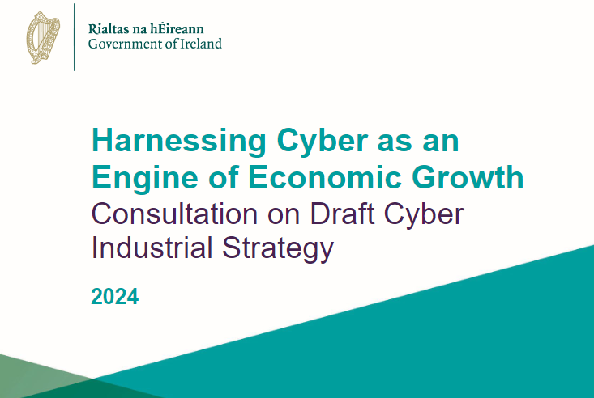
What’s required:
Government prioritisation of cyber security.
Train up 10,000 new professionals with cyber security skills.
Supporting SMEs & scaling Irish companies.
National Cybersecurity R&D Centre.
Notes:
What’s required – Final Slide

Slide 21
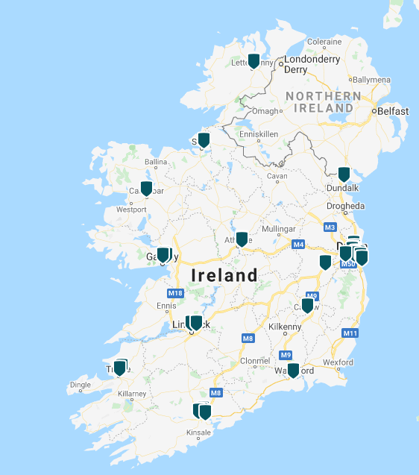
Cybersecurity Skills Landscape
Strengths:
8,000 professionals in the Cyber Security sector
+ 14,000 professionals with cyber security skills
+10,000 additional jobs by 2030
Gender split 76% Male – 24% Female
Cyber Ireland Course Finder: +70 courses
+14 Education Providers
Challenges:
66% of organisations reported staff-related issues.
Cyber Course Finder Map

Slide 22
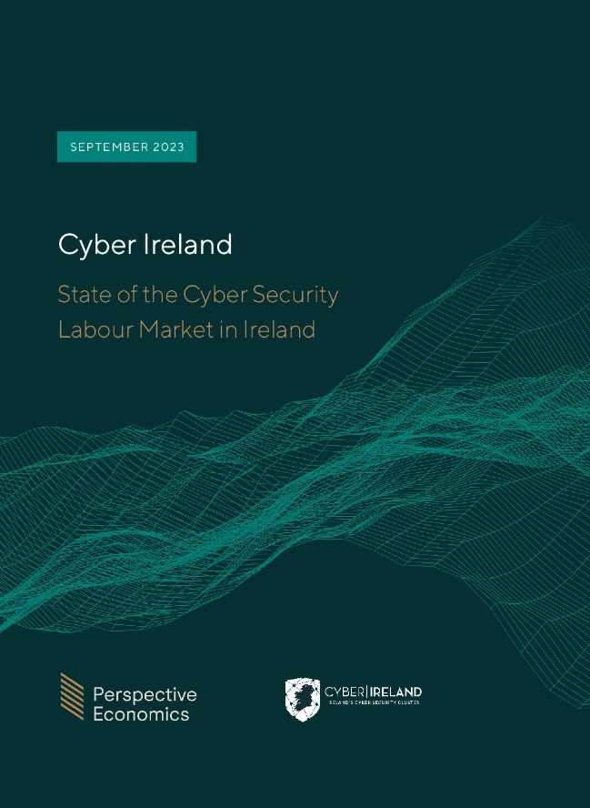
Cybersecurity Labour Market in Ireland (2023)

Slide 23
Cybersecurity Labour Market in Ireland (2023)
Roles: Cyber Implementor (46%), Incident Responder (13%), Risk Managers (12%)
Level: Mid – Senior level roles
Key sectors - Information Technology (17%) , Financial Services (16%) & cyber security (14%)
Alternative job titles for this role include: Information Security Implementer, Cyber security Solutions Expert, Cyber security Developer, Cyber security Engineer, Development, Security & Operations (DevSecOps) Engineer
Alternative job titles for this role include: Cyber Incident Handler, Cyber Crisis Expert, Incident Response Engineer, Security Operations Center (SOC) Analyst, Cyber Fighter /Defender, Security Operation Analyst (SOC Analyst), Cyber security SIEM Manager
Alternative job titles for this role include: Information Security Risk Analyst, Cyber security Risk Assurance Consultant, Cyber security Risk Assessor, Cyber security Impact Analyst, Cyber Risk Manager

Slide 24
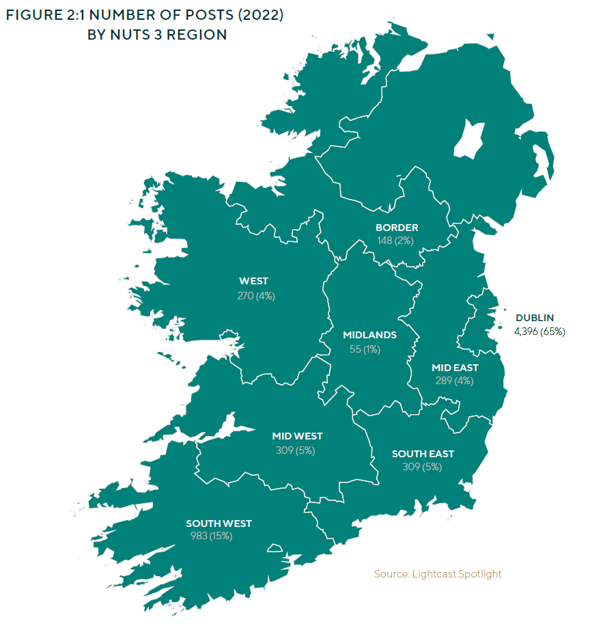
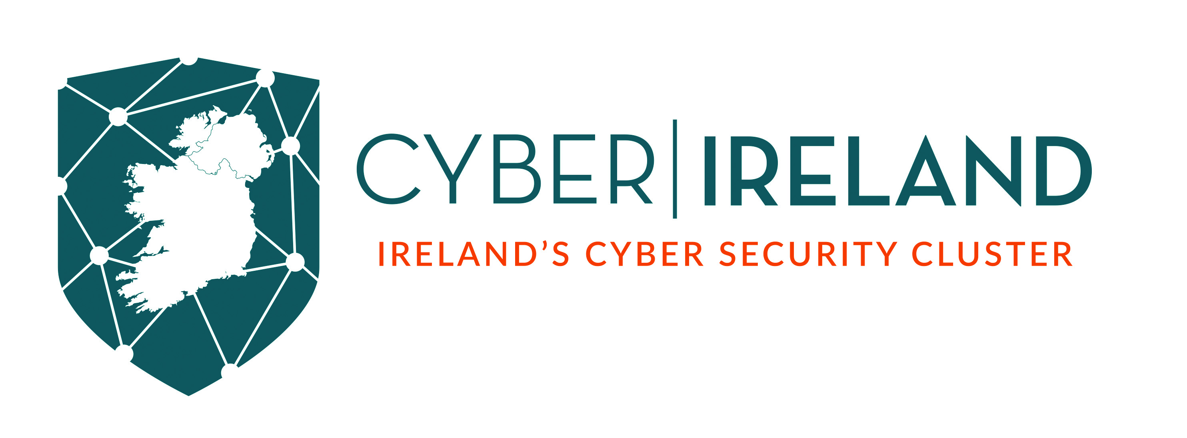
Regional Demand
All of Ireland’s regions have seen a significant increase in cyber security job postings between 2019 and 2022.
Regions with the highest demand in 2022: Dublin (4,396 posts), South-West (983), Mid-West (309), and the Mid-East (289).
Largest net increase in job postings: Dublin (2,967 jobs), South -West (715 jobs), South-East (255), Mid-West (224), and Mid-East (217).

Slide 25
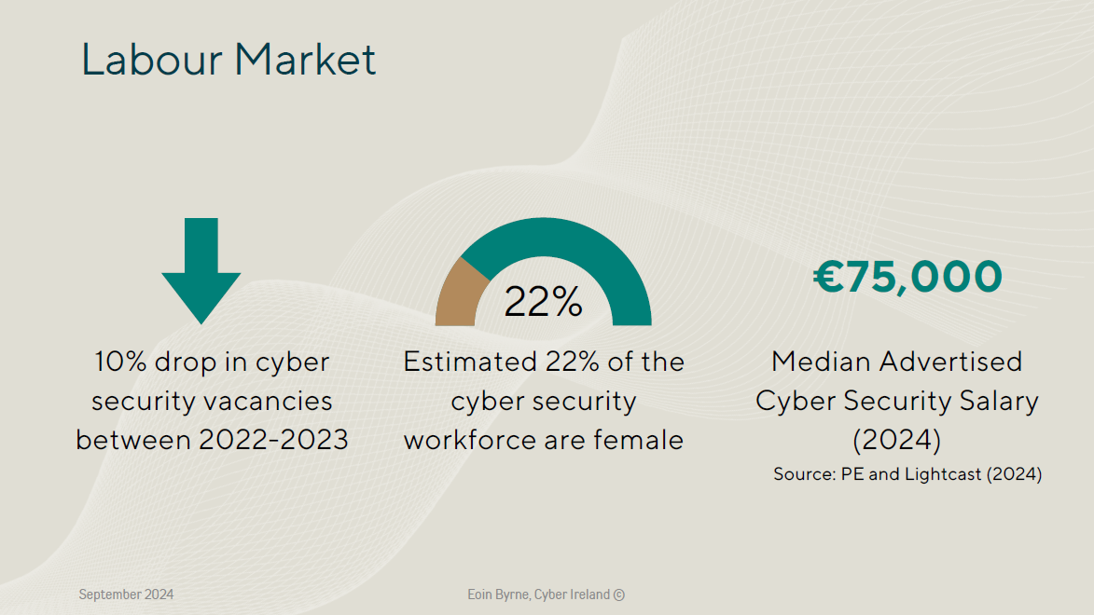
Notes:
Labour Market: There is an international shortage of cyber security skills, impacting organisations both large and small. However, in Ireland, we saw a 10% drop in cyber security vacancies between 2022 and 2023. Median salaries are €75k, demonstrating these roles and the sector are highly skilled and high value.

Slide 26
Cybersecurity Skills – What’s Required
Understand the demand for cybersecurity professionals across the Irish economy.
Understand the supply of cybersecurity skills and churn.
Identify the skills shortage between demand & supply and skills gap (competencies).
Develop a National Cybersecurity Skills Strategy with the mission of creating a sustainable pipeline of cyber security skills to meet our country’s needs
Cyber Course Finder Map
Notes:
Need:
Understand the demand shown for cyber security professionals across the Irish economy.
Consider the shortfall in skills provision, and the extent of support required to support skills, retraining, and attract people to work in the cyber security sector in Ireland.
Is there demand = Labour Market Report 2023
+ 367 live jobs on LinkedIn with Cybersecurity as an assigned skill
18.4% of Cybersecurity professionals moved jobs in the last 12 months
1.3 years is the median tenure of these professionals.

Slide 27
Notes:
Cyber Ireland is the national cyber security cluster organisation, an industry represented body launched in 2019 to bring together industry, academia and government to represent the needs of the cyber security sector in Ireland and support its growth.
The cluster is industry-led, hosted at Munster Technological University and is supported by government through Enterprise Ireland, IDA Ireland and the National Cyber Security Centre.

Slide 28
Notes:
Hidden slide

Slide 29
Notes:
Cyber Ireland represents over 180 companies and organisations nationwide, including 100 Irish start-ups and SMEs, 50 MNCs, 15 Universities and training providers, as well as government agencies, non-for-profits and investors across the cyber security ecosystem.
The cluster brings together all the relevant stakeholders under one umbrella organisation with clear strategy to the realise Ireland’s cyber security potential:
To position Ireland to be the leading location for cyber security operations in Europe.

Slide 30
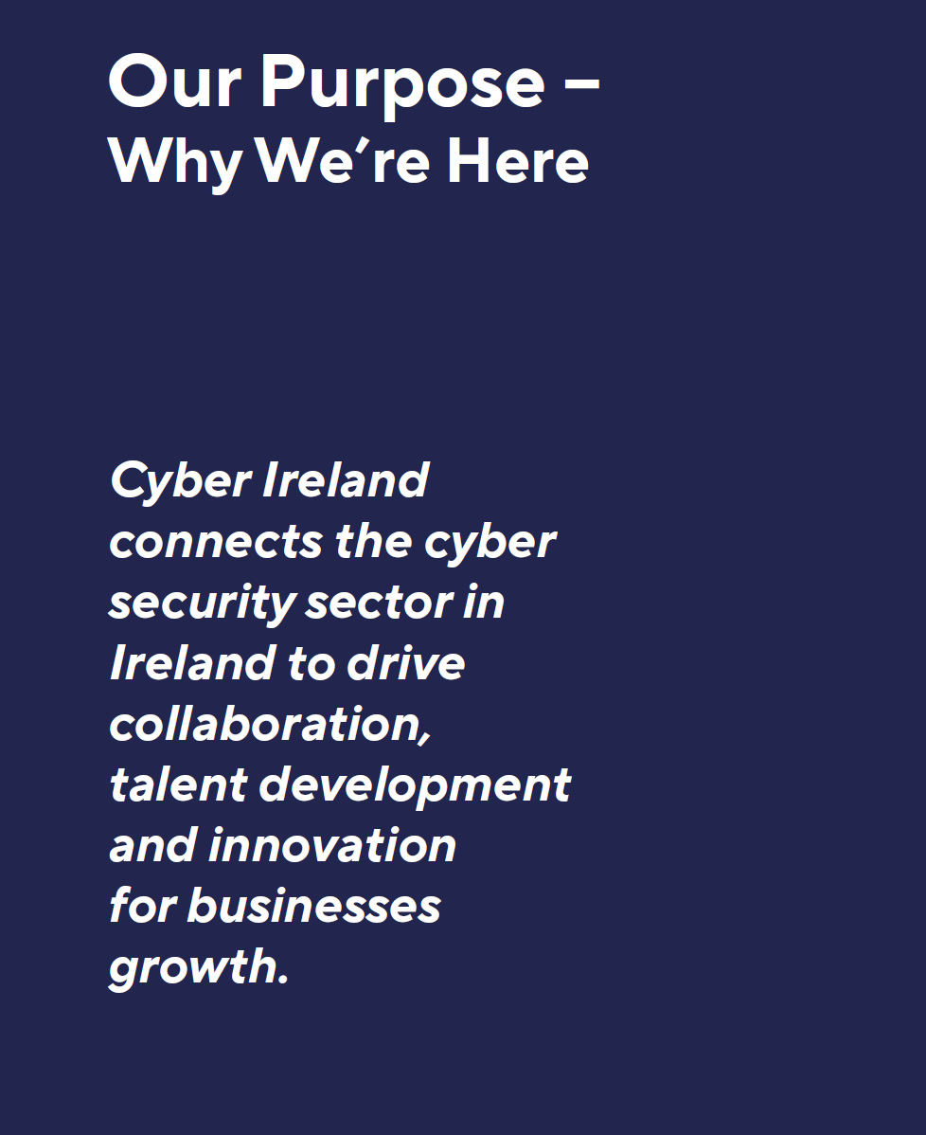
Notes:
We aim to this by connecting all the companies and organisation in the sector to drive growth through collaboration, talent development and innovation.
In January 2024, we launched our new cluster strategy 2024 – 2027. The strategy steers the cluster’s activities across four focus areas:
Building the community – bring together the people in the cyber security sector, to connect organisations, facilitate information sharing and drive collaboration.
Business Growth – we support companies from Irish start-ups, SMEs and MNCs to grow their operations, realise collaborative business opportunities and support innovation.
Developing the Workforce: Our job is to understand the skills and training needs of industry at a national level and work with the education and training providers to ensure we have a sustainable supply of cyber security skills to meet industry needs.
Promotion & Advocacy: the cluster is now the collective voice for the cyber security industry in Ireland. We aim to understand the barriers to growth for industry and address these with partners in the private and public sectors. We also champion the importance of the cyber security sector to Ireland’s digital economy, with the recent publication of an updated report on the size and economic contribution of the sector to Ireland

Slide 31
Notes:
What have we delivered over the past 4 years:
Our biggest achievement is in building the community. We now have over 180 members companies and organisations nationwide.
We’ve delivered over 70 events nationally & regionally,
Our flagship event each year is our national conference which was held over 2 days in Kilkenny in September. We had 500 senior leaders and cyber security experts from across the sector and country coming together.
We have 5 regional chapters which allow for companies in each region to work locally (Dublin, South, West, North-West, South-East)
We have 2 special interest groups – our CISO Forum brings together over 50 security leaders from large enterprises across various sectors to understand the needs of the end-user. The Operational Technological security group is a forum for solution providers, integrators and end-users on OT security.

Slide 32
Notes:
Across our workstreams we’ve delivered for industry:
Under Talent Development:
We have produced two reports on cyber security skills and the labour market to understand demand and skills shortages.
We then work with education and training providers nationally to ensure their courses meet industry needs and to develop new courses where required. e.g. We have developed 10 new short online courses with the Cyber Skills project for specific industry skills shortages such as pen-testers for financial services, OT security for manufacturing, DORA compliance and cyber security for SMEs. As well as a course on leadership skills for mid-level cyber security managers with the Irish management institute.
We have mapped over 70 NFQ accredited courses in cyber security from entry level courses and apprentices up to postgraduates MScs.
We support career promotion initiatives to young people such as Cyber Futures, CyberWise, ZeroDays CTF.
Business Growth:
Our Business Growth Committee of Irish cyber security providers sets the strategic direction and has identified market opportunities for the sector across: CISO investment decisions, OT security for Manufacturing, the Offshore Wind sector, and the emerging Safety Tech sector.
For Start-ups: we provide access to investors, we have partnered with leading global investor Paladin Capital to host an event in April on “Building a Transatlantic Cyber Startup” and on November 28th will see the return of our annual Founders meet-up in Dublin.
A major initiative to support Irish companies’ cyber security is the launch of two grants from Enterprise Ireland and the National Cyber Security Centre. The grants will have massive potential to put cyber security on the radar for Irish companies helping to subsidise the cost of cyber security at a time of rising costs and restricted IT budgets. It will also create market demand for cyber security consultants and services. Cyber Ireland and our members have been inputting into the development of the grants before their official launch to enable the success of the grant scheme (See Cyber Security Grants).
Supporting Research and Development through promotion of grants and links with academic research groups.
Supporting exports – we work with Enterprise Ireland to bring our members on trade missions to key markets or tradeshows, e.g. CyberTech Rome 2023, CyberExpo Amsterdam 2022, InfoTech London 2021.
Promotion & Advocacy
We represent the sector at national level, working with government and inputting into policy development.
For example, we welcome the development of Ireland’s first Cyber Industrial Strategy, a whole-of-government cyber security industrial strategy to support Ireland’s cyber security industry to achieve its potential. Cyber Ireland is the only non-government body on the Strategic Advisory Group.
We have launched a new report – “Ireland Cyber Security Sector Snapshot 2024” - on the size, operations and economic contribution of the cyber security sector in Ireland.

Slide 33
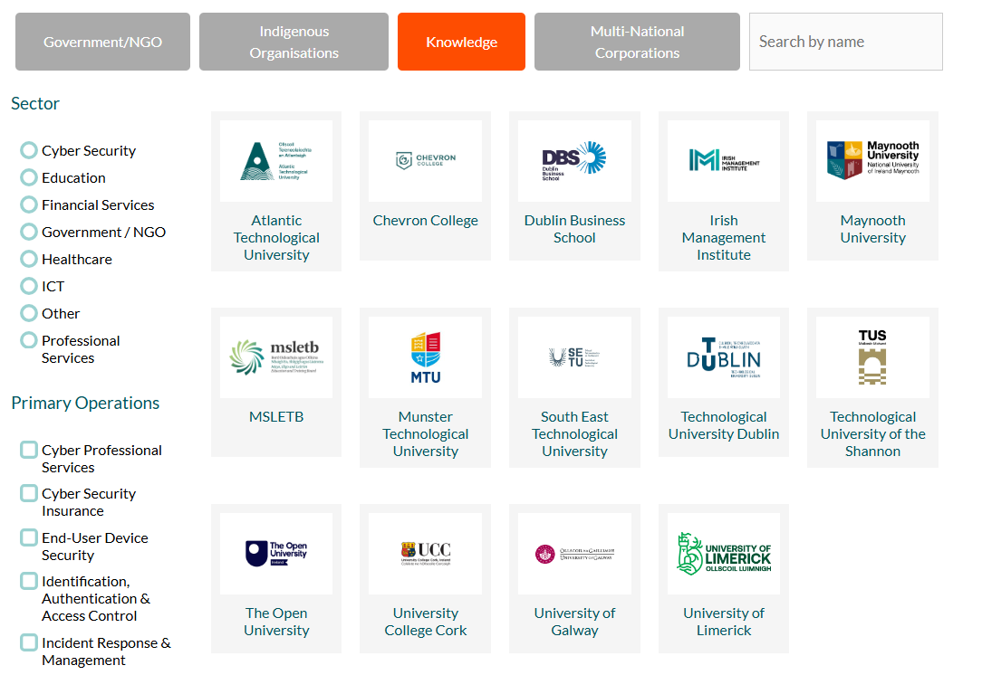

Slide 34
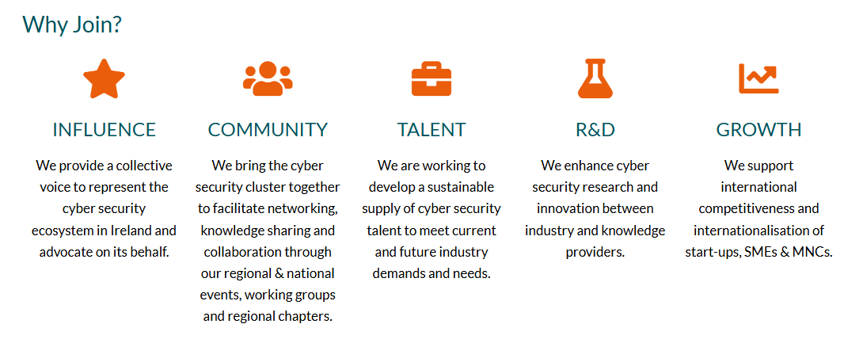

Slide 35
Educational Initiatives
https://cyberwise.ie
https://www.cybersafekids.ie/
ECSC.eu
ZeroDays.ie
CyberSecurityChallenge.ie

Slide 36
Cyber Security Academy
Try it out!!
Join our FREE Cyber Security Academy from Monday June 9th - Friday 13th 2025
Delivered by Cyber Security Lecturers at MTU
Topics Covered
No prior knowledge required!
Suitable for beginners and advanced students
Attack Frameworks
Ethical Hacking
Encryption
Register at:
cyberfutures.ie
Dr. Hazel Murray
Dr. George O'Mahony

