Slide 1
Unburdening Accessible Content Creation in Articulate Storyline 360
Eveline Holmes
Instructional Designer, Digital Learning Development Team
Notes:
Good morning. I’m Eveline Holmes, an Instructional Designer with the Digital Learning Development team in Trinity College. This short presentation gives you an overview of a project we ran on incorporating accessibility into our Articulate Storyline 360 course development process. The EU accessibility directive, incorporated into Irish Law in 2020, requires that public bodies online content meet the equivalent of WCAG conformance level 2. We wanted to see how we were performing against this.

Slide 2
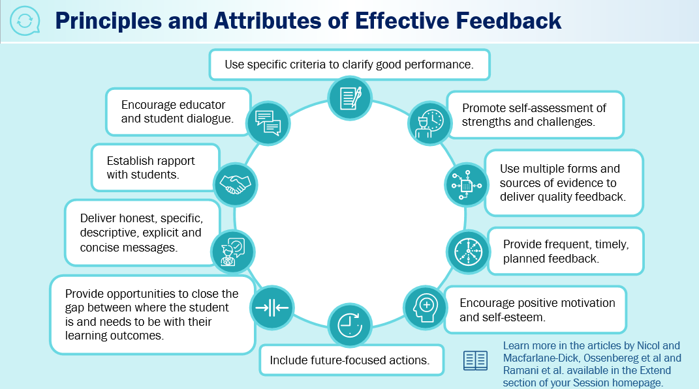
Accessibility Measures
What we include in our online resources
CC
PDF Transcripts
Closed captions
Could we do more?
Audio on all our presentations
Colour contrast
Alternative-text
Notes:
Our Storyline 360 interactive presentation is only one part of our course offering. With accessibility and UDL in mind, the course also includes alternative formats to support students including accessible PDF transcripts for screen reader users, closed captions on videos, audio on all our presentations as well as separate podcasts. Color contrast and alternative-text for relevant images. Could we do more? We needed to find out.

Slide 3
Students Using Screen Readers
Are students having an equitable experience?
Screen Reader Users in TCD by Disability Category (2021/22)
Notes:
After an initial audit of a SL 360 resource against the WCAG guidelines, we realized that although we were offering students alternative formats, screen reader users with specific learning difficulties such as dyslexia, dyspraxia or dyscalculia, and those who are vison and hearing impaired were not having an equitable experience with our interactive presentations when compared to those who didn’t use screen readers. Let me show you what I mean.

Slide 4
What a Screen Reader “Sees” on Storyline
Screen reader users ‘see’ 124 pieces of information and have no clear pathway to guide them around the content.
Storyline slide title: Principles and attributes of effective feedback
Main information:
Use specific criteria to clarify good performance
Promote self-assessment of strengths and challenges use multiple forms and sources of evidence to deliver quality feedback
Provide frequent timely planned feedback encourage positive motivation and self esteem
Include future-focused actions
Provide opportunities to close the gap where the student is and needs to be with their learning outcomes
Deliver honest specific descriptive explicit and concise messages
Establish rapport with students
Encourage educator and student dialogue
Note: learn more in the articles by Nicol and MacFarlane-Dick, Ossenbereg et al and Rahmani et al available in the extend section of your session home page
Notes:
How many pieces of learning can you see on this slide? We’ve the title, the 10 points and a note – these are supported by icons - so 12 pieces of learning. Would you be surprised to hear that for the screen reader user, there are 124 pieces of information and no set sequence for them to follow? So, for the screen reader user, identifying the main content on this slide is difficult - and here’s why.

Slide 5
Storyline 360 Default Settings
Items that affect accessibility
All items on the slide are visible to accessibility tools.
Icons can appear on the timeline as:
A group AND
Individual freeform elements
Development notes, even if hidden on timeline, are visible to accessibility tools.
Information appears in random order.
Notes:
All items placed on a SL slide are automatically visible to accessibility tools.
The majority of icons do not appear as single items but are recognized as a group of freeform objects, and each freeform object is also seen as being an item on its own.
Items hidden in the timeline or placed off-screen are picked up by the screen readers
Information can appear in random order making the sequence of content nearly impossible to distinguish.
We were keen make our interactive presentations an equitable experience for our screen reader users, and wanted to see if we could incorporate accessibility deeper into our development process. Whilst the default Storyline 360 settings aren’t ideal, it does have inbuilt functionality to help.

Slide 6
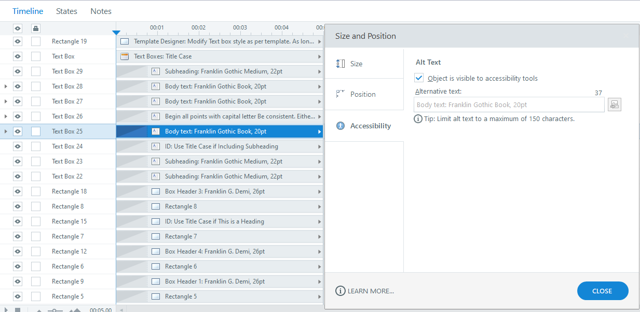
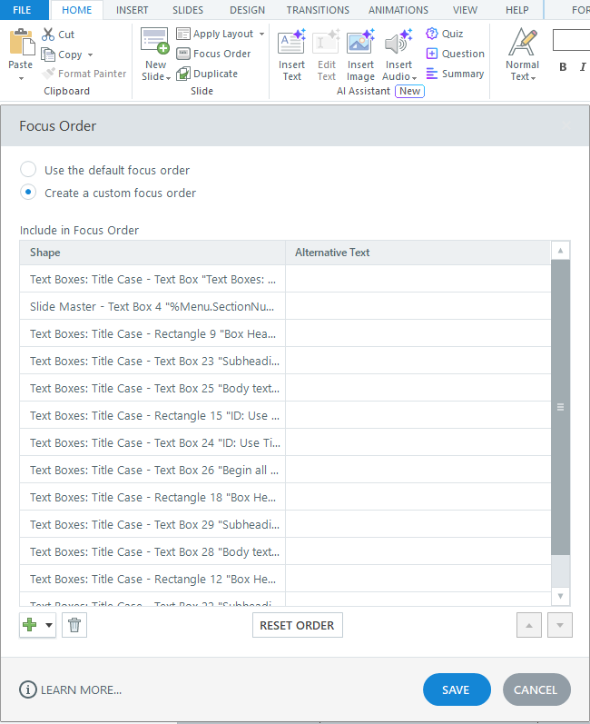
Storyline Tools
Timeline and focus order
Timeline
Focus Order
The timeline does not facilitate reading order.
Notes:
There are two options:
The timeline shows us all the elements on the screen and allows us to add alternative-text and set visibility (although this can be fiddly) - but we can’t set the reading order here.
Focus order is another tool which allows us to set all three. This is the tool we use most.

Slide 7
Amendments to Work Practices
Develop work practices to incorporate changes
Master template configured so only necessary features are visible to the screen reader.
Designers must:
Set all design elements to invisible
Include off-screen items
Instructional designers must:
Have overall responsibility
Set the focus order
Add alt-text
Notes:
We then amended our process in the following ways:
1. We configured our Master Template so that only the necessary features were visible to the screen reader.
2. Our multimedia designers are responsible for making all design objects invisible to accessibility tools. Unnecessary items will be deleted from the timeline.
3. The instructional designers have overall responsibility for ensuring screen reader accessibility and are responsible for setting the focus order as well as adding alternative-text to images that add to the learning.
The legislation allows for accessibility exemptions should the process represent a disproportionate burden, and we recognize that legitimate burdens exist. Whilst there is a lot of good will towards accessibility in universities, implementing it can be difficult as academics and digital content creators may not know where to start or what they need to do. Marry that with existing workloads and the process can be seen as a burden.

Slide 8
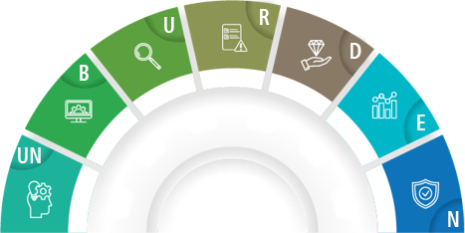
Unburden Accessibility!
4. Review the accessibility issues identified
Prioritise the issues that need to be addressed. (WCAG conformance levels 1 and 2)
3. Uncover accessibility gaps
5. Develop work practices to incorporate improvements
Audit against WCAG.
Review accessibility reports for applications you use.
Amend workflows to incorporate accessibility rather than adding it on at the end.
2. Be aware of the student experience
6. Evaluate the changes
Team feedback to identify pain points and solutions.
Seek user feedback.
Professional review from disability offices in universities.
Put yourself in the learner’s shoes.
Test resources using accessibility apps.
7. Never assume it’s up-to-date
1. UNderstand the legal requirements
Carry out annual audits.
Keep abreast of new WCAG.
Be aware of software updates.
UNBURDEN
Notes:
To unburden incorporating accessibility into online resource creation, here’s the process we created - an “UNBURDEN framework” so-to-speak - which has 7 stages – 1. Understand the legal requirements. 2. Be aware of the student experience. 3. Uncover accessibility gaps. 4. Review the accessibility issues identified. 5. Develop work practices to incorporate improvements. 6. Evaluate the changes. 7 Never assume it’s up-to-date – accessibility is everchanging with new software and guidelines so annual audits are required. We hope this provides a starting point and some direction on how to approach accessibility for online resources. Thank you.

Slide 9
Thank You

