Slide 1
Why should we Open (up) Research
Jenny O’Neill, Research Engagement Officer

Slide 2
What are Research Data?
‘research data’ means documents in a digital form, other than scientific publications, which are collected or produced in the course of scientific research activities and are used as evidence in the research process, or are commonly accepted in the research community as necessary to validate research findings and results;
Directive (EU) 2019/1024 On Open Data and the Re-use of Public Sector Information

Slide 3
Open Science
“Open Science represents a new approach to the scientific process based on cooperative work and new ways of diffusing knowledge by using digital technologies and new collaborative tools.”
European Commission, Open innovation, open science, open to the world. A vision for Europe

Slide 4
Open Science
“Open Science is about extending the principles of openness to the whole research cycle, fostering sharing and collaboration as early as possible thus entailing a systematic change to the way science and research are done.”
Foster Open Science

Slide 5
Open Science
“to make the primary outputs of publicly funded research results – publications and research data – publicly accessible in digital format with no or minimal restriction.”
OECD, Making Open Science a Reality

Slide 6
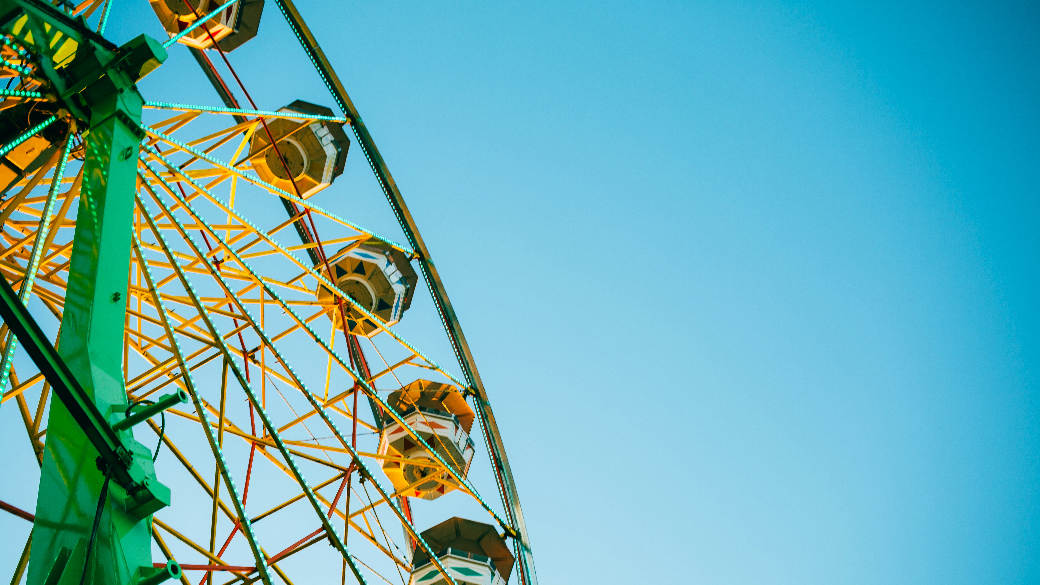
What are FAIR Data?
A set of principles that describe the attributes data need to have to enable and enhance reuse, by humans and machines.
Findable
Accessible
Interoperable
Reusable
Wilkinson, M. D. et al. The FAIR Guiding Principles for scientific data management and stewardship. Sci. Data 3:160018 doi: 10.1038/sdata.2016.18 (2016).
Photo by Luke Pamer on Unsplash

Slide 7
“as open as possible, as closed as necessary”

Slide 9
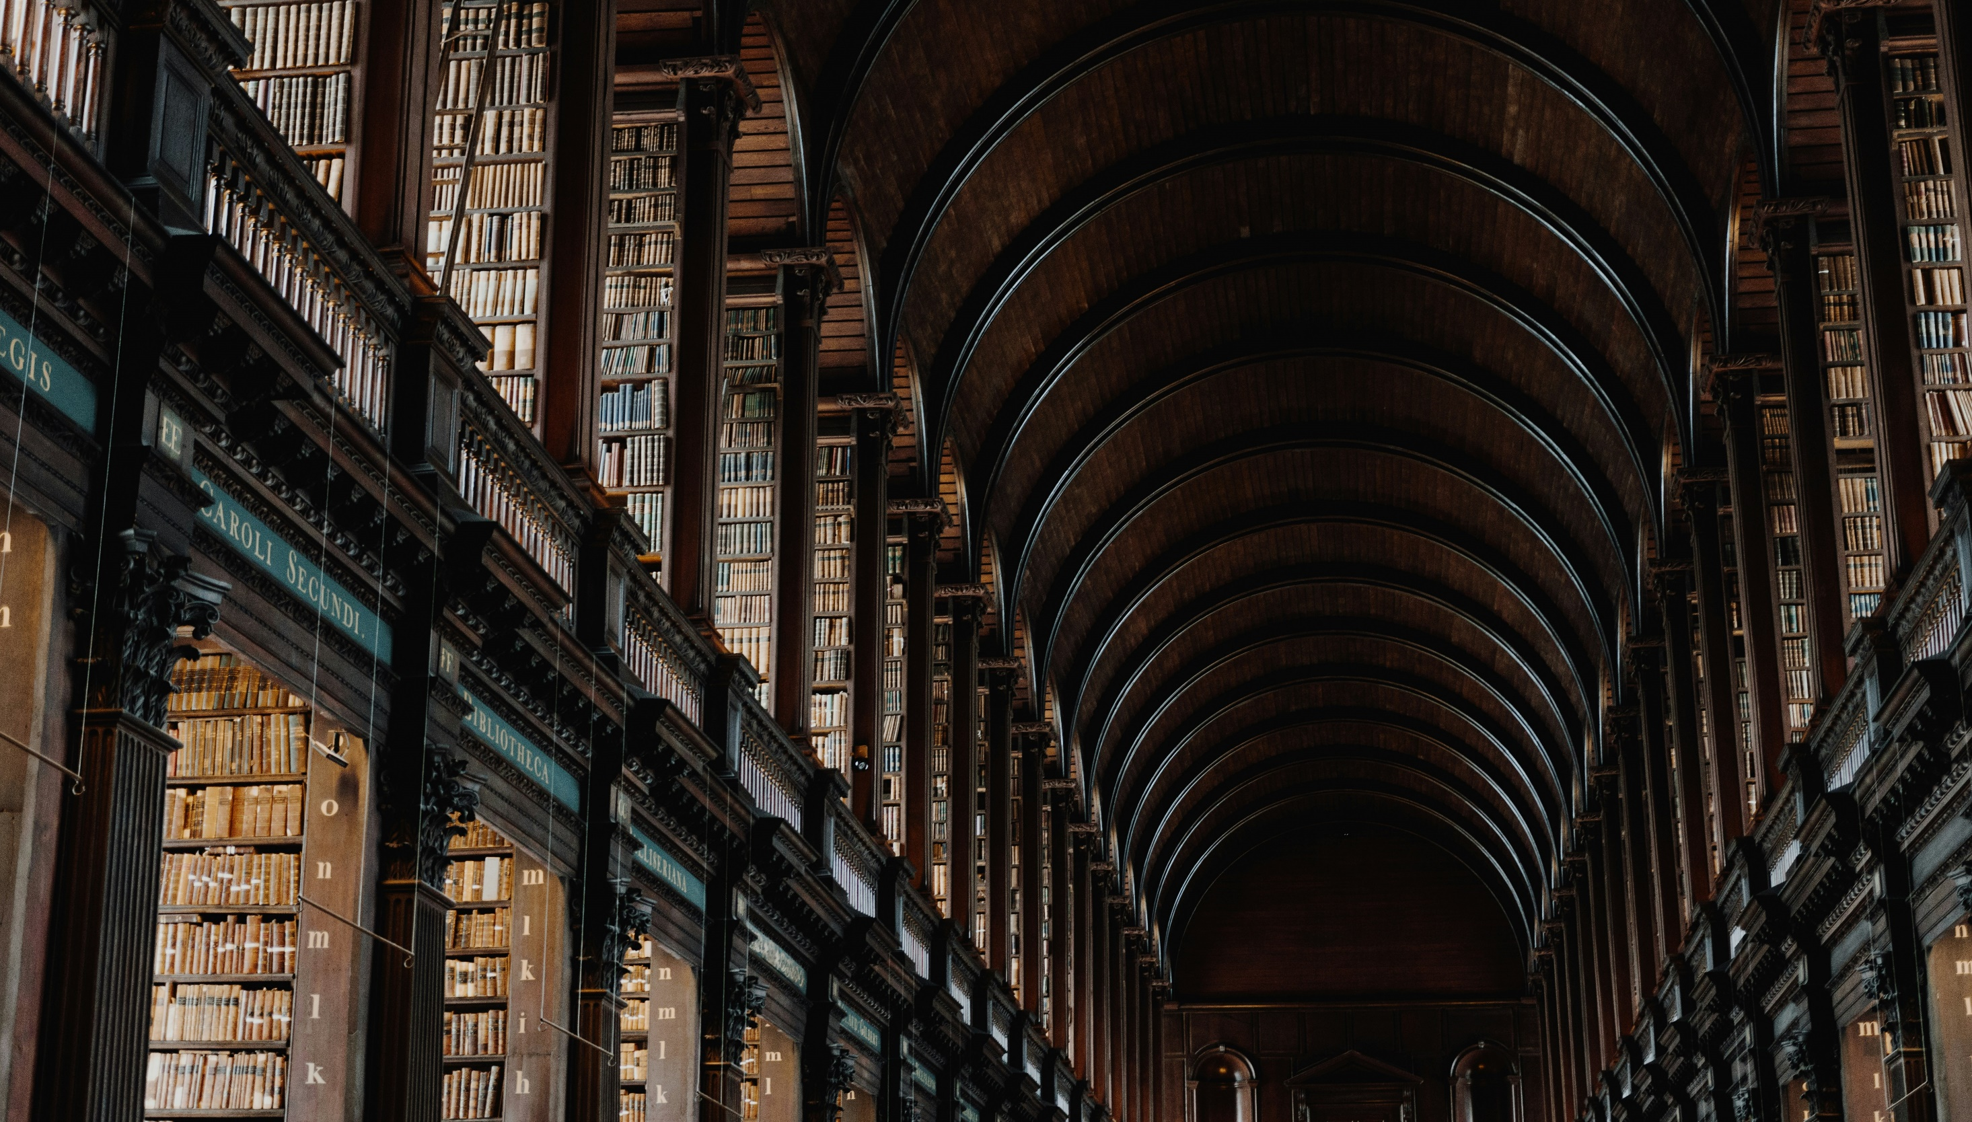
Open Research Values
Quality and integrity
Collective benefit
Equity and fairness
Diversity and inclusiveness
When UNESCO published their recommendations on Open Science in 2021 they included a list of values including
UNESCO Recommendation on Open Science
Photo by Giammarco Boscaro on Unsplash

Slide 10
Personal values
Making a difference
Empathy
Creativity
Learning
Expertise
Photo by Henry Be on Unsplash

Slide 11
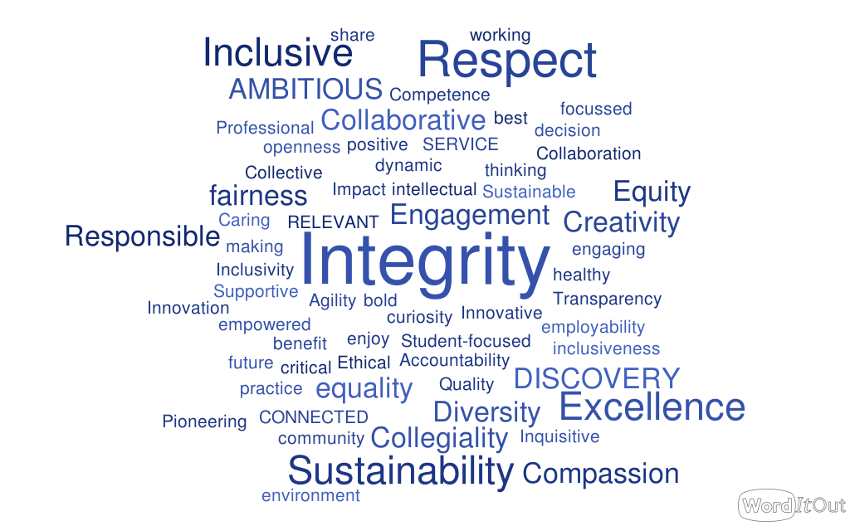

Slide 12
Thank you
jenny.oneill@heanet.ie
www.linkedin.com/in/jenny-oneill

