Slide 1
Schools Network
And the HIP migration project

Slide 2
- Schools Broadband Network (SBN) serving primary schools
3150 SBN routers
Schools High Speed network (SHS) serving secondary schools
825 SHS routers

Slide 3
HEAnet Intervention Program
Started in 2021
Department of Education plan to upgrade bandwidth to 100Mb for lowest bandwidth primary schools
Over 1000 circuits tendered

Slide 4
What were we working with?
One router type: Juniper SRX300
Identical interface configurations across our entire SBN fleet. 5 lan ports, 1 wan port.
Providers (with a little encouragement) who were willing to plug in cables as part of the installation.

Slide 5
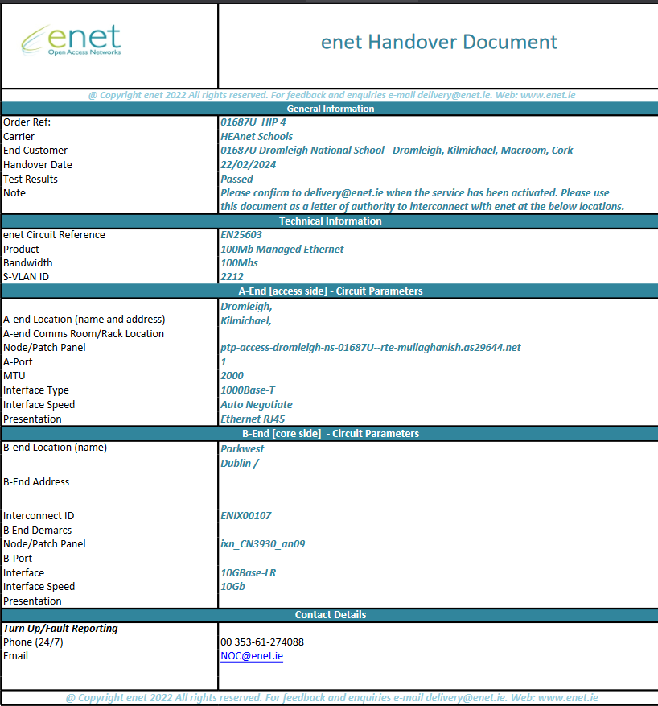
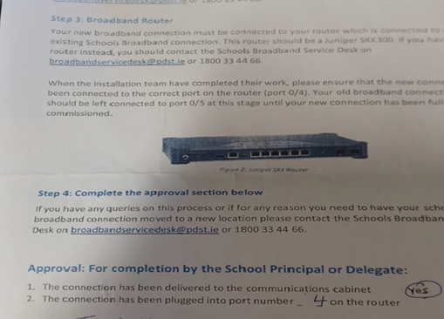
Providers supplied vlan and interconnect details for circuits
After install, providers had to create a handover pack detailing the circuit details, install checklist and a signoff sheet from someone in the school

Slide 6
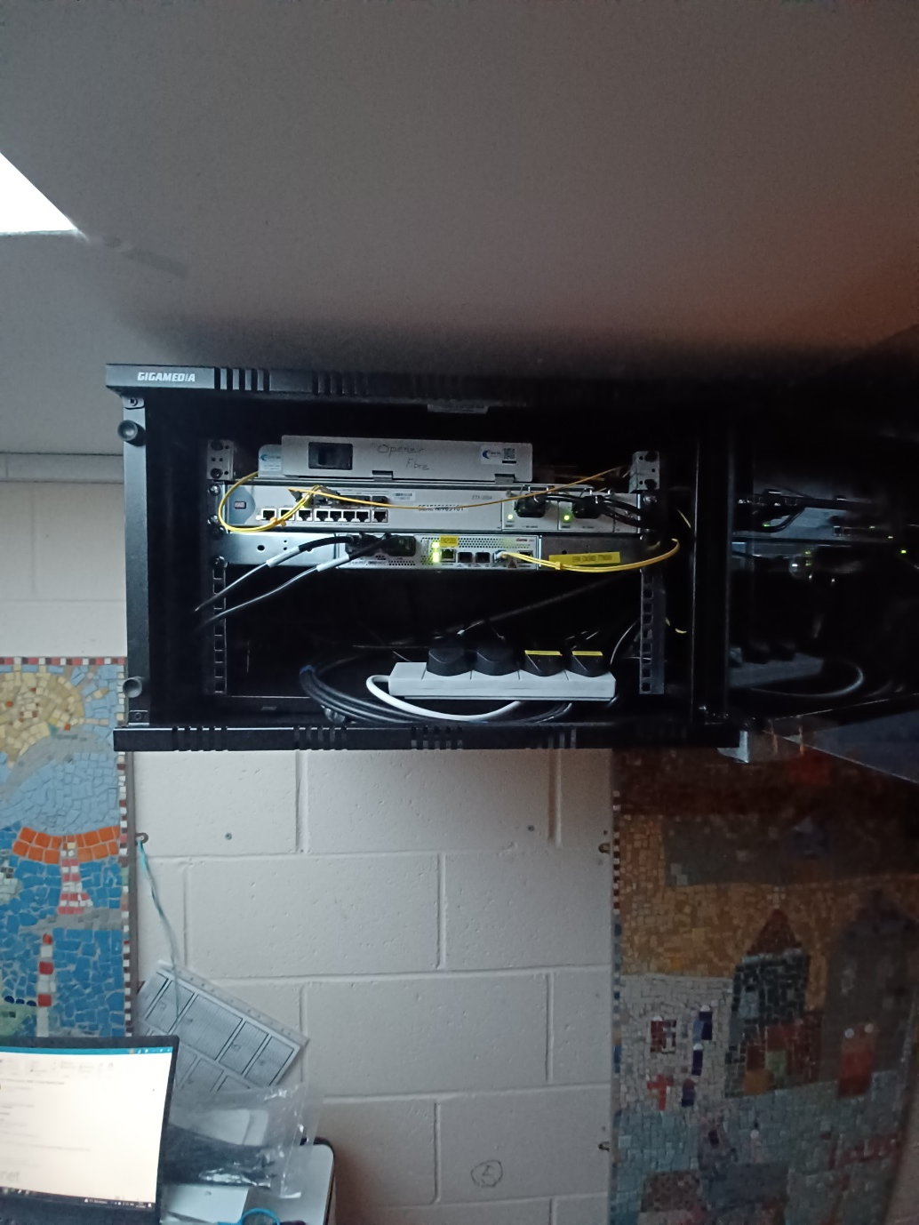
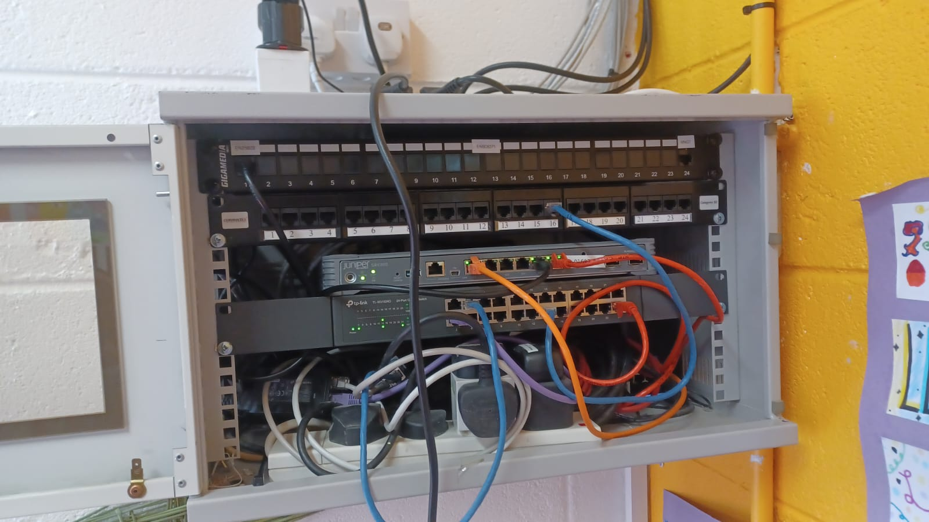
A lot of schools wouldn’t have dedicated infrastructure rooms, so devices are often in half cabs installed in classrooms or beside desks in offices

Slide 7
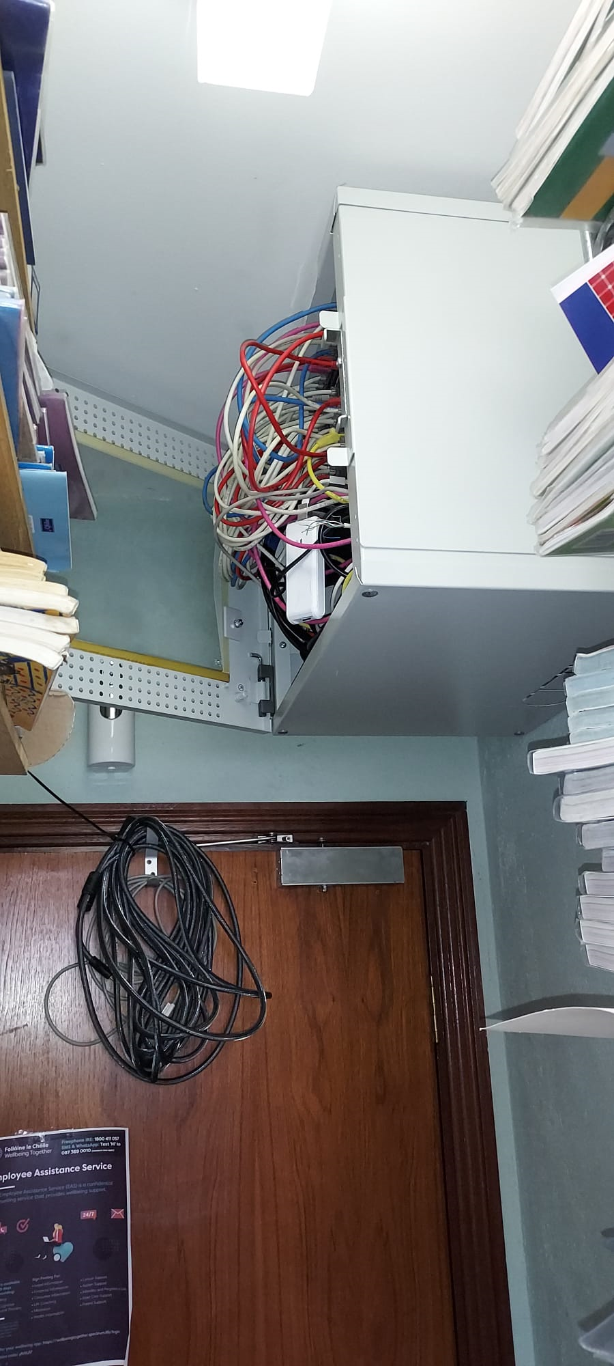
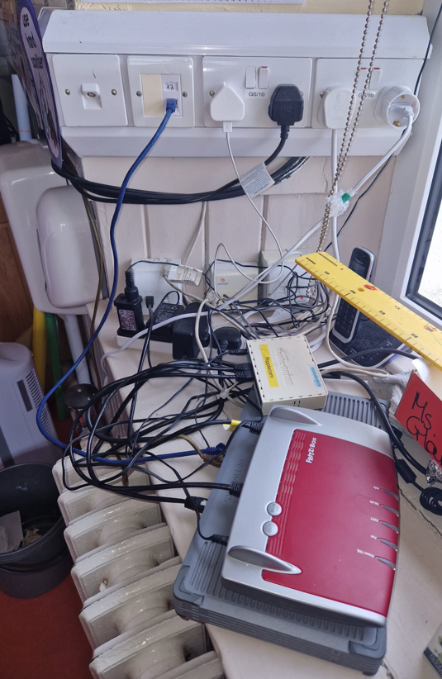

Slide 8
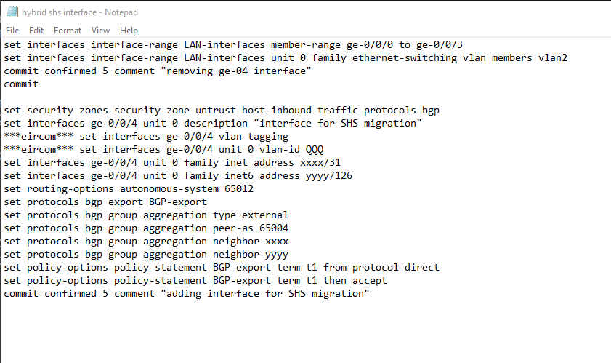
This is the pseudocode text snippet we wrote to create “hybrid” interfaces on our SBN routers. It would allow us to test connectivity of the new circuit before attempting migration.
We used this to create a script and deployed it to devices using Ansible.

Slide 9
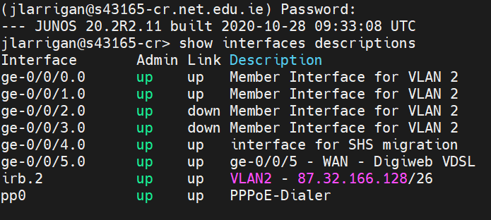
This is the view of a device after creating the interface. We would check for an arp entry on ge-0/0/4 to validate connectivity to the correct interconnect on our aggregation routers.

Slide 10
Once there is a successful arp entry, a python script will load the SHS config on to the SBN connection associated with the relevant roll number.
It will wait 2 minutes, then log into the new SHS router and commit the config. On failure, the config rolls back to the SBN config and previous PPP connectivity.

Slide 11
And since the project started, we’ve used this process to successfully migrate over 1000 connections!

