Slide 1
Digital network transformation including the use of AI modern networking tools

Slide 2
Digital Network Transformation
2020 - Early indicators of issues with security architecture
Planning for Smart Campus begins
2021 - Pilot of Mist WiFi in one building –April 2021
Replacement of 32 legacy edge switches – July 2021
Initial network segmentation
2022 - Building moves related to new construction project
Renovation of 121 St Stephens Green – pilot for Smart Building
Replacement of old IDF cabinets
2023 – Replacement of Campus WiFi network in SSG and Bahrain Campus
Replacement of legacy Cisco VSS with Juniper Mist collapsed core Fabric
Remainder of SSG campus switching
2024 - Replacement of security estate – on prem and cloud
Completion of Edge Rollout
Completion of network segmentation
Redesign of WiFi Auth
2025 – Implementation of new WiFi auth
Completion of Smart Campus

Slide 3
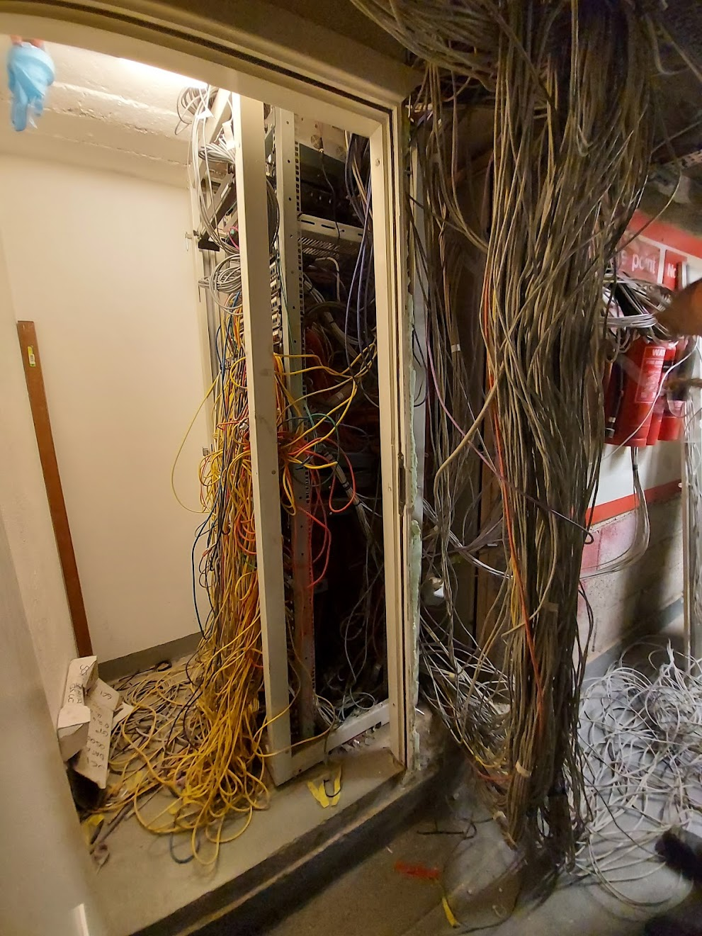
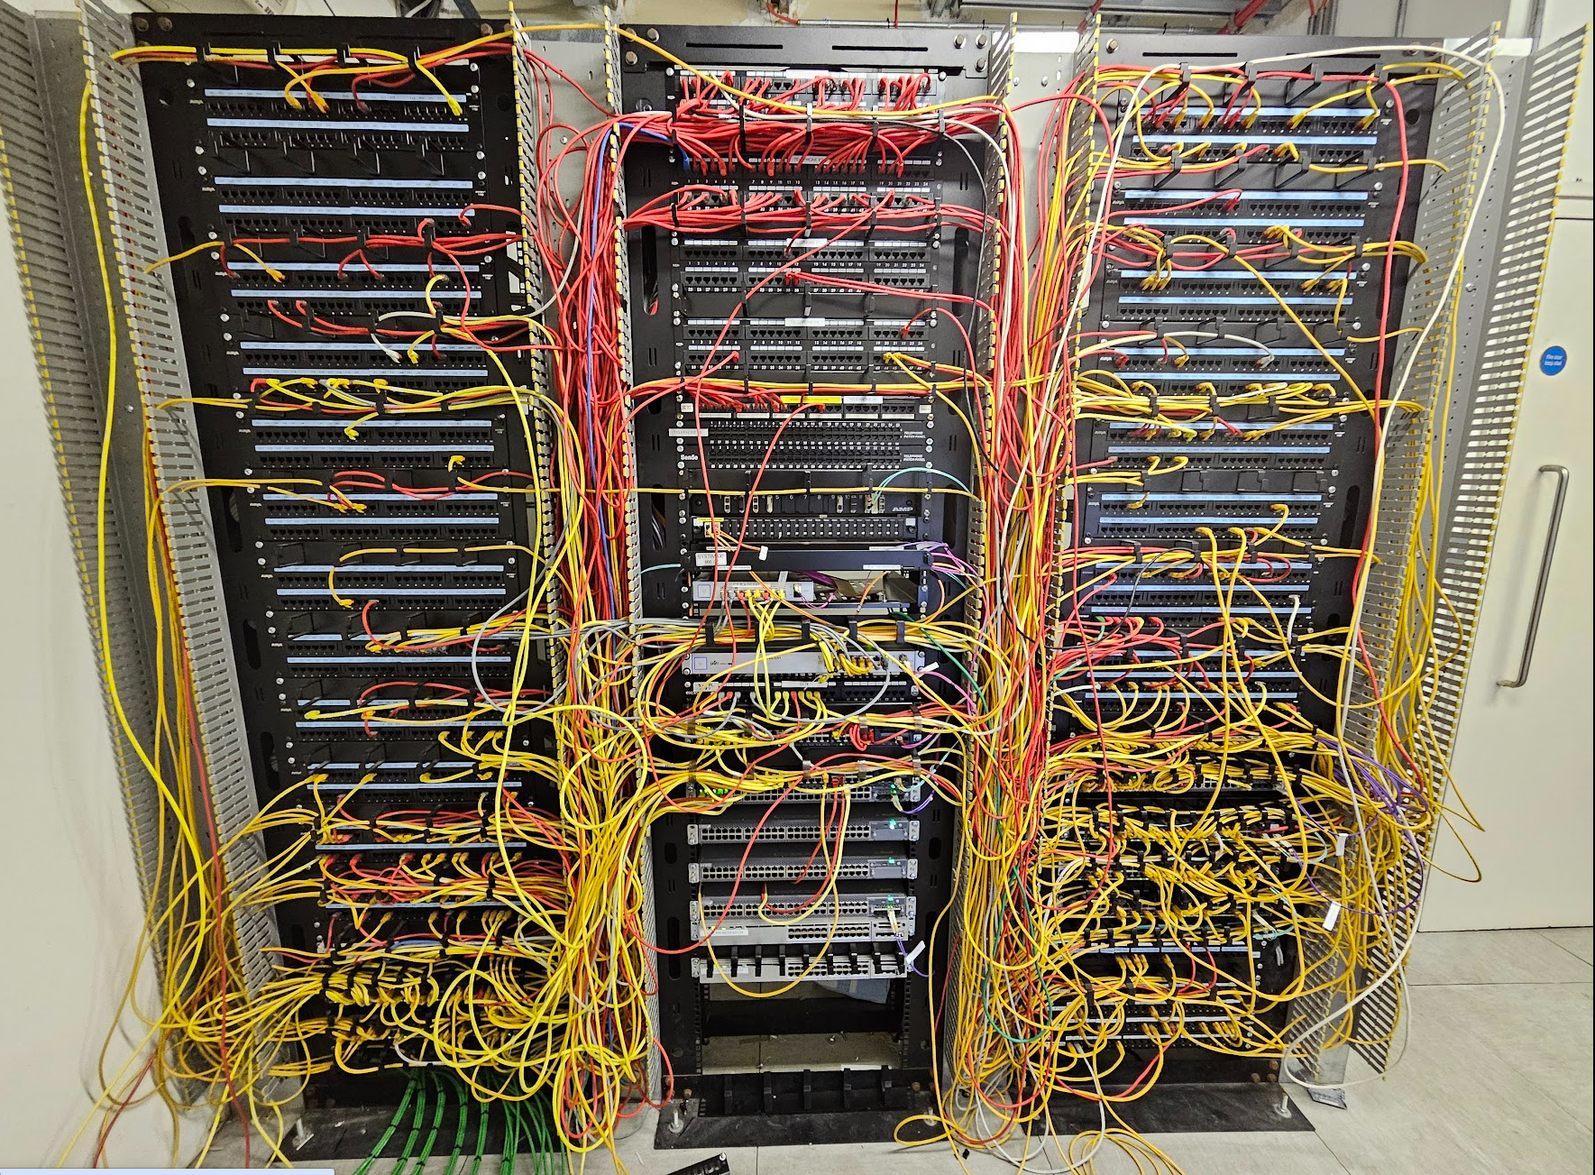
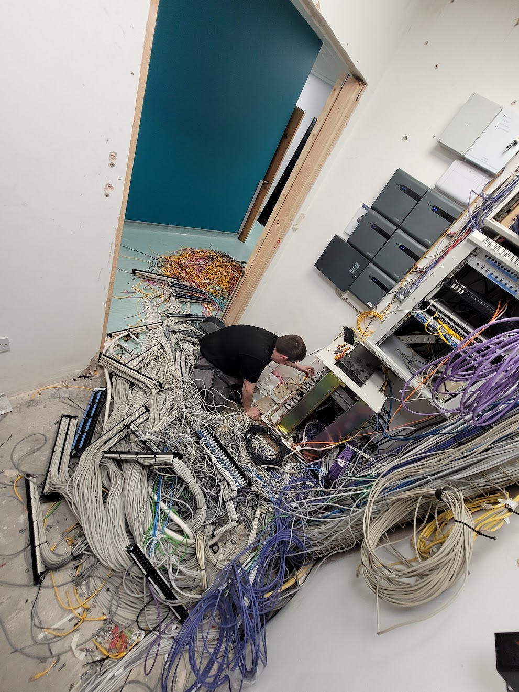
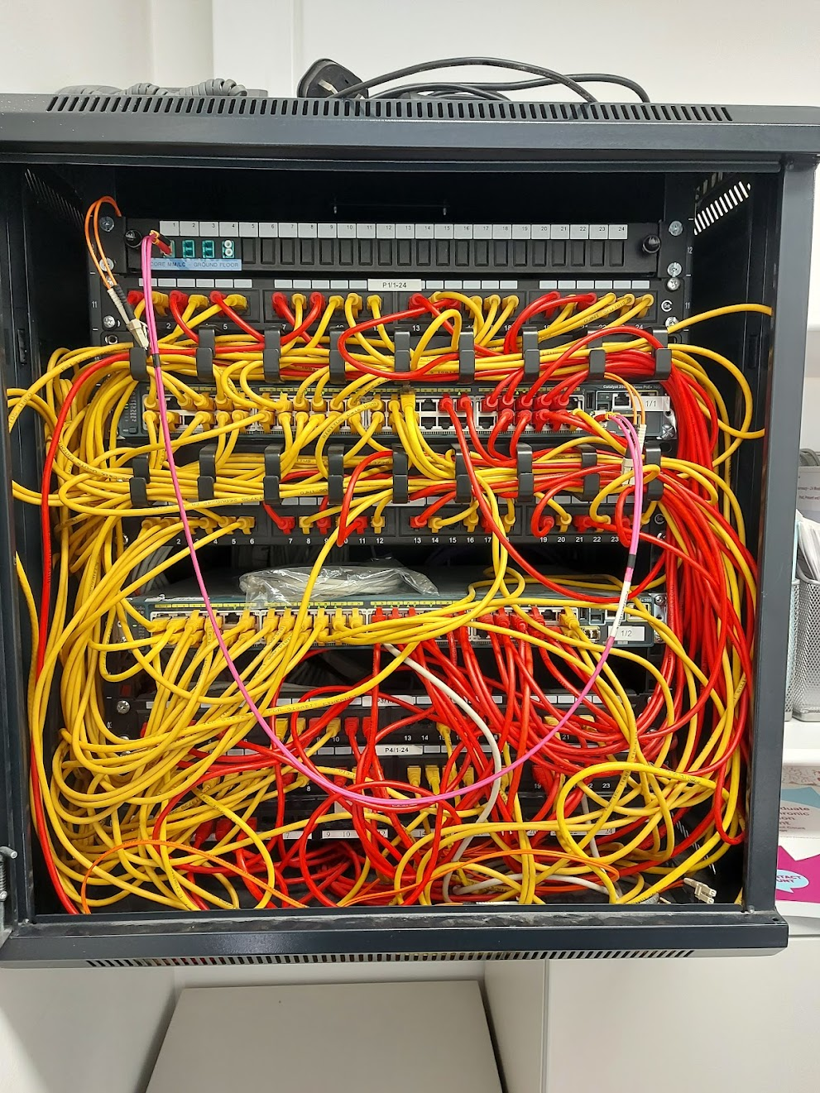
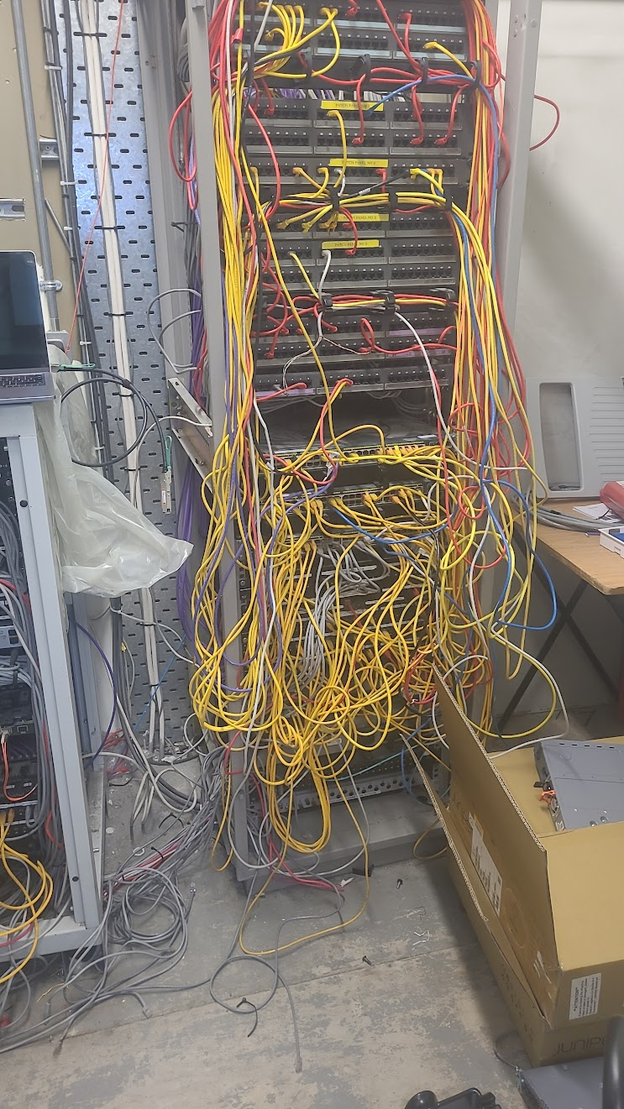
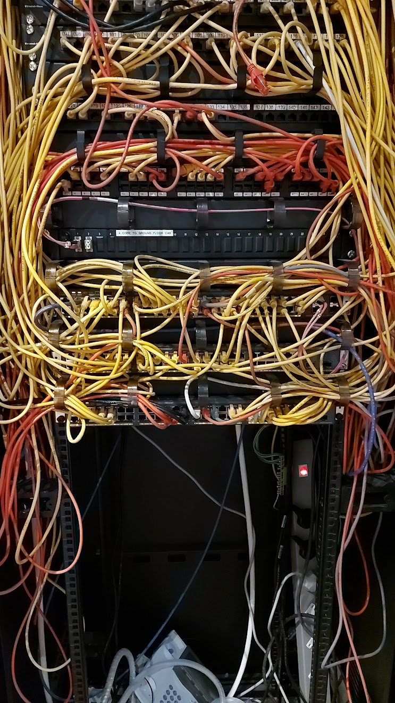
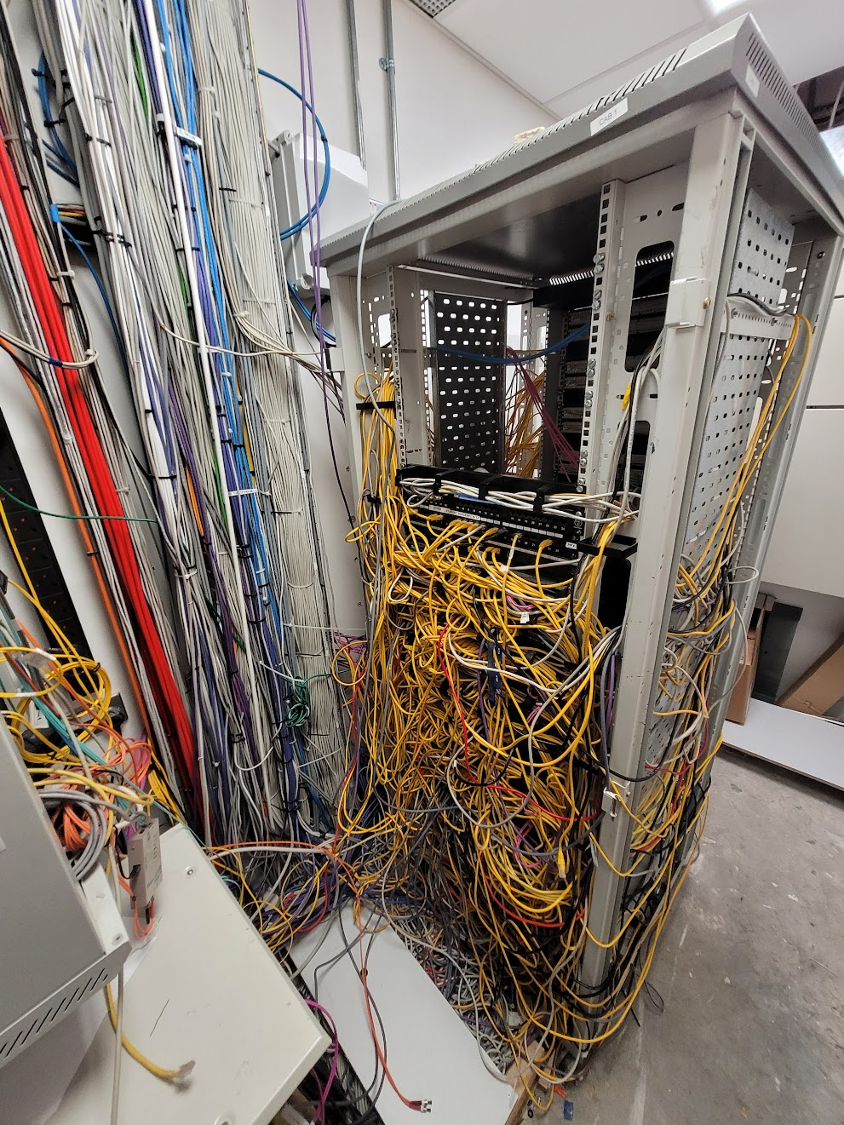
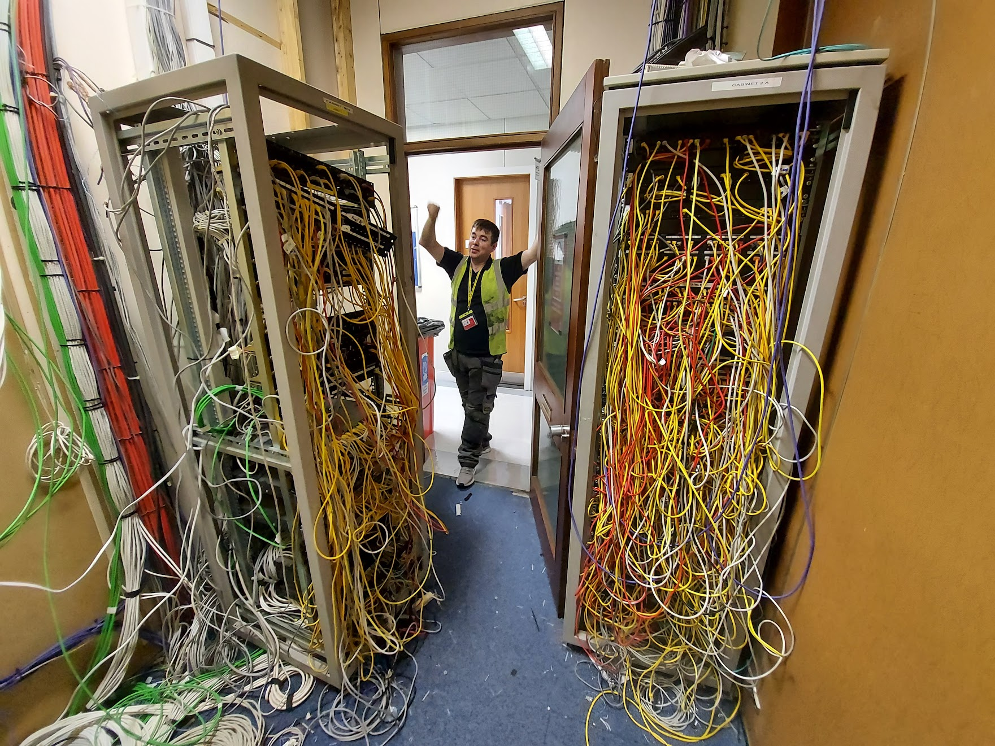

Slide 4
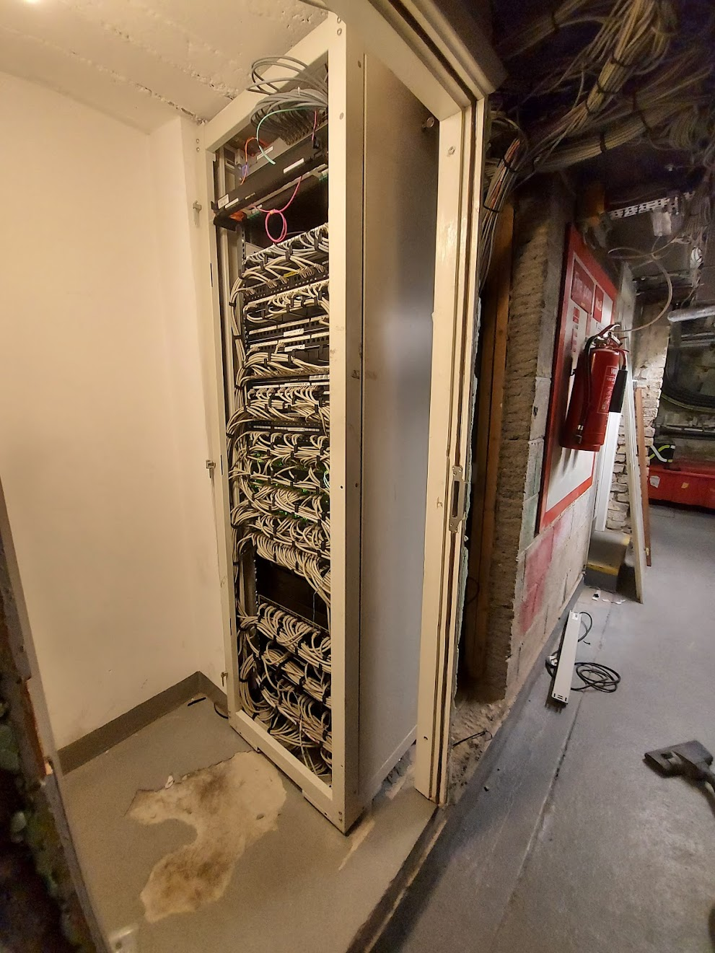
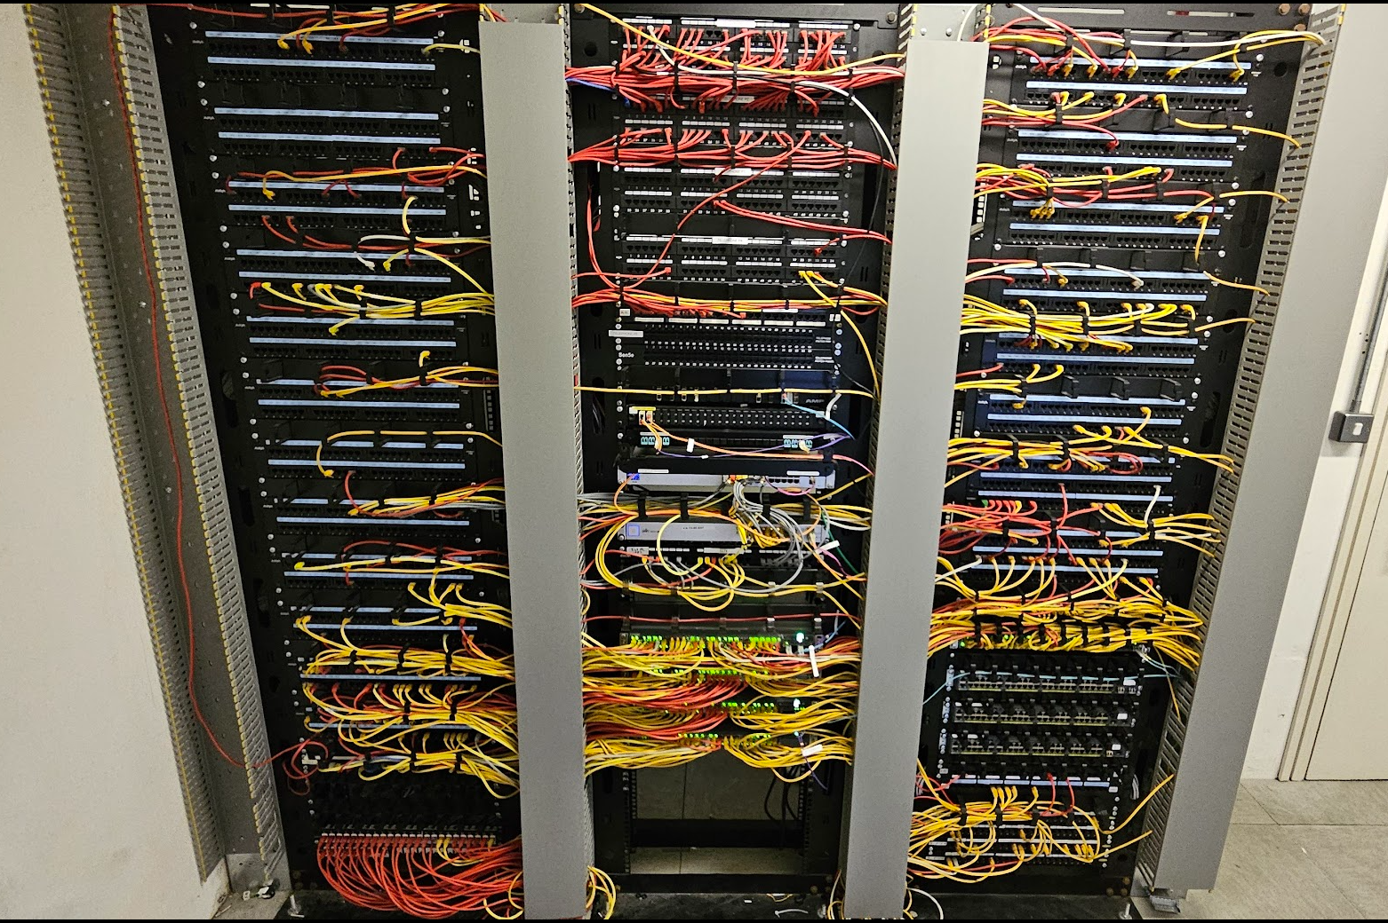
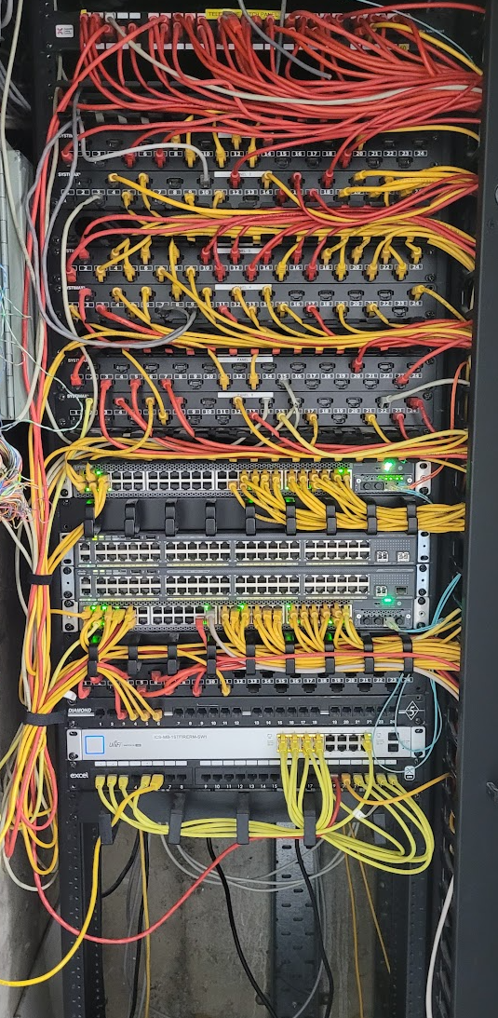
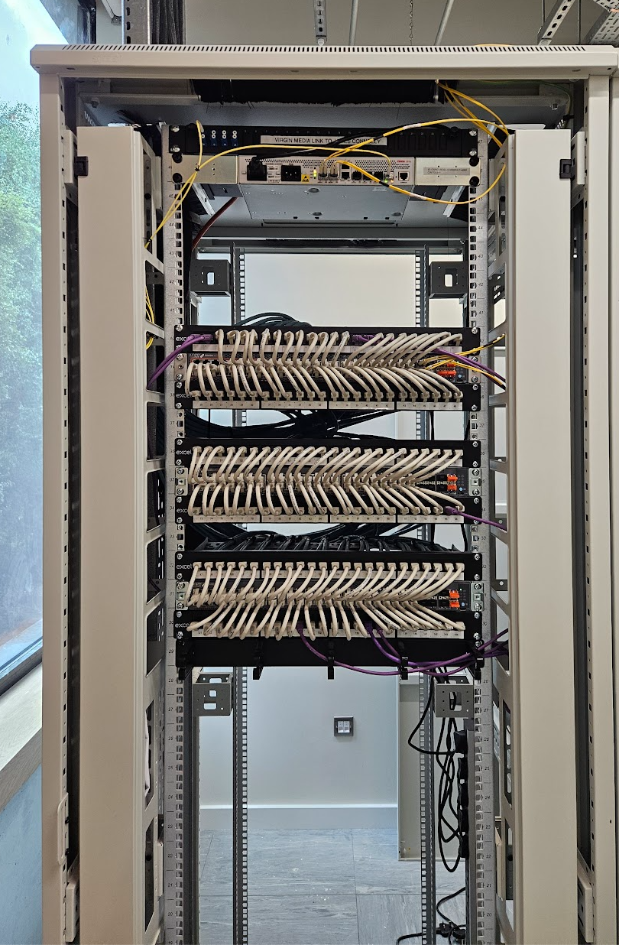
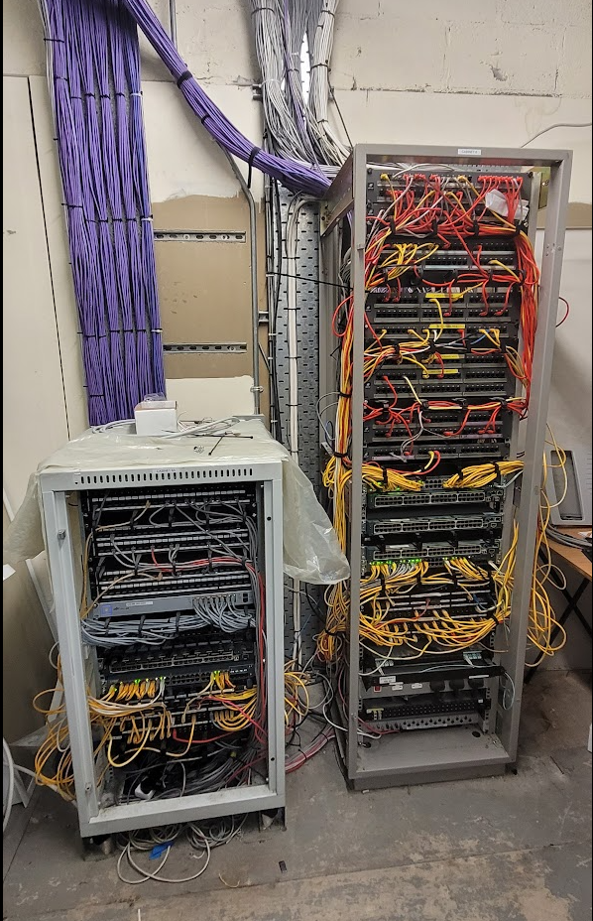
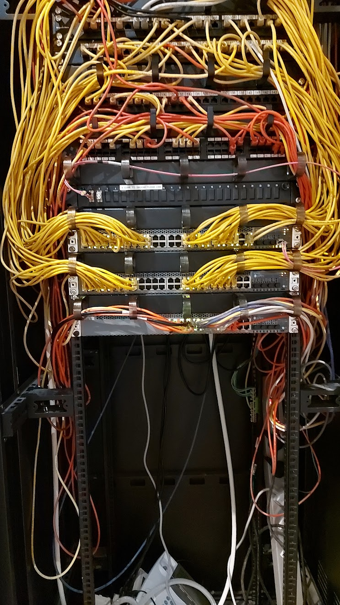
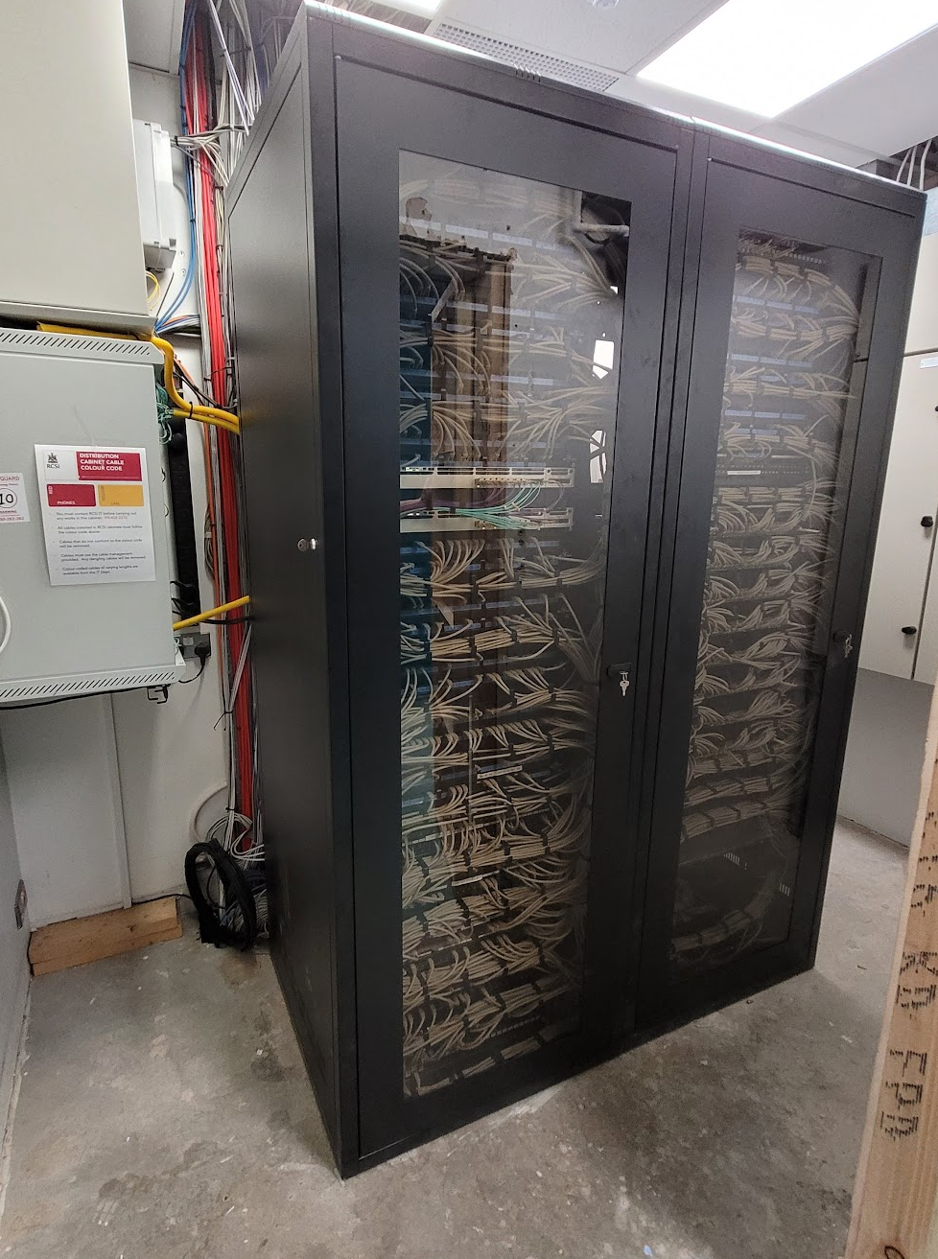
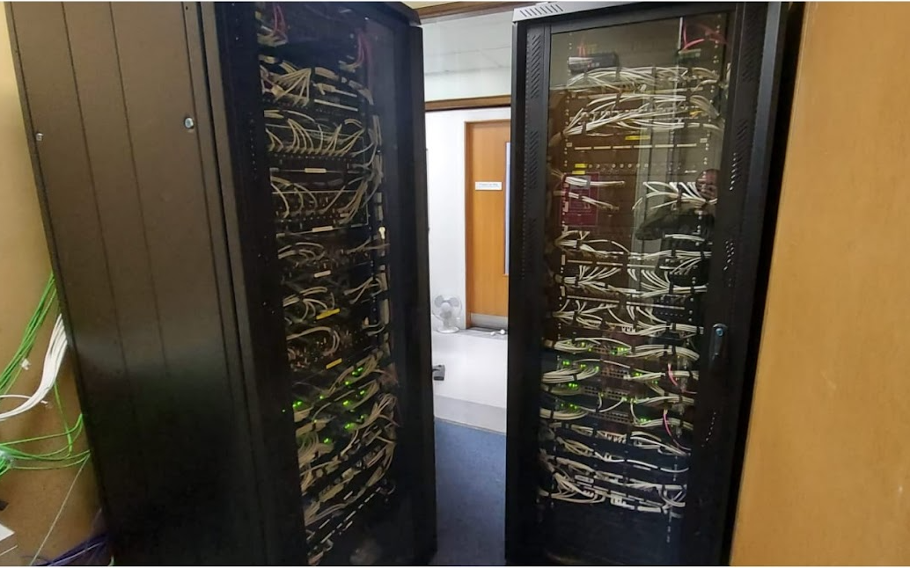

Slide 5
Physical Topology 2020
PoP site
Main Campus
Cisco ASR
Cisco ASR
Perimeter
Cisco 9300
Cisco 9300
Firewall
Cisco firepower
Cisco firepower
Cisco firepower
Cisco firepower
Cisco C9500
Cisco C9500
Cisco C9300
Cisco C6880
Cisco C6880
Cisco C9300
Core and Aggregation
Cisco WiFi
Cisco WiFi
Edge
Servers
Servers
Servers
Cisco Edge in Buildings
Cisco Edge in Buildings

Slide 6
Physical Topology 2024
All services in SSG campus
Cisco ASR
Cisco ASR
Firewall and Perimeter
Cisco 9300
Cisco 9300
Firepower 4215
Firepower 4215
Cisco C9300
EX4650
EX4650
Cisco C9300
Core and Aggregation Fabric
EX4650
EX4650
Servers
EX3400/4100/4400 Switches
Servers
Edge
620 x AP33/43/45
Total realized CAPEX reduction delta for full network – 50%
Total forecasted OPEX reduction delta across 5 years – 30%
Smaller network footprint with 10 times the capacity and processing.
7000 edge ports reduced to 5000 edge ports despite 2 new buildings coming onstream
Increase in WiFi footprint from 350 to 620 radios

Slide 7
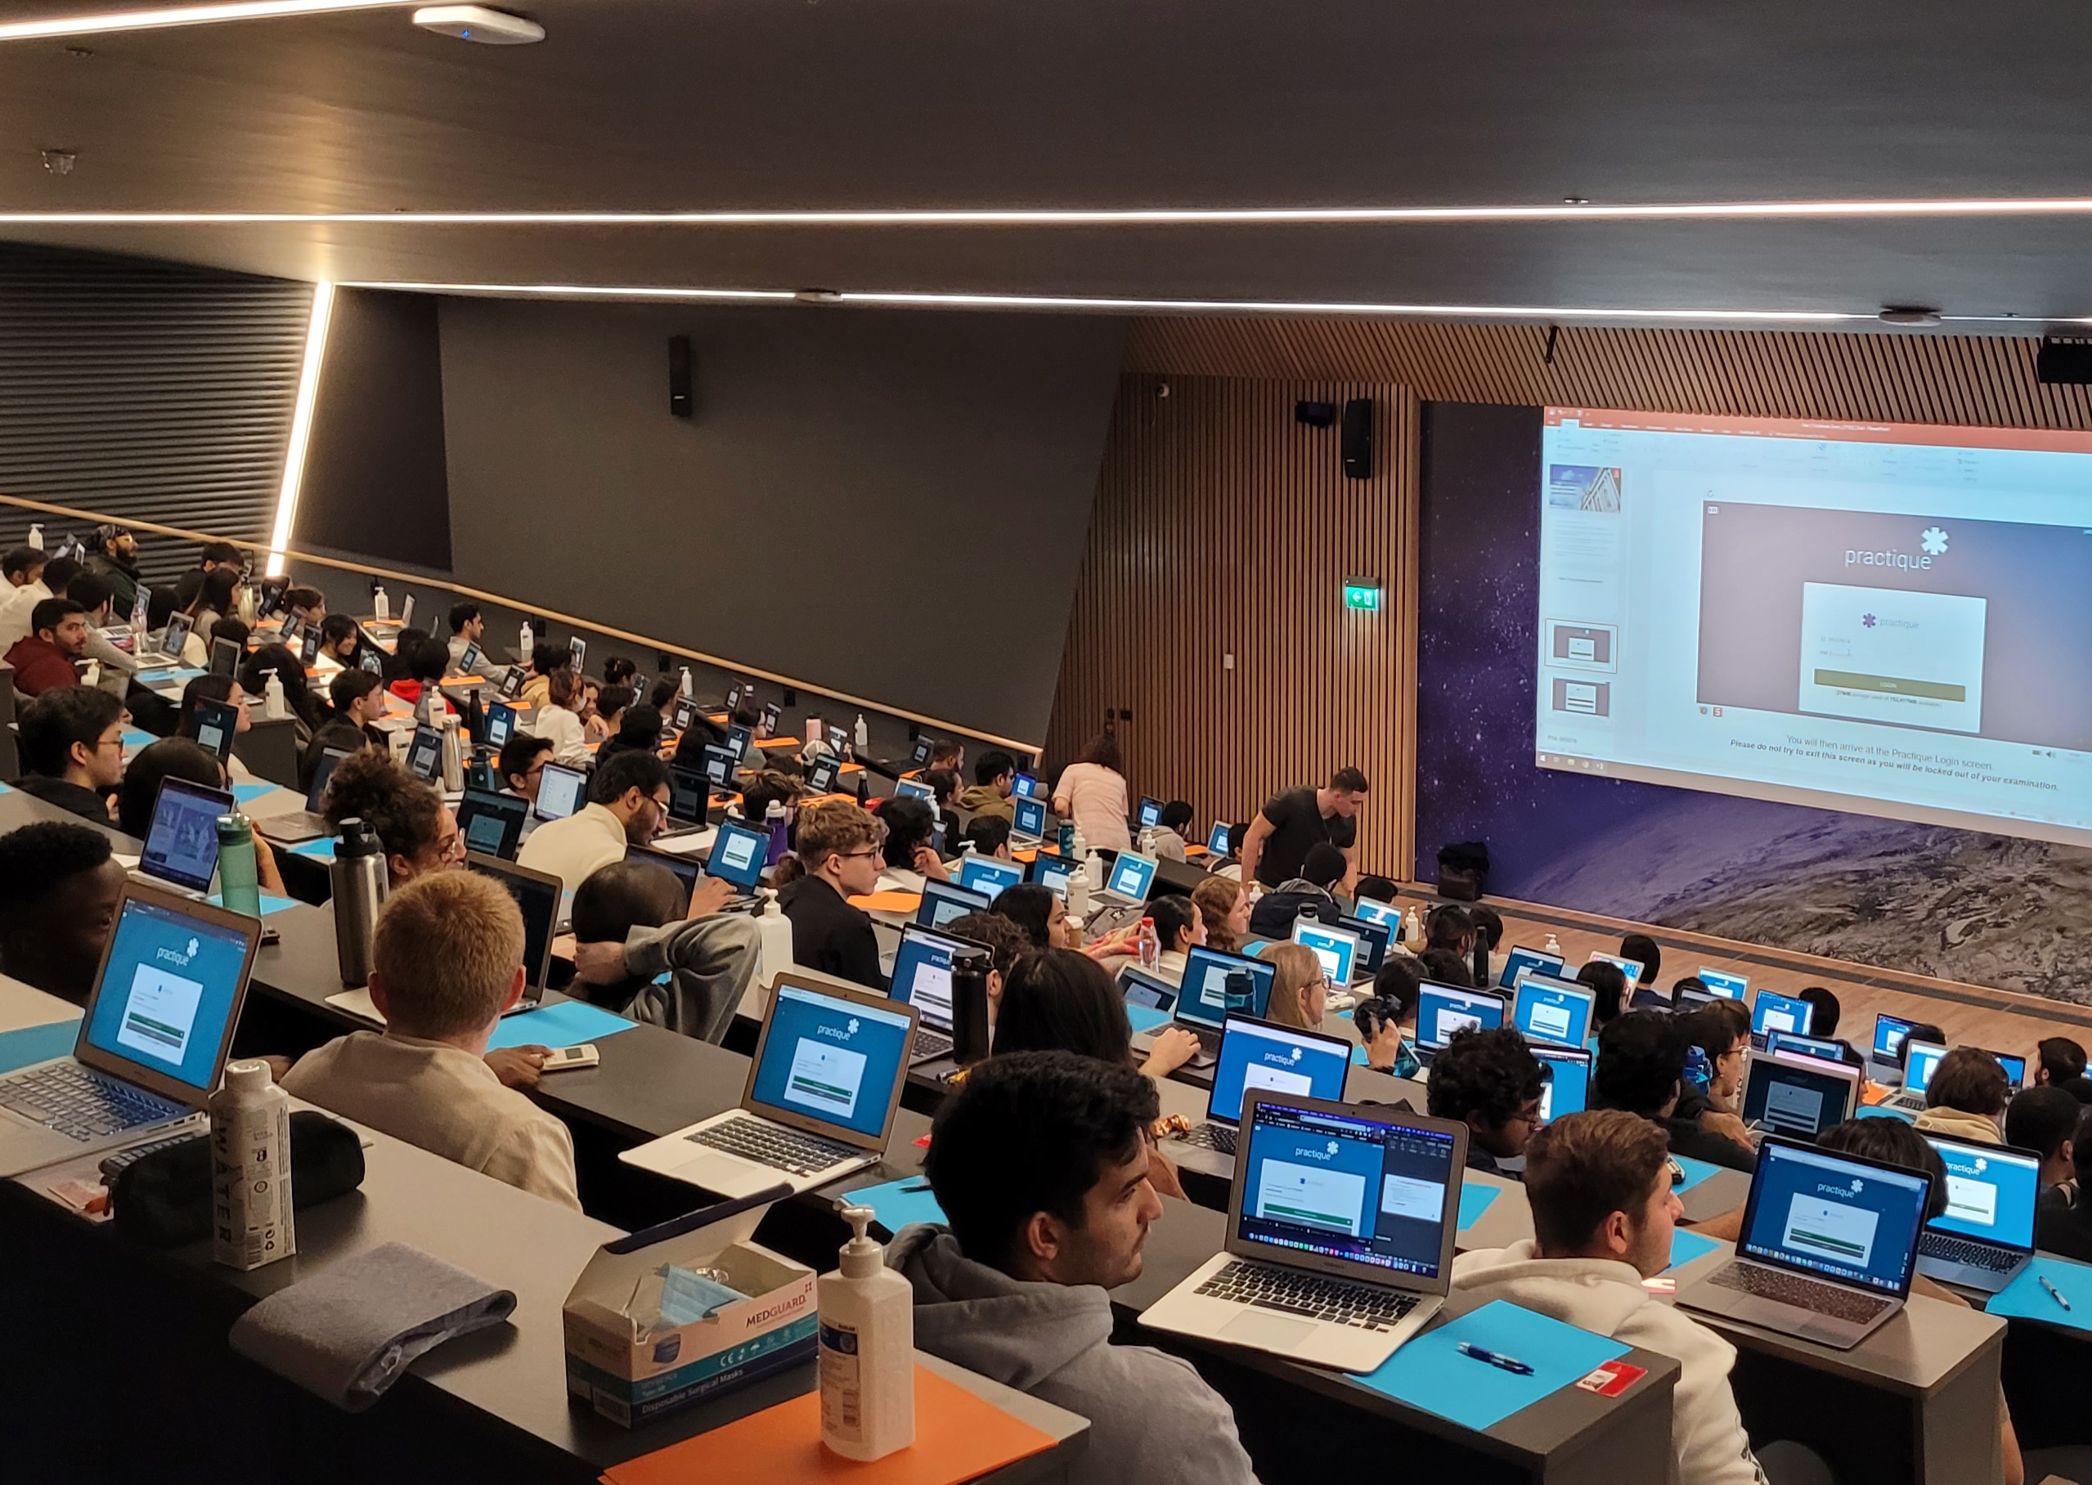
AI and Modern Networking Tools
Cloud Management
Mist AI Platform with Marvis
Cisco Defense Orchestrator
Cisco Multicloud Defense
Cisco AI for security

Slide 8
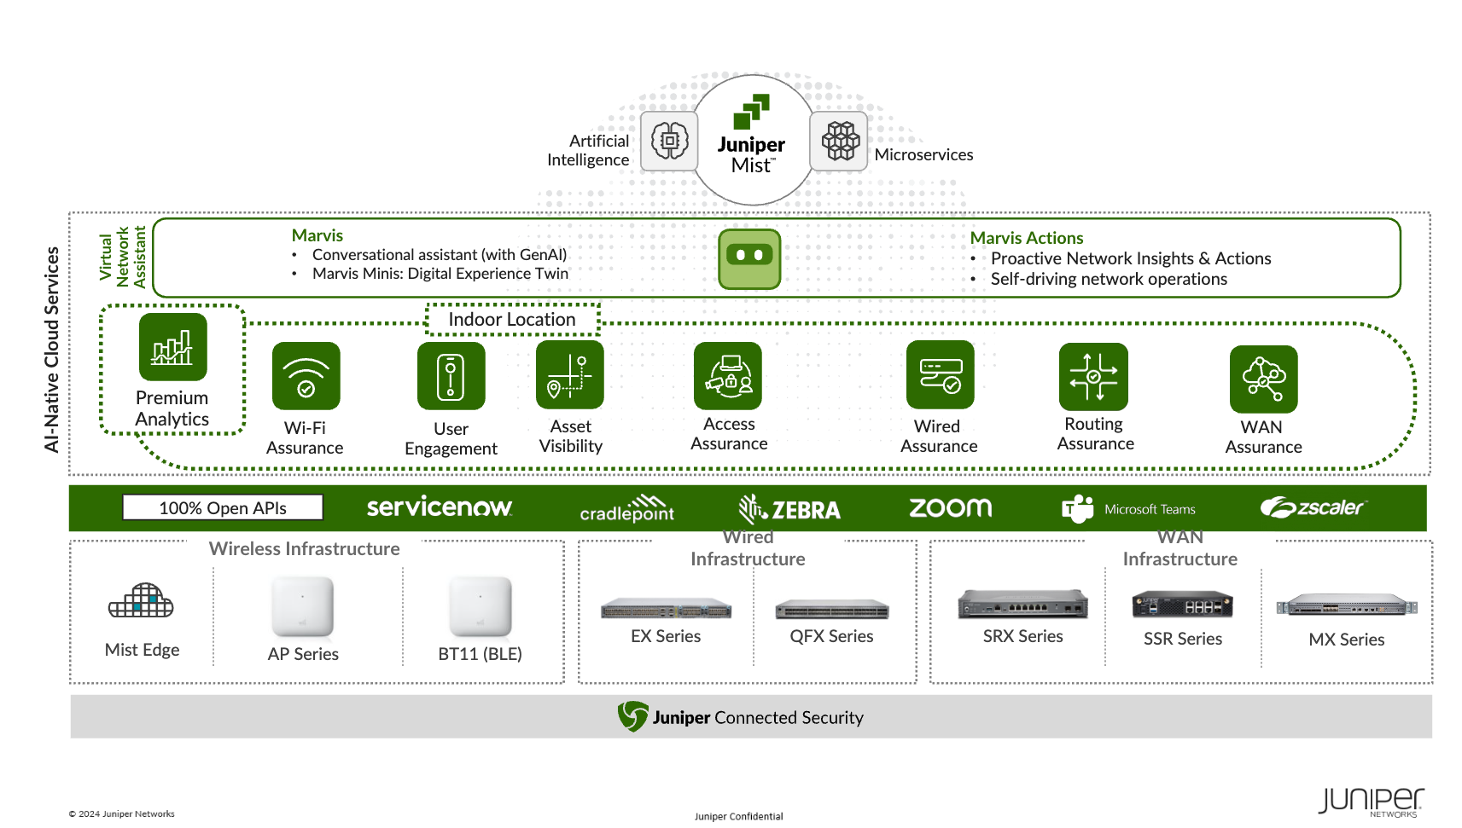

Slide 10
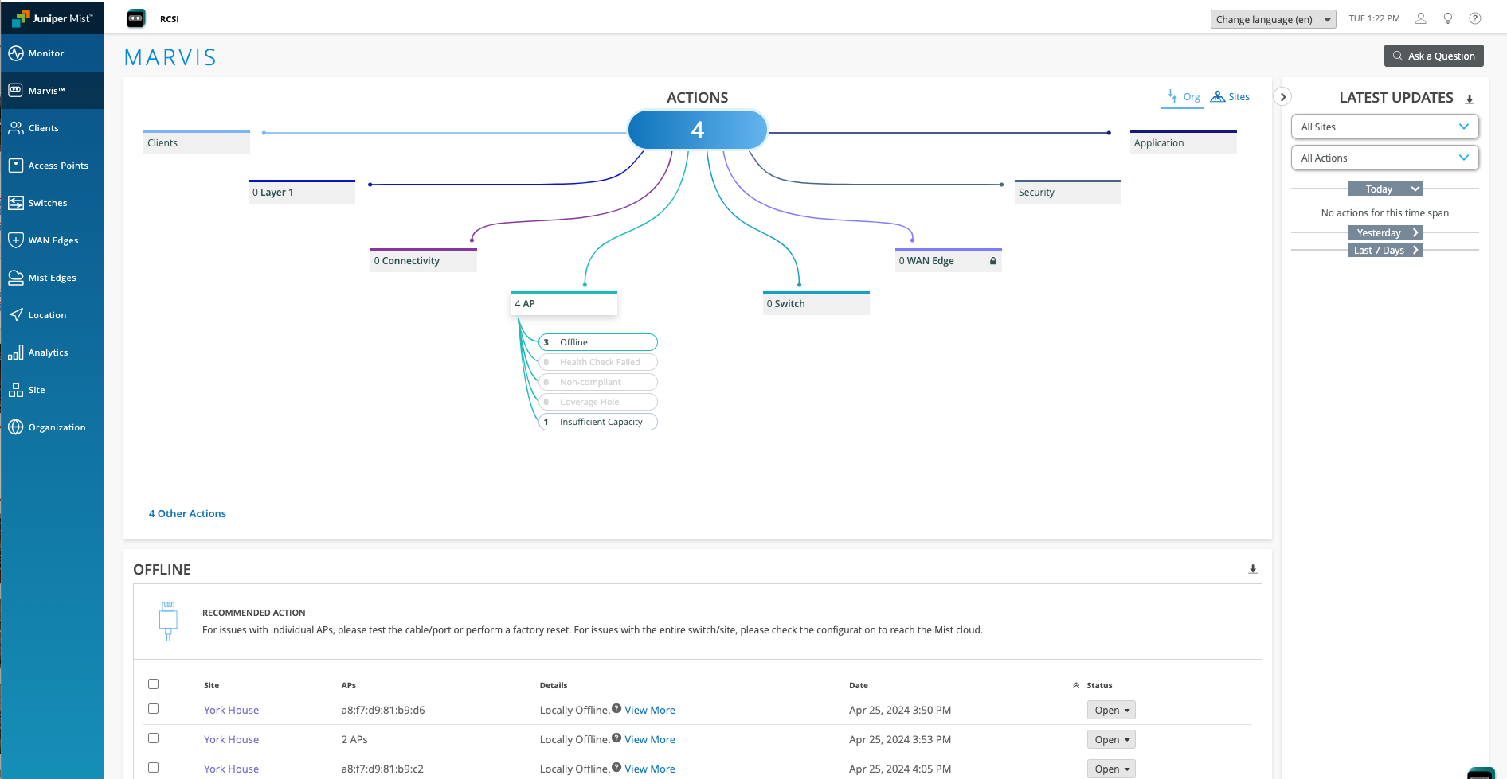

Slide 11
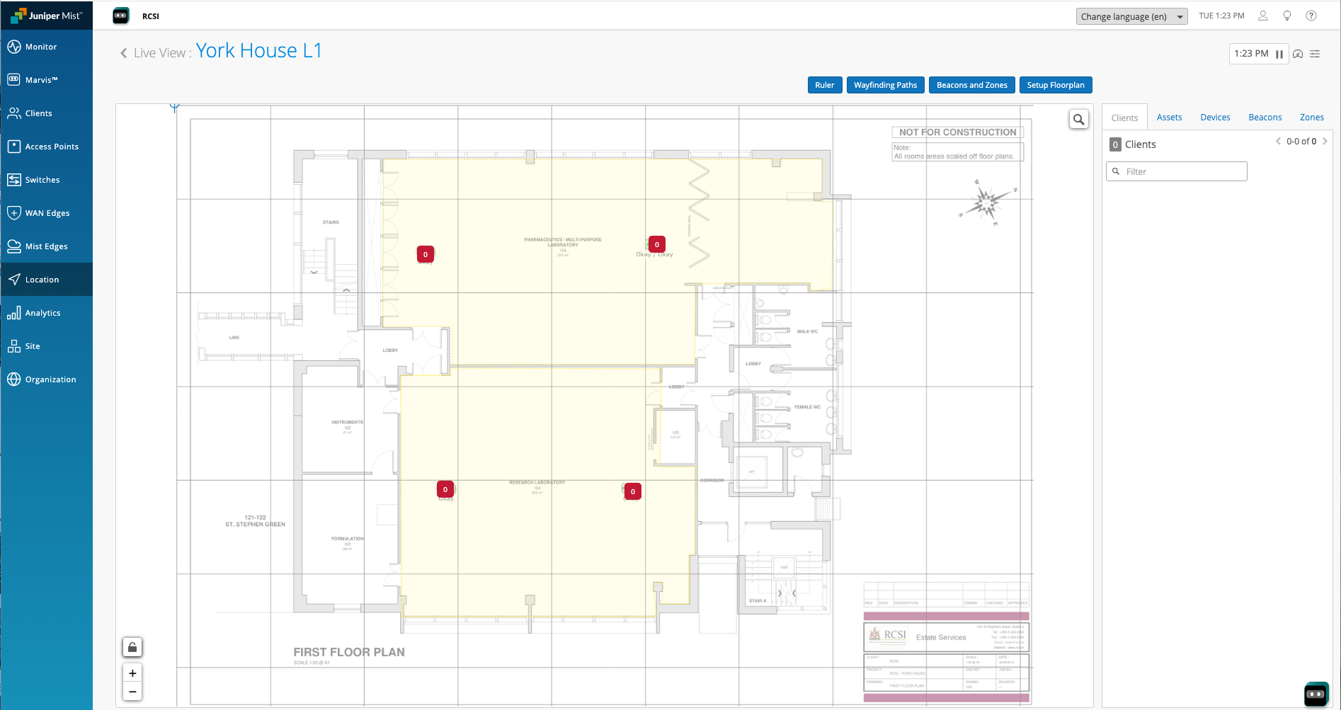

Slide 12
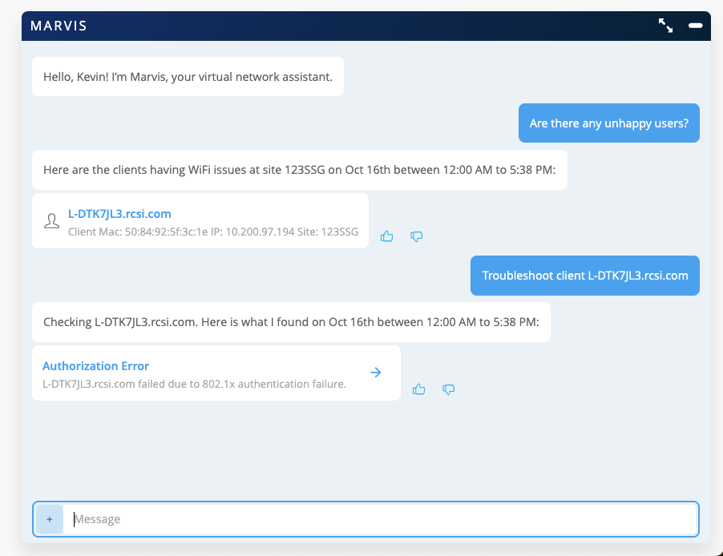
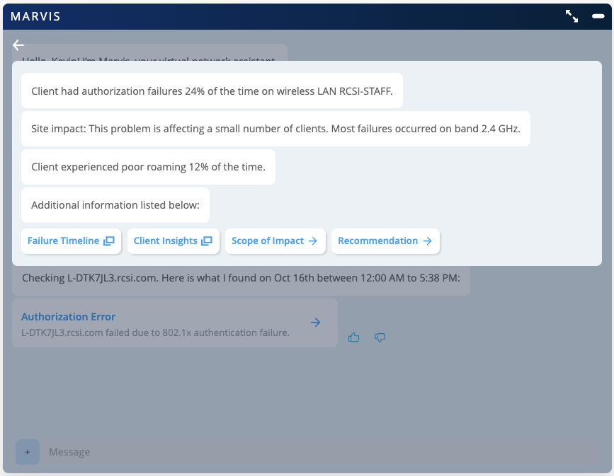
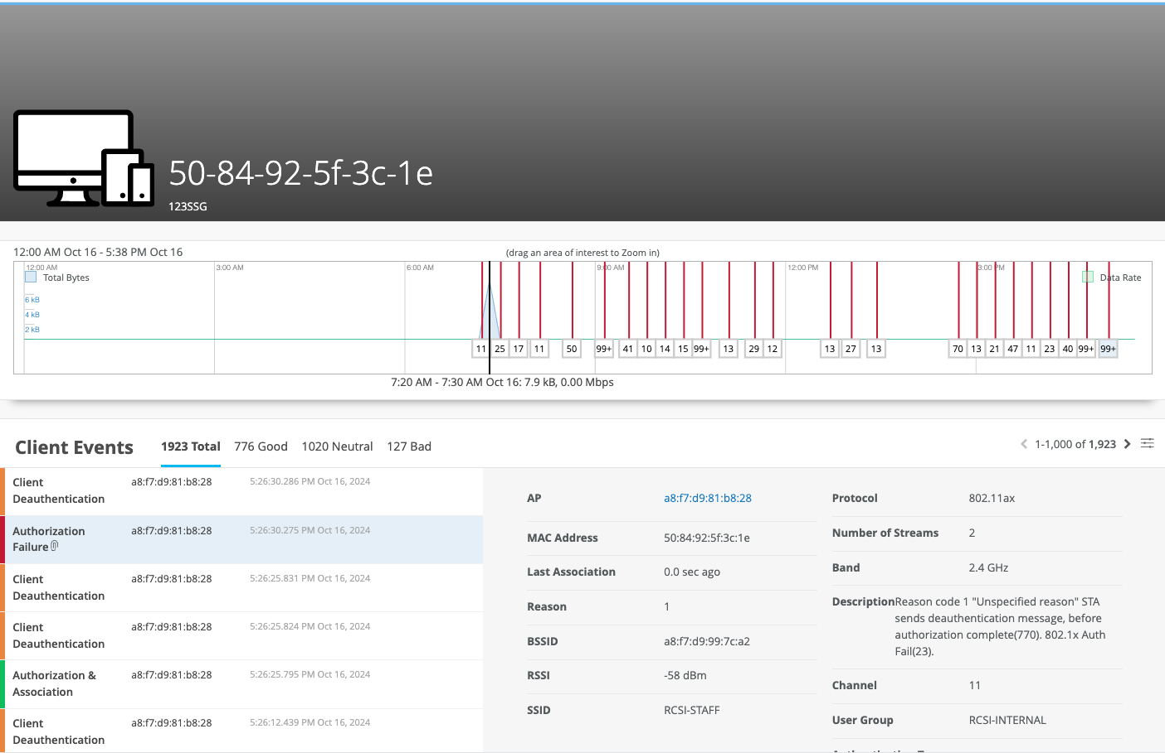

Slide 13
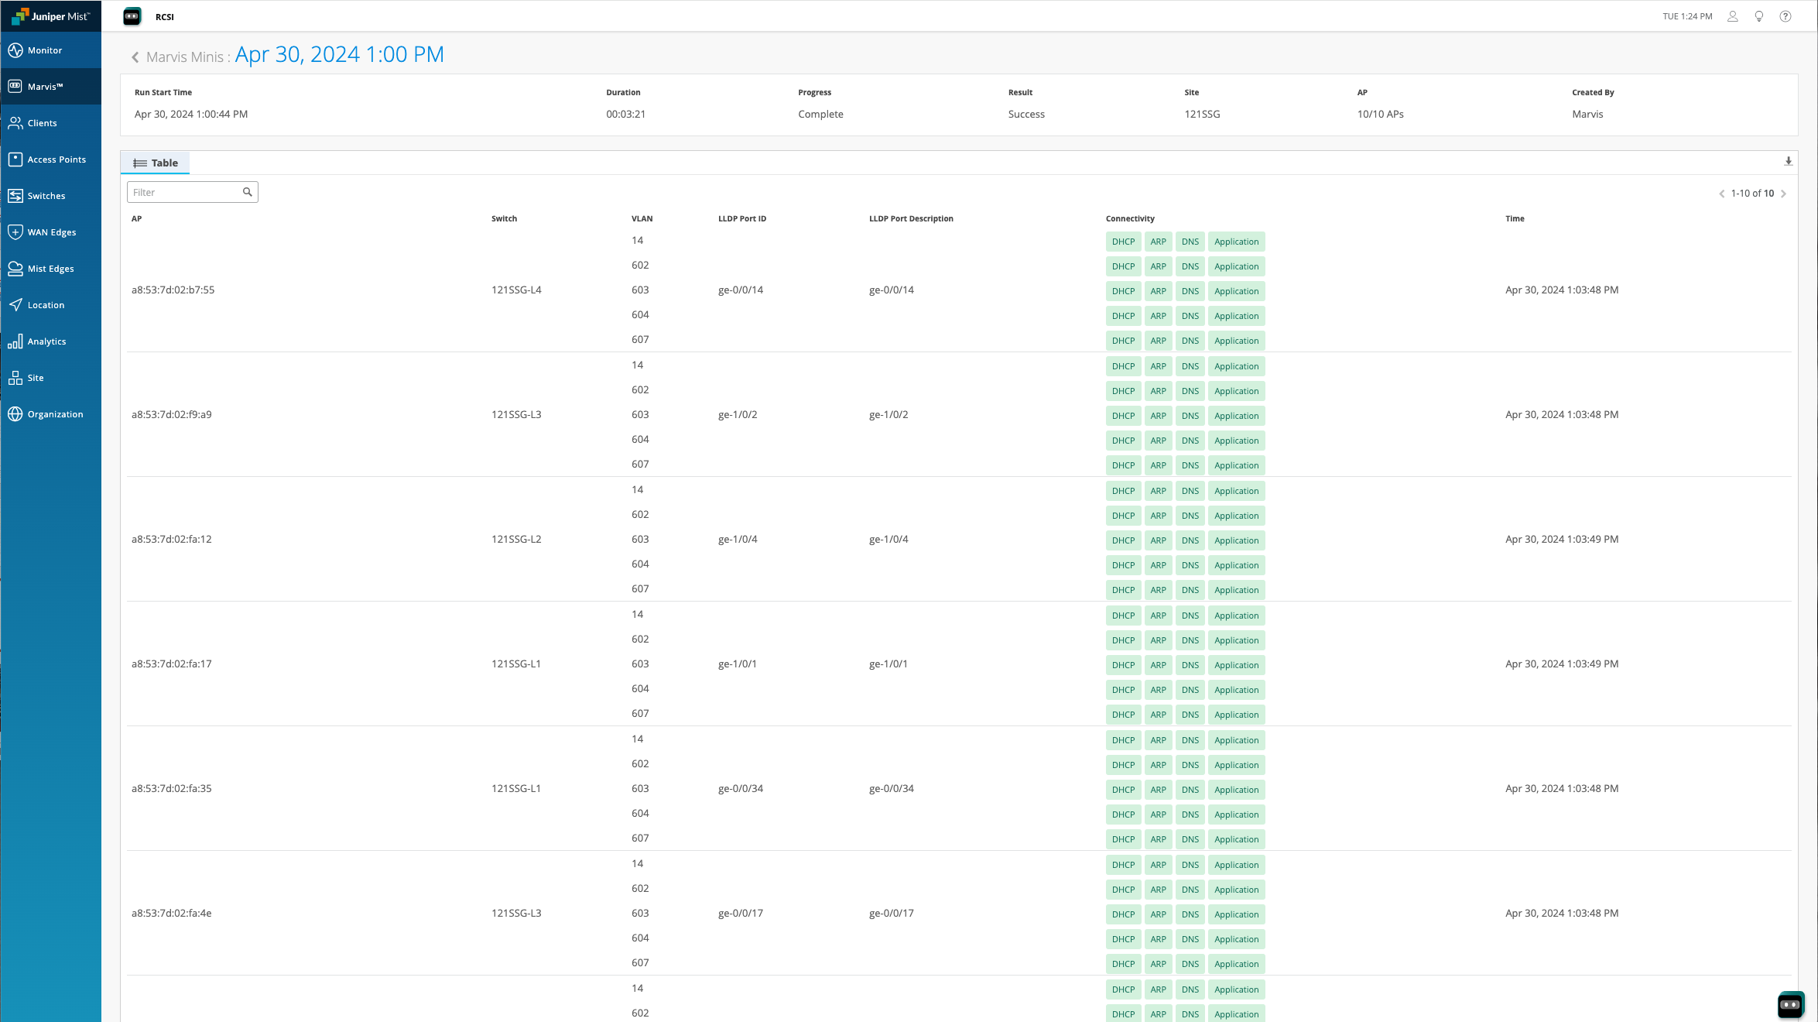

Slide 14
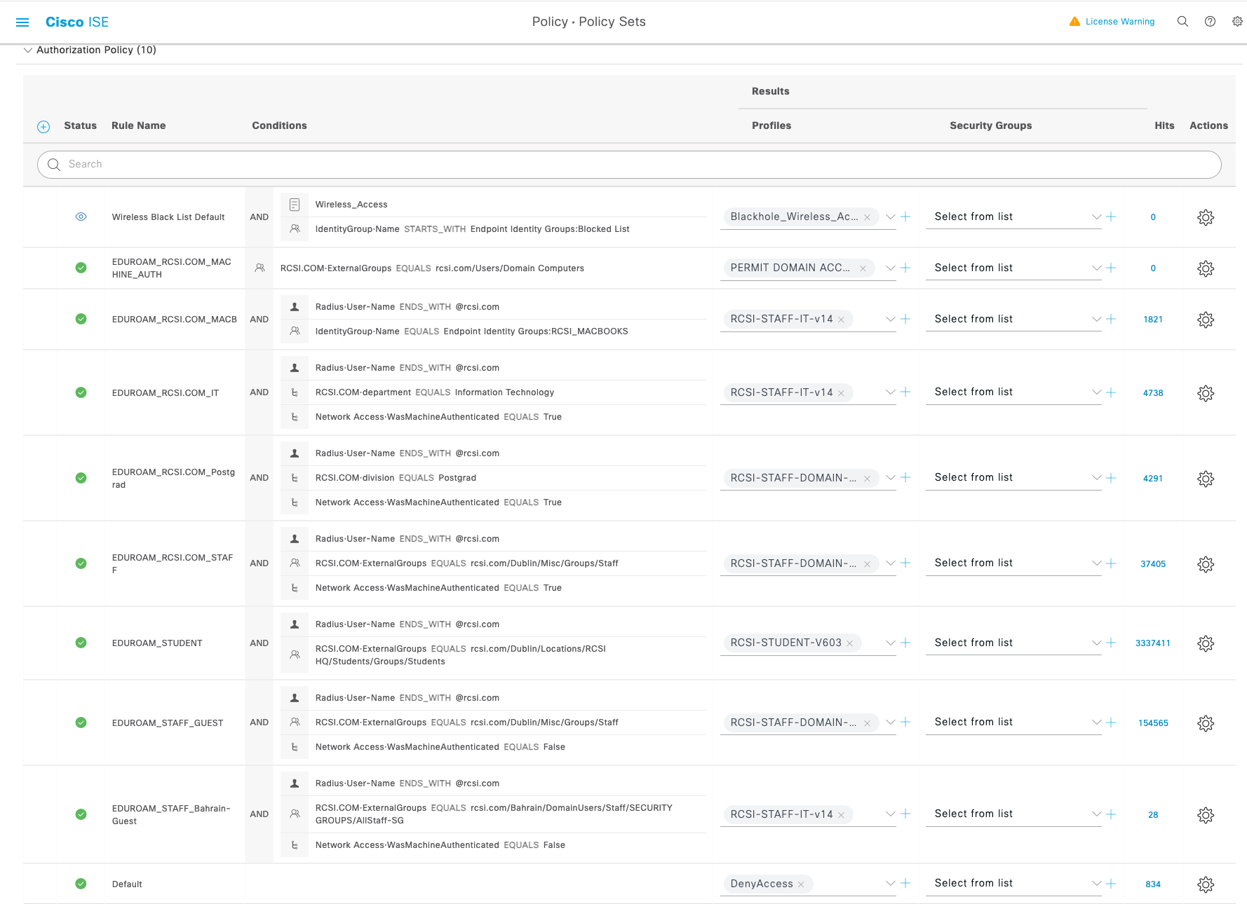

Slide 15
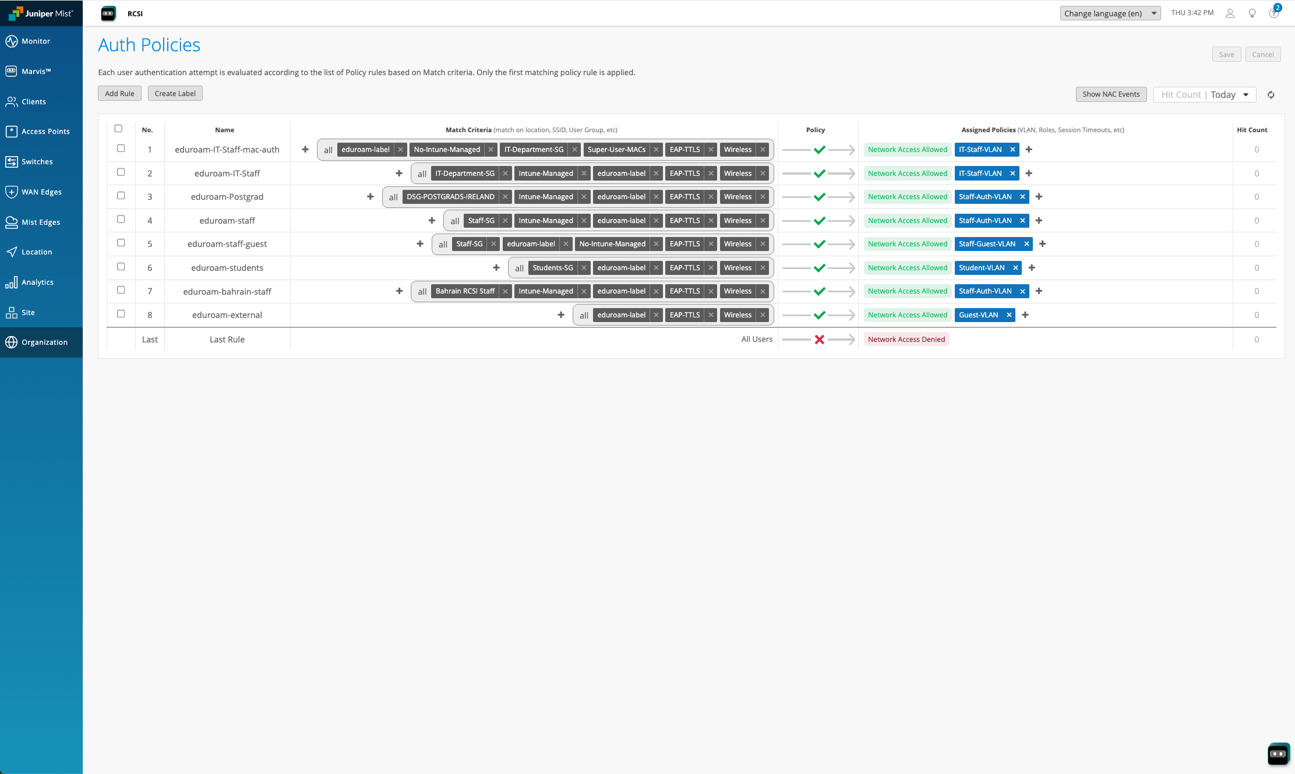

Slide 16
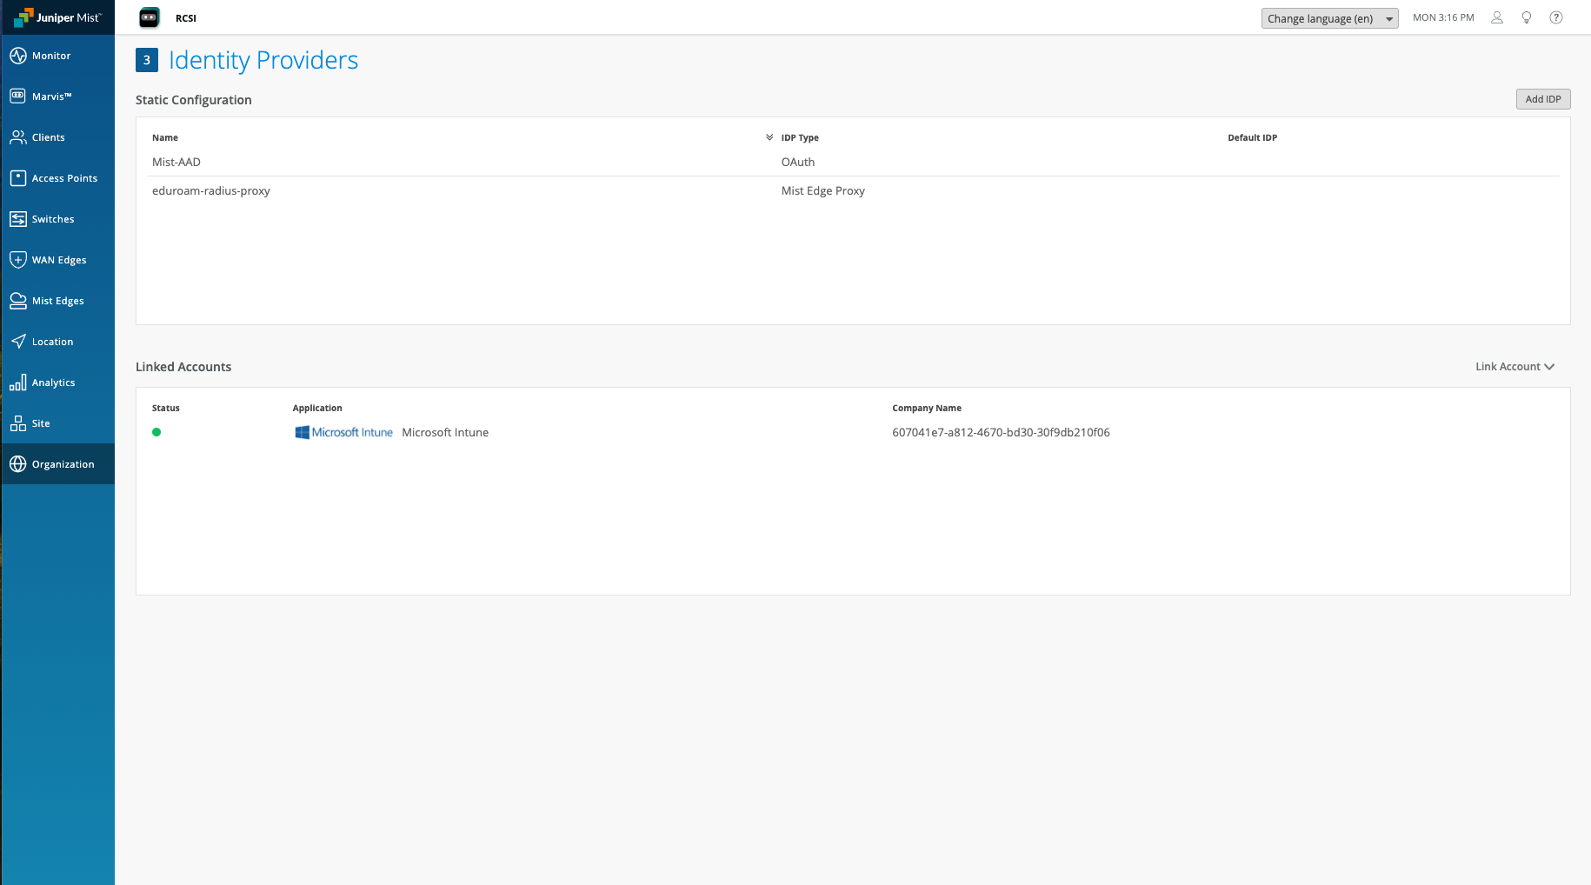

Slide 17
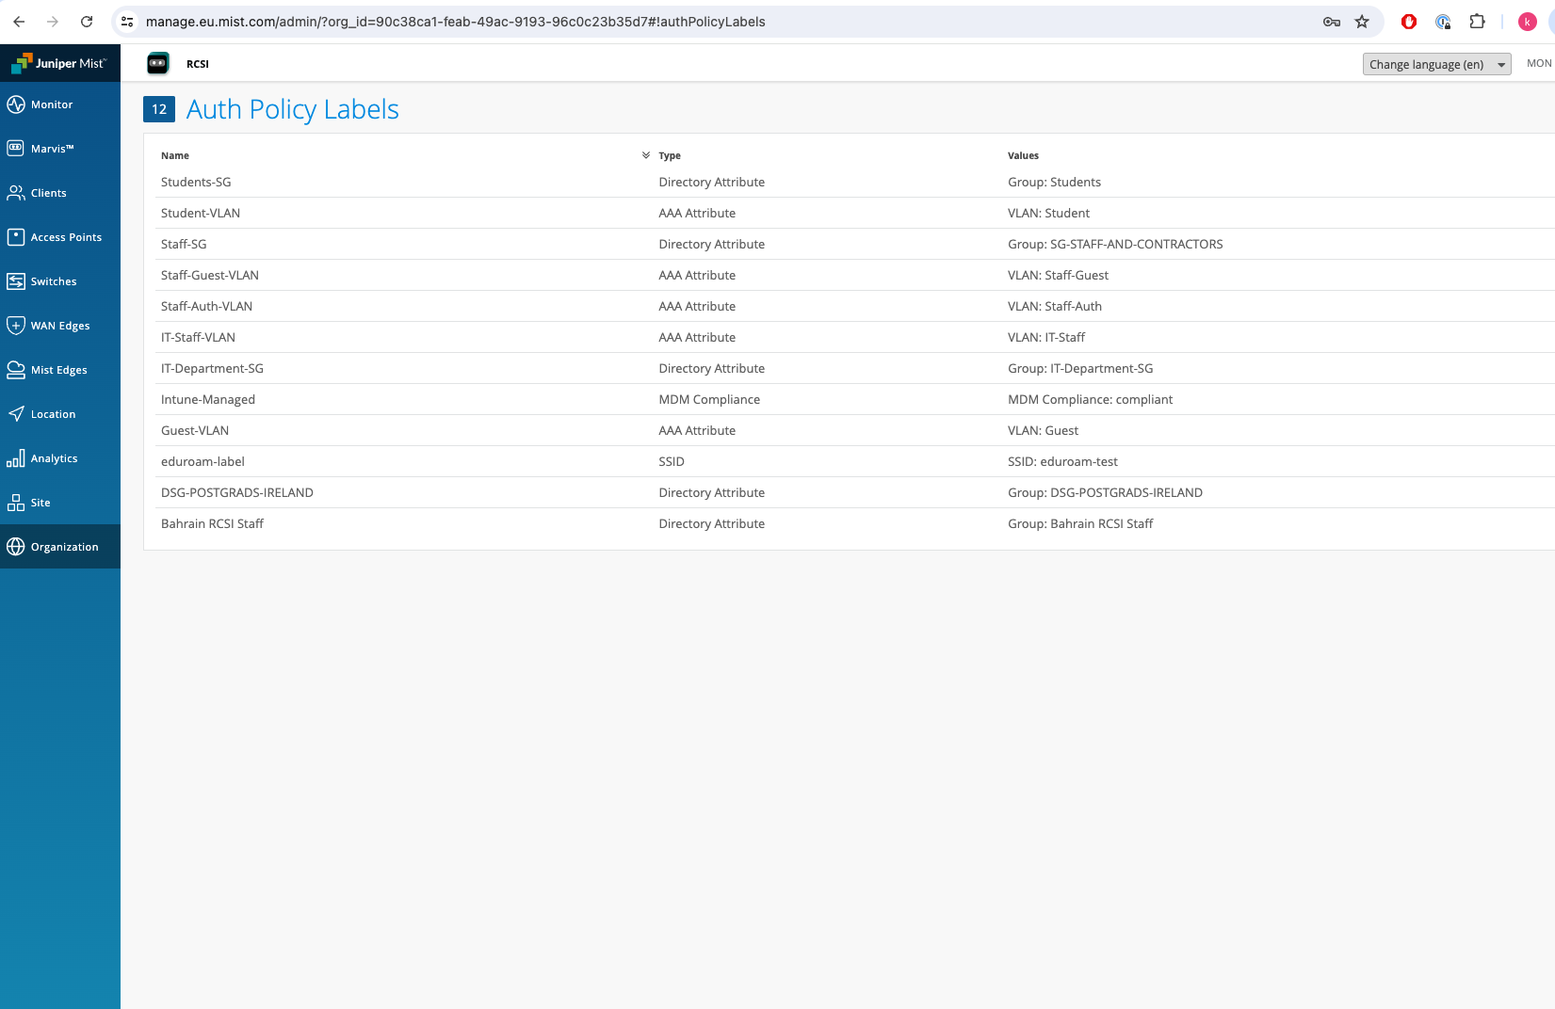

Slide 19
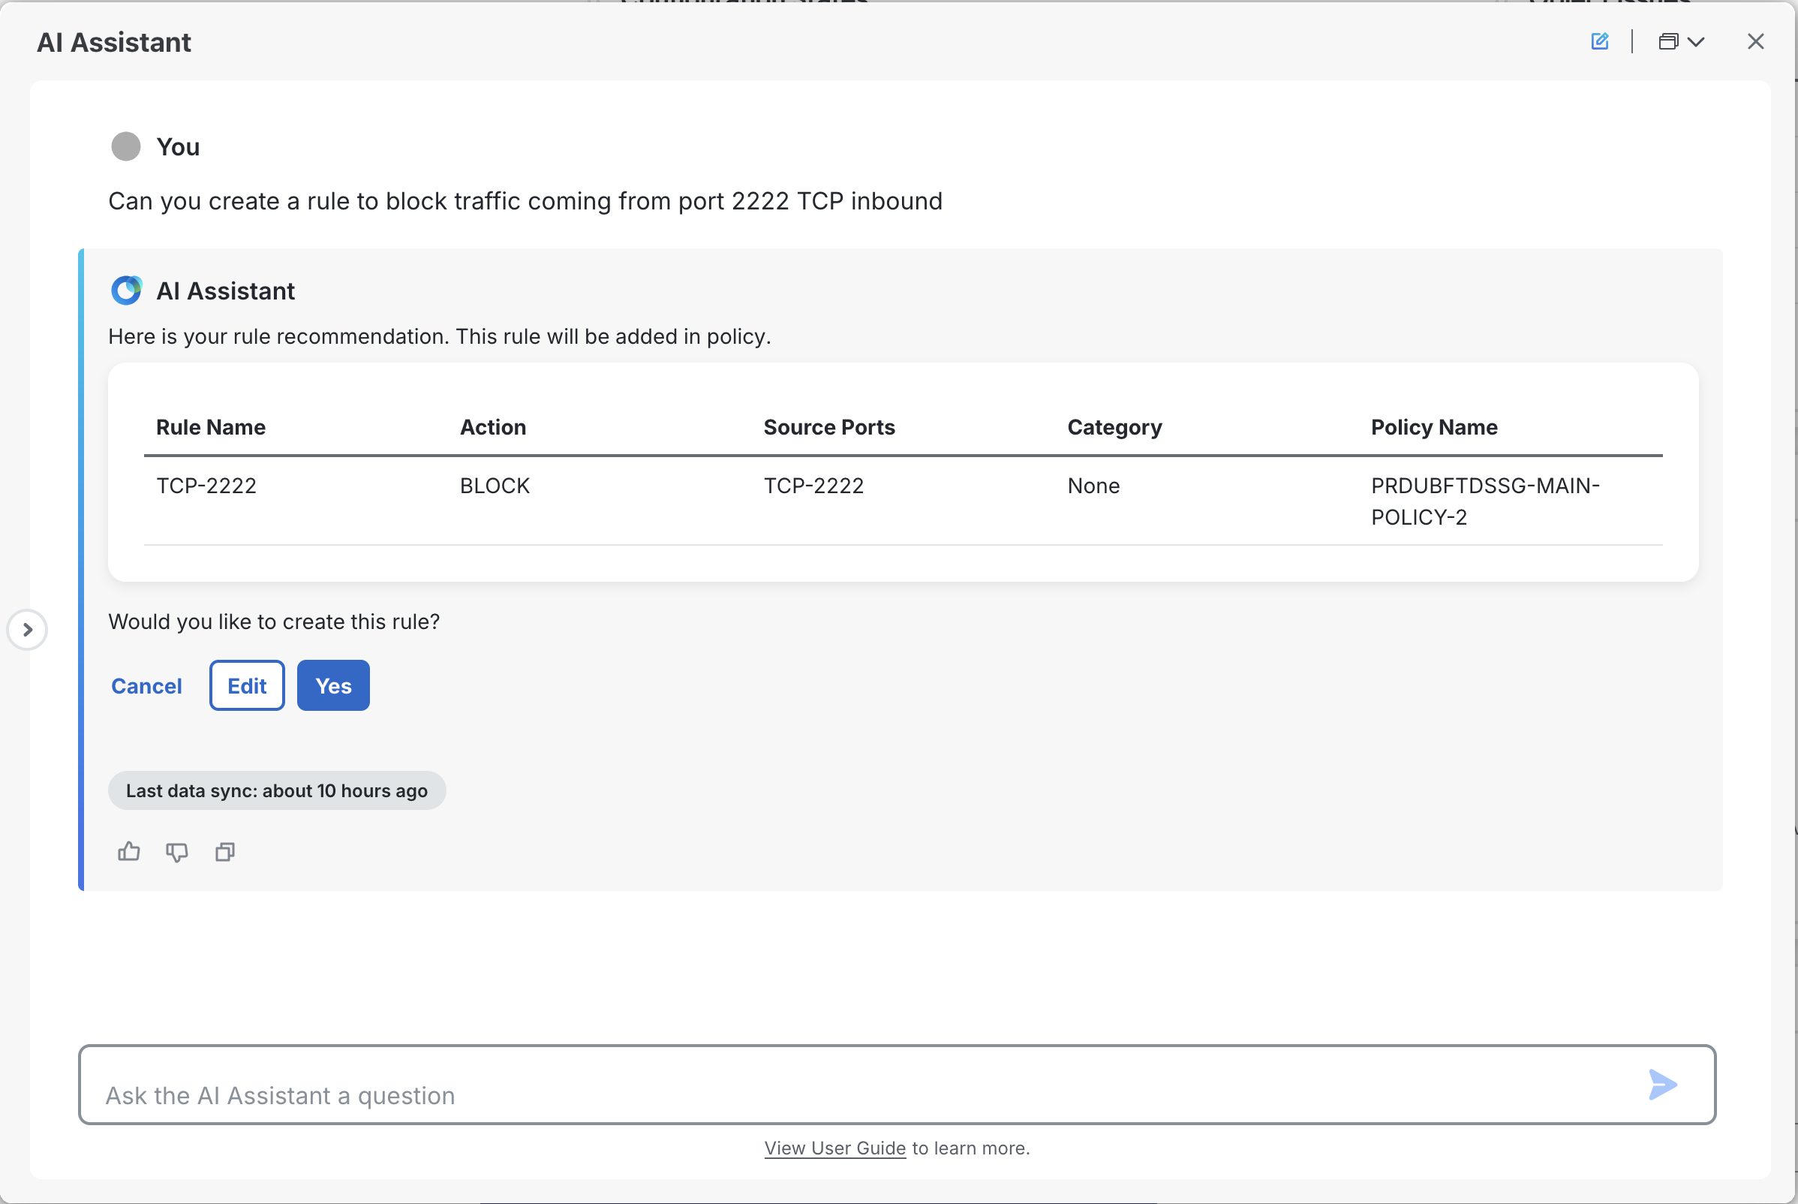
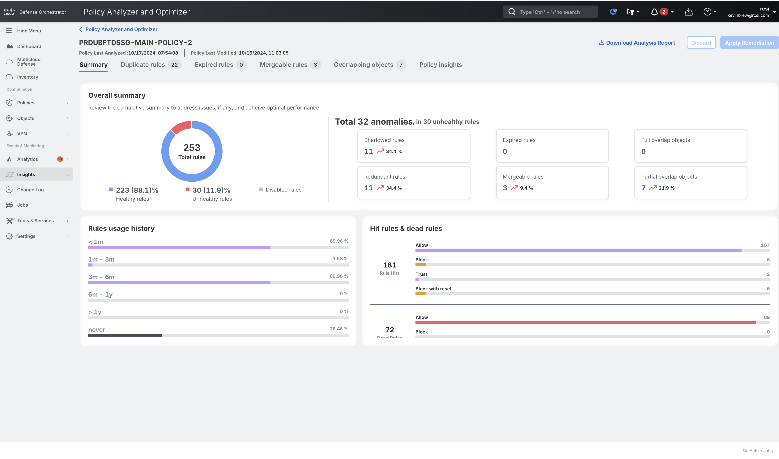

Slide 21
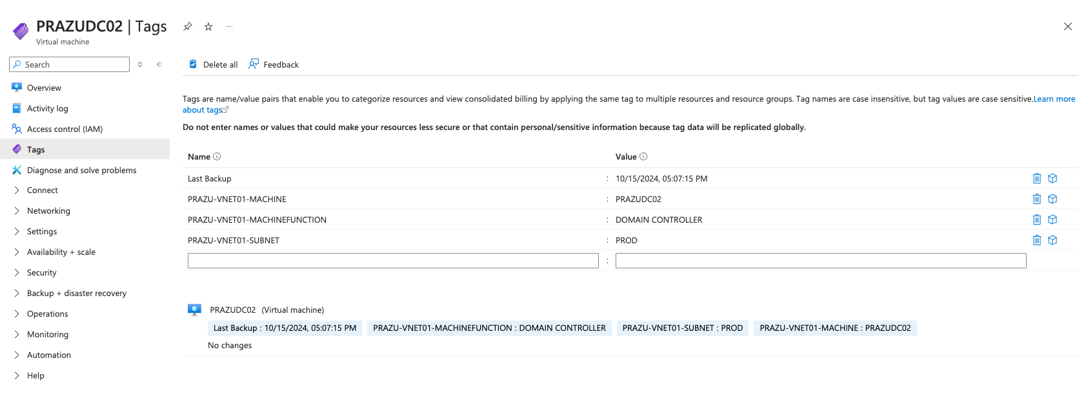

Slide 22
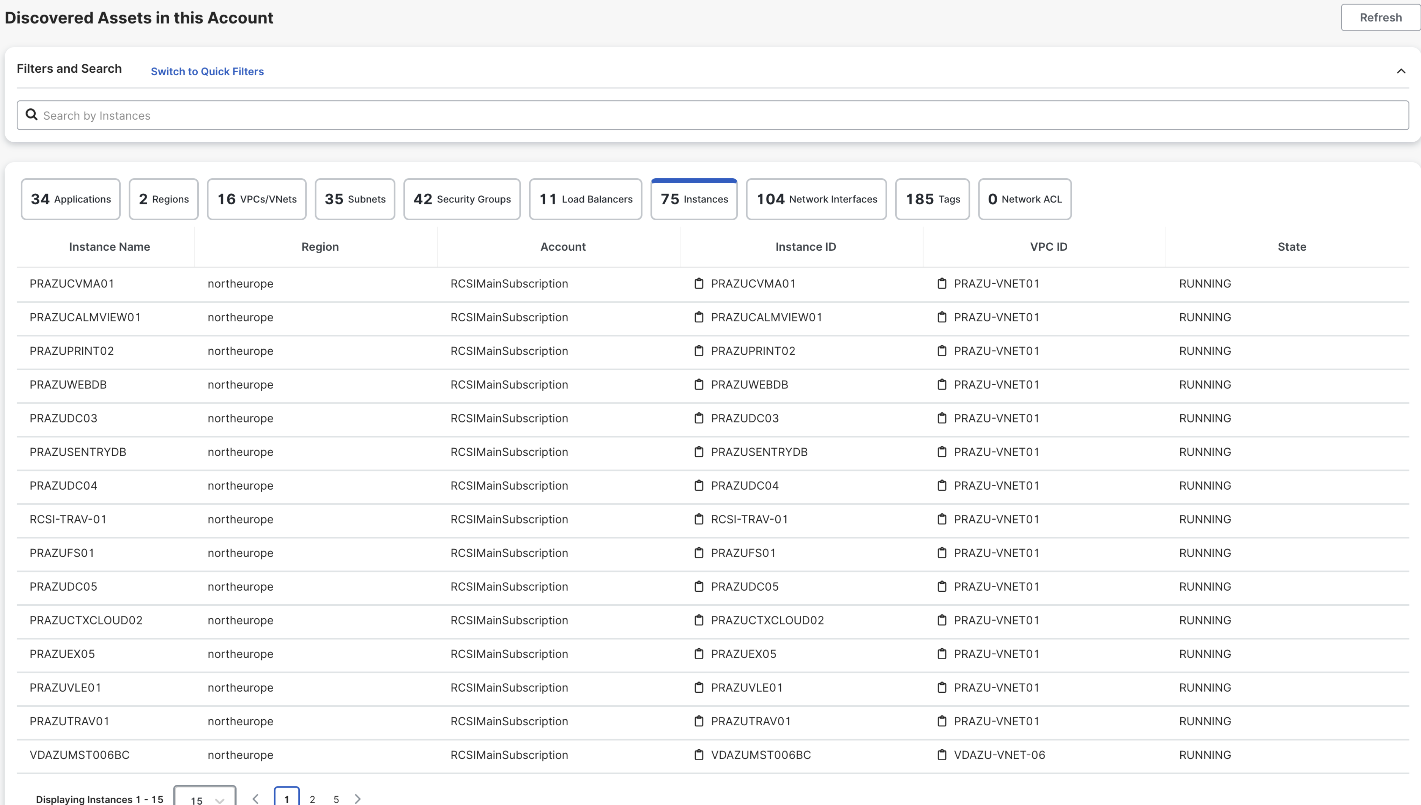

Slide 23
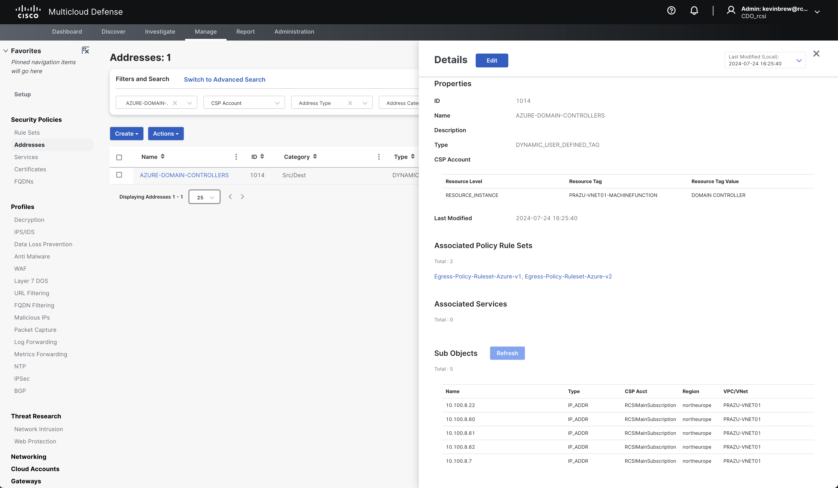

Slide 25
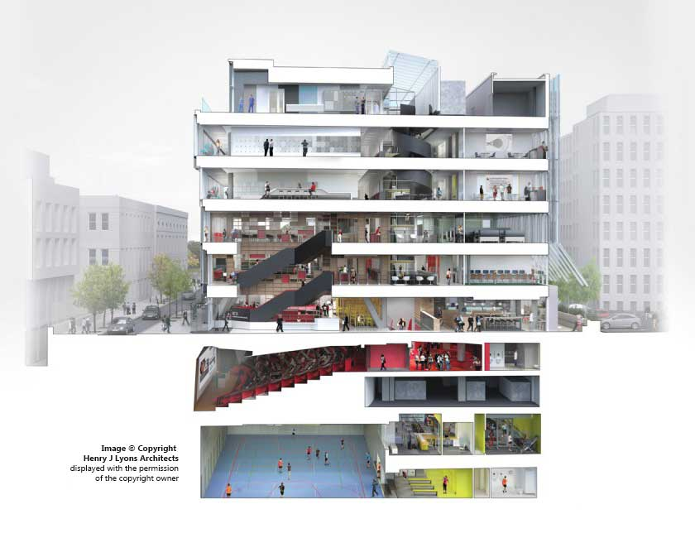
Questions?

