Slide 1

Transforming device management in the era of the modern workforce
How UL went from traditional device management to a modern device management approach
Mark Twomey
University of Limerick November 2024

Slide 2










Context: Pre-MDM-Managing our Windows desktops and laptops
Traditional approach to managing UL owned Windows devices
What issues did we face?
Lack of insight
Device setup
Device Security
Remote Risk
Backup
No. of devices
Device status
3rd party tools or custom scripting required
Significant effort required by IT support post image
Downtime for the end user
Staff had full local admin rights
Compromised user account risk
VPN required – All staff
Remote users:
No VPN connection = No updates
Should we backup our cloud hosted settings & configurations like we do on premise?

Slide 3


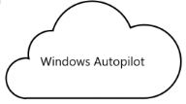
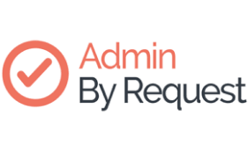





Modern Device Management…What did we want?
Remove reliance on VPN for all users
Gain insight into device numbers and usage, especially remote devices
Gain greater control of remotely used UL owned Windows devices
Ensure any UL device complies with our security policies
Enhance the user experience while adopting a ‘zero-trust’ approach to device mgmt.
Increase our cyber resilience by ensuring our cloud hosted data and configurations are backed up
How?
UL: Modern Device Management solutions
Intune
Autopilot
Admin by Request
Keepit
Cloud first scalable architecture
Reduced need for costly on-premise servers & support requirements
Remove the reliance on VPN for remote users
“Single pane of glass” mgmt. portal
Improved user experience
Device setup and updates applied with zero touch for users & minimal downtime
Adopt a ‘policy of least privilege’ approach
Instead giving users JIT/JEA by allowing them elevate their permissions when necessary
Provides an immutable air gapped backup of UL MS365 cloud hosted data
Crucially it is also backing up our Entra ID & Intune configurations

Slide 4
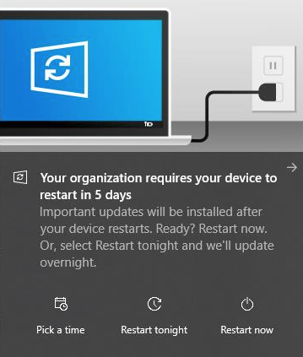
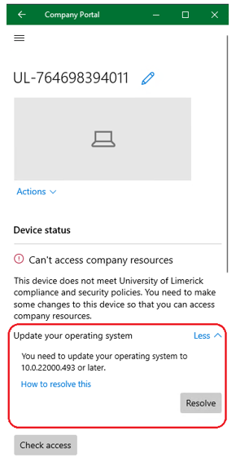
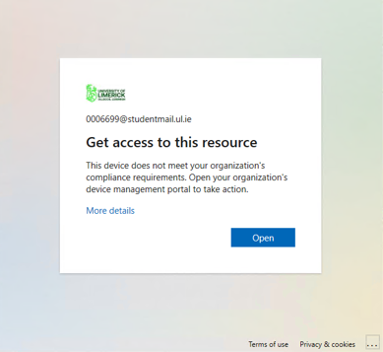
Windows feature update rollout…
Intune
Pre-Intune
Major Windows feature update required a project team
Months of testing, rollout planning
Comms re: requirements for the end user to complete
Actual rollout of upgrade
Troubleshooting and manual intervention of issues e.g. a remote user would need to come on-site for support
Since April 2020, over 6000 UL owned Windows devices have been enrolled in Intune with a number of major Windows 10/11 feature updates deployed via WUfB
Win: Users are more productive as less disruptions while updating
Win: Support staff can redirect their time to other value-adding work
Win: Intune compliance lets the end user act on a device the is not up-to-date via the Company Portal
Win: Blocking access if a device remains non-compliant, enhancing our security posture
How?
Notes:
Pre-Intune a feature update required a lot of planning, comms and light of sight to WSUS to get the update….

Slide 5
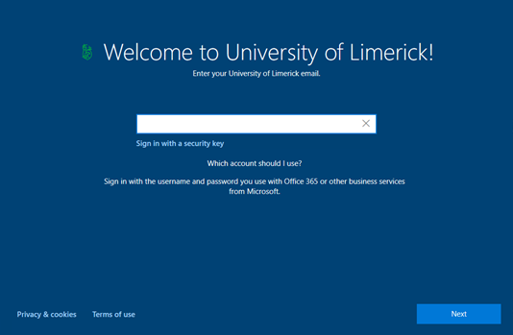
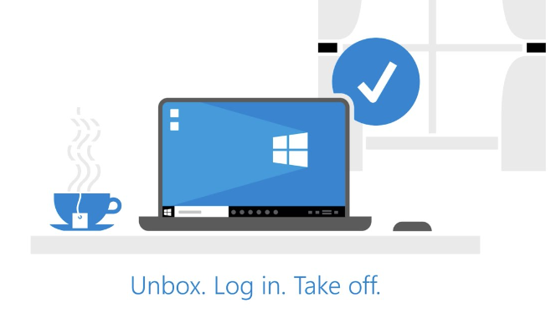
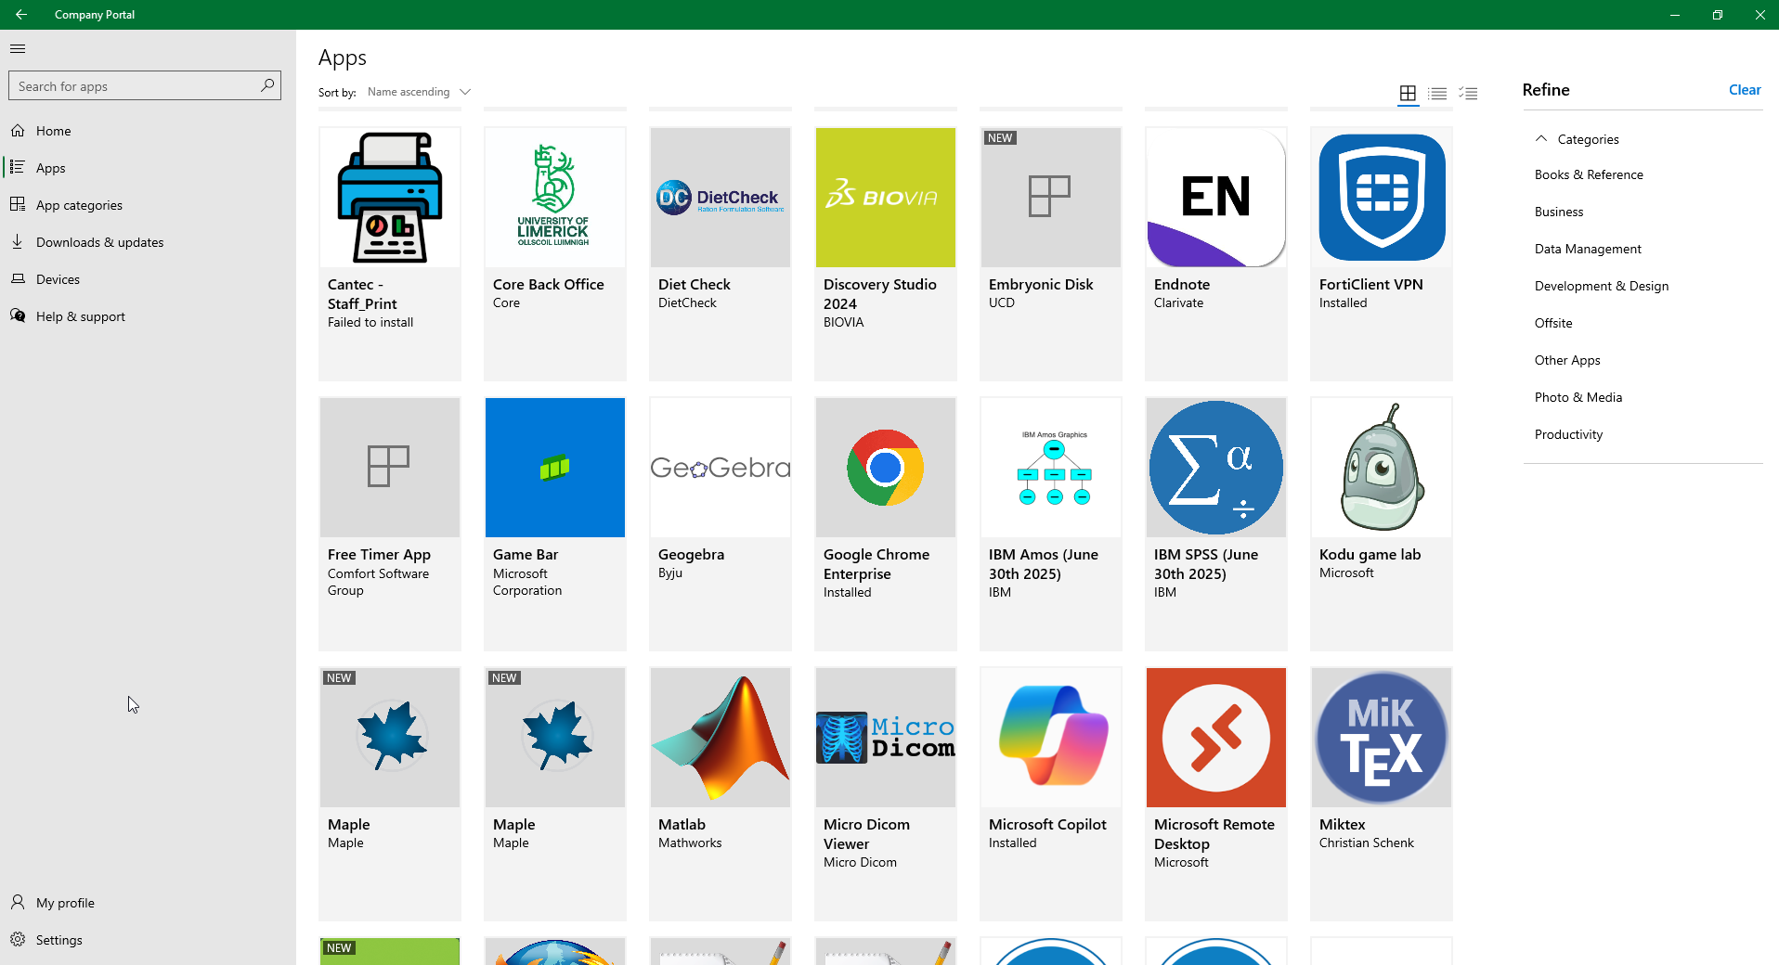
Device setup…
Pre-Autopilot
Autopilot
Significant technician time spent on setting up new Windows desktop & laptops:
  Device needed to be physically connected to UL network on first boot post image deployment
  Install updates
  Encryption (laptop)
  Install software
  Install & update antivirus
  Up to 2hrs config time per device
Example
2020:
2hrs x 1100 (laptops) = 2200hrs ÷ 7hrs (typical workday excl. lunch) = 314 days
2021:
  2hrs x 970 (laptops) = 1940hrs ÷ 7hrs (typical workday excl. lunch) = 277 days
“The old method of configuring one device at a time is not efficient.”
Today all configuration is done in the cloud before a device is even delivered.
Win: The device is encrypted out of the box and is locked into the UL tenant
Win: Technician’s time is saved
Win: Software available via Company Portal
Win: End-user productivity
The end user is up and running within a couple of hours rather than depending on availability of a support technician to configure the device
How?
Notes:
Pre-Autopilot – Large amount of time was spend configuring a device post image deployment….
On first boot, the device is detected by Autopilot and enrolled in Intune where all configurations, settings, applications & policies configured by ITD are deployed to the device
Device can be delivery straight to the end user supporting the hybrid work force

Slide 6
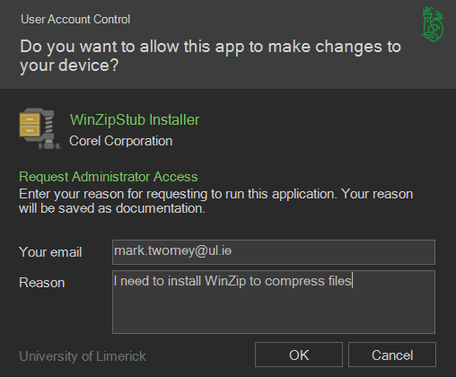
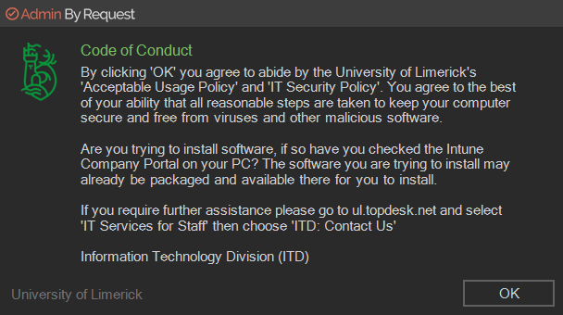
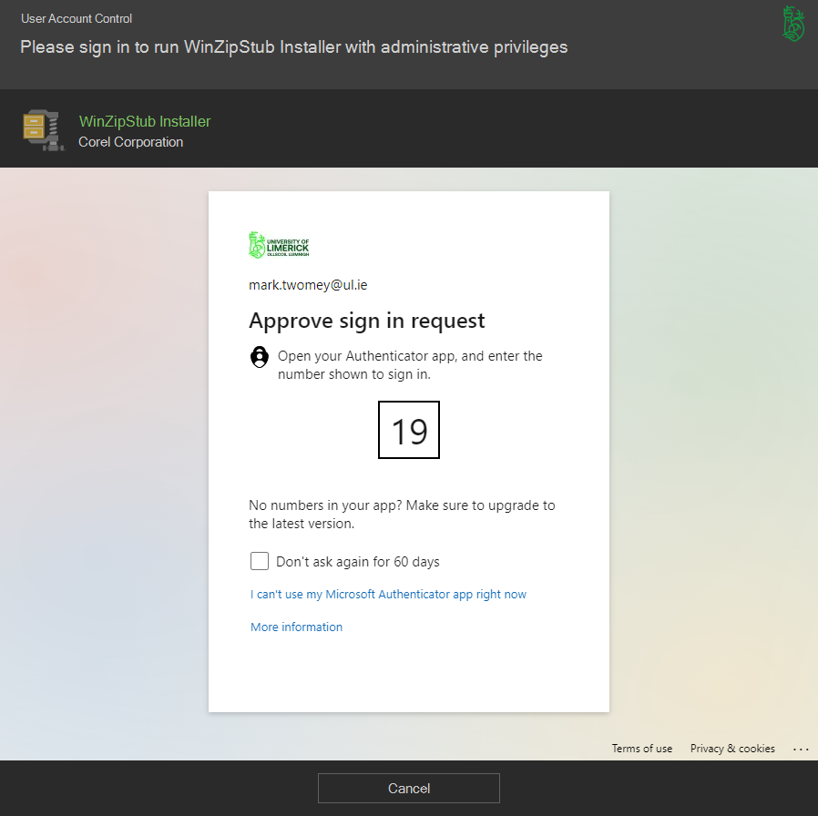
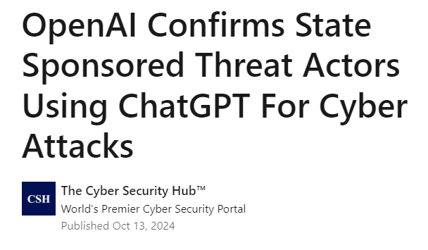
Privileged Access Management
Pre-ABR
Admin by Request
All staff had full local admin rights on their laptop and or desktop
Why? That’s just the way it was done…
This made life easier for the technician setting up the device and for the end user using the device
This presented a number of security risks due to the risk of a compromised account having full access to a device to install malicious software or run scripts
With the threat landscape is constantly evolving…
No longer feasible…
After completing a PoC and Pilot project in July/Aug 2024 we rolled out ABR to all UL staff desktop and laptops
Win: End user is no longer in the local admin group removing the risk and aligning with our move towards Zero Trust
Win: Any admin related task can be run on the device by the end user via the ABR client where they provide:
  Reason
  MFA
  Code of Conduct
Win: SaaS solution so no requirement for server infrastructure…
How?

Slide 7

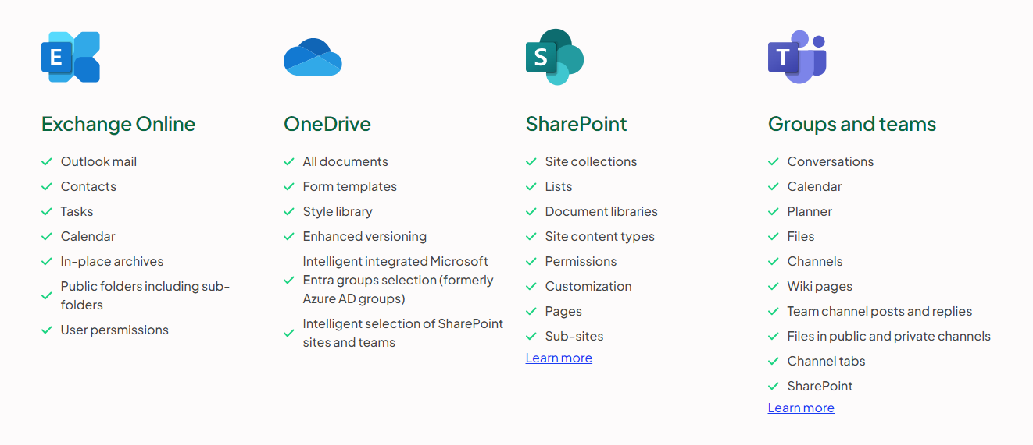
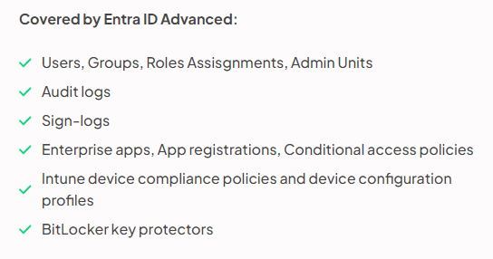
Enhanced Cyber Resilience…
Pre-Keepit
Keepit
As we move more and more towards the modern management approach with cloud first being one of those goals
It posed some important questions…
MS promise high availability and redundancy but how do we get back to BAU in the event of an incident like accidental or intentional deletions of data or config settings or a major incident like a ransomware attack?
Onboarding a Microsoft 365 SaaS backup solution from Keepit
Win: It not only backs up our MS365 hosted data
Win: But also, our important objects and configurations in Entra ID and Intune
Win: It gives us that immutable and air gapped backup of our data and configurations
Win: Allows us plan for getting back to BAU in the event of an outage and getting UL owned devices back to a managed state as quickly as possible
How?

Slide 8






Improved monitoring and reporting
Summary:
The move from traditional device management approach which was very much reliant on on-premise infrastructure and connectivity to a cloud first approach has greatly improved our processes, enhanced security and compliance resulting in a better more secure experience for the modern workforce
Compliance & Risk Mitigation
Remember communication:
Lastly, a modern managed approach requires communication. Keeping your stake holders informed on enhancements and changes by including them in the process really helped get buy in from the wider university community…
Enhanced security and threat detection
Cyber Resilience
Improved end user experience

Slide 9
Thank you.

