Slide 1
Building the future on Cloud Together
Community Collaboration in Cloud
Monique Pellinkhof
Sr. Procurement manager GÉANT
November 2024
The HEAnet 2024 Conference
Connectivity Matters
Notes:
Introduction + To share the story of the new Open Cloud for Research and Education 2024 project- OCRE2024t—the new pan-European tender uniting 39 National Research and Education Networks (NRENs) and their participating entities on procuring cloud services for the future.

Slide 2
Once upon a time…
2006 – 2012
Start Cloud platforms
2015
Start collaboration NRENs to tender commercial Cloud services
2016 - 2020
(2016) First collective NREN tender
IaaS frameworks available in 27 countries
3 Cloud platforms available
2019
Start OCRE Project How can Cloud computing be beneficial for Reseach and Education? Open Clouds for Research Environments
2020 - 2024
(2020) Launch OCRE tender (IaaS+)
IaaS+ frameworks in 40 countries
On average 14 platforms availabe per country
2024 -2029
(2024) Launch OCRE2024 tender (IaaS+)
Frameworks availabe per 03/2/2025 – ending 02/02/2030
Notes:
Once upon a time in a Kingdom not so far away…

Slide 3
Timeline of the OCRE2024 Tender
13.05.2024
Evaluation
December 2024
20.03.2024
Contract Completion
03.02.2025
Publication*
End Nov.2024
Start
Award + standstill
Deadline for Call-off Contracts
under OCRE 2020 (30.11.2024)
Commence date
OCRE2024
Duration of framework contracts is up to five (5) years from the Commence Date.
Notes:
So what happened this time arround…

Slide 4
OCRE2024 = Unique collaboration and amazing team effort
Notes:
This initiative exemplifies the power of community collaboration in navigating the complexities of cloud procurement. GEANT, acting as the EU central purchasing body, is at the heart of this effort, coordinating and facilitating collaboration across a diverse array of stakeholders.

Slide 5
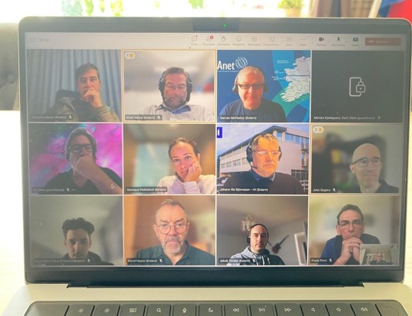
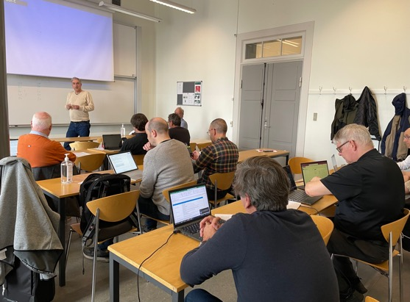
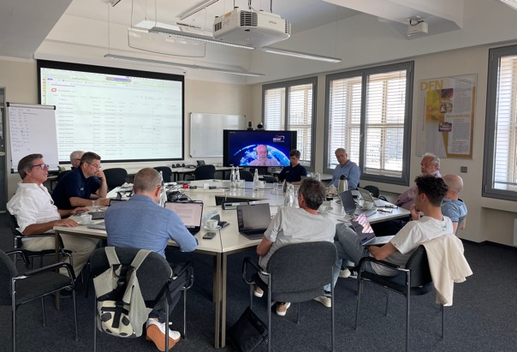
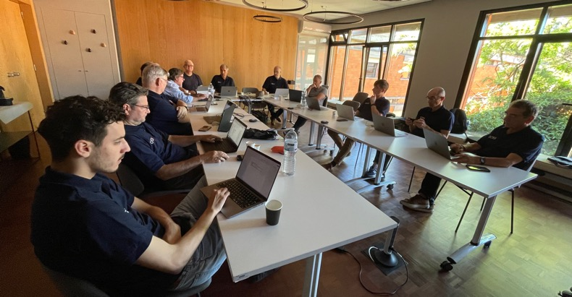
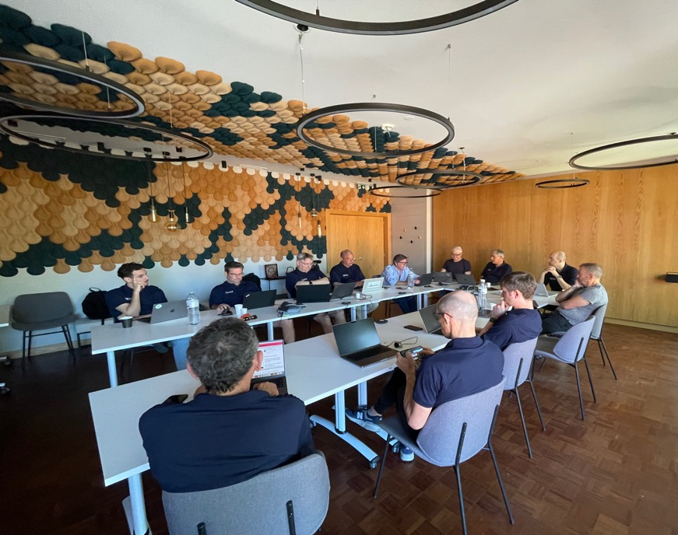
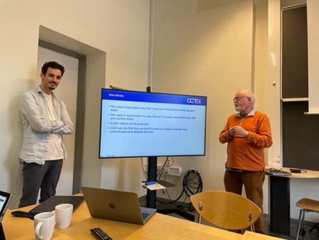
Work hard…
Notes:
This collaboration is unique and allows the community already for years to streamline procurement processes, reducing redundancy and administrative burden for participating entities. Continuously improving its procedures and documentation, adapting to current times, requirements, developments and dynamics in (EU) legislation. The new OCRE2024 initiative highlights the transformative potential of community collaboration in cloud procurement. By joining forces, we achieve better outcomes and create a more resilient, future-proof and innovative research and education ecosystem in Europe. GEANT’s central role is crucial in harnessing our community’s collective power while honouring the unique needs of each participating entity.

Slide 6
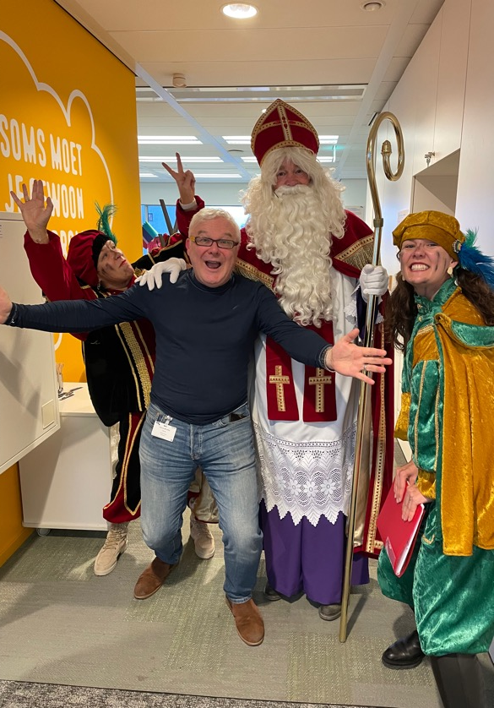
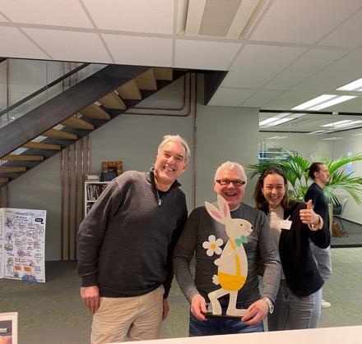
Even during the holidays…

Slide 7
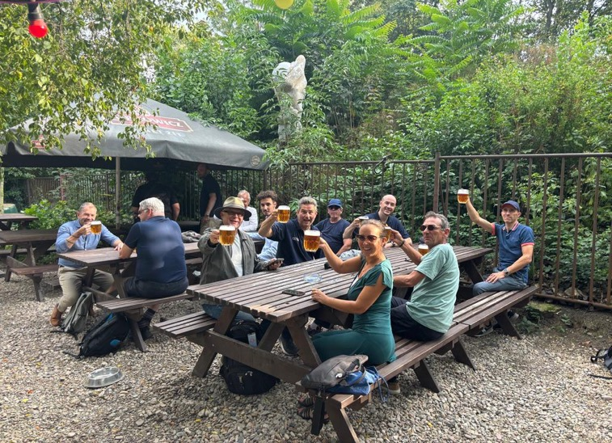
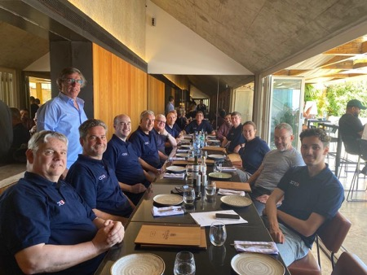
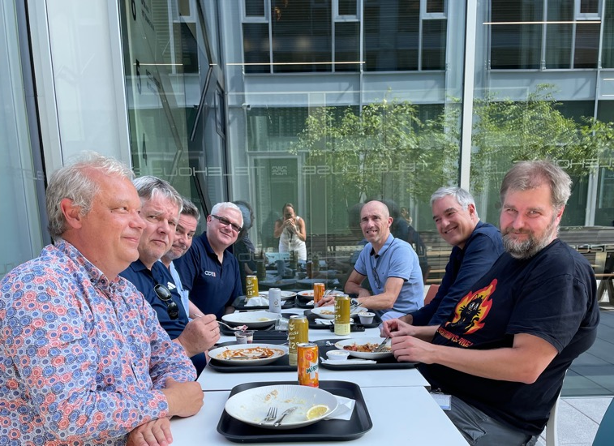
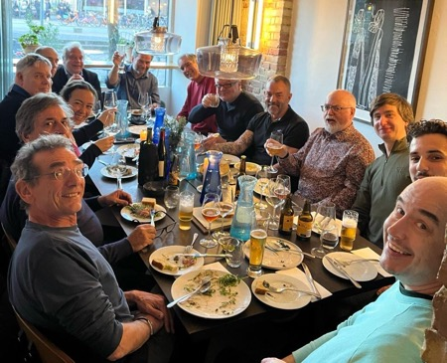
Play hard!
Notes:
Fortunately we’ve also got a lot of fun together while battling through

Slide 8
Results and key benefits for the R&E Community
Easy to use and compliant agreements. Fitting requirements of the R&E community
Set up of Cloud
Identity Management
Shared use across institutions
BYOL
Local support & trainings
Access to best in class suppliers and technologies. Suppliers are continously monitored and managed
Pricing & Conditions
Minimal discount 8%
Access to vendor’s senior management via GÉANT CMG
Access to trainings and workshops on new technologies
Services offered by suppliers are compatible with GÉANT infrastructure
Connectivity
Peering Connection (Géant / NREN)
Ingress fully waived
Minimum Egress waiver caped at 15% of monthly consumption and exit support
Data Protection
GDPR analysis updated yearly
Information of data processing changes during contract
No AI training with customer data
Available standard GPA upon request
Safe data handling, GDPR compliant
Ease of doing business, reporting
Reporting
Online Portal
Split billing and E-invoicing / billing in local currency
Security incident reporting

Slide 9
With focus on sustainability
Minimum Requirements:
Real-time insights on sustainability key figures
Demonstrate Corporate Social Responsibility
Provide free sustainability workshop
Annual institute-specific sustainability analysis and recommendation
No used European data has a Power Usage Effectiveness
At least 70% renewable energy in 2024 and 100% before 2030
Awarding criteria:
Green Energy usage
Support reporting of the Carbon footprint
Notes:
R&E institutes are, as we are all, increasingly aware of their organisation’s carbon footprint and Social Responsibility. Many have (or will have) policies and or legislations, dictating that they record the carbon footprints of individual activities or departments, and define steps to lower these footprints. In addition, organisations are also required to report on sustainability figures.
When looking at the carbon footprint of their IT department, institutes should not only be able to measure the footprint of their own datacentres, but also that of the cloud services they use through this ITT. Transparency on sustainability is one of the most desirable additional requirements for institutes and NRENs in multiple countries.

Slide 10
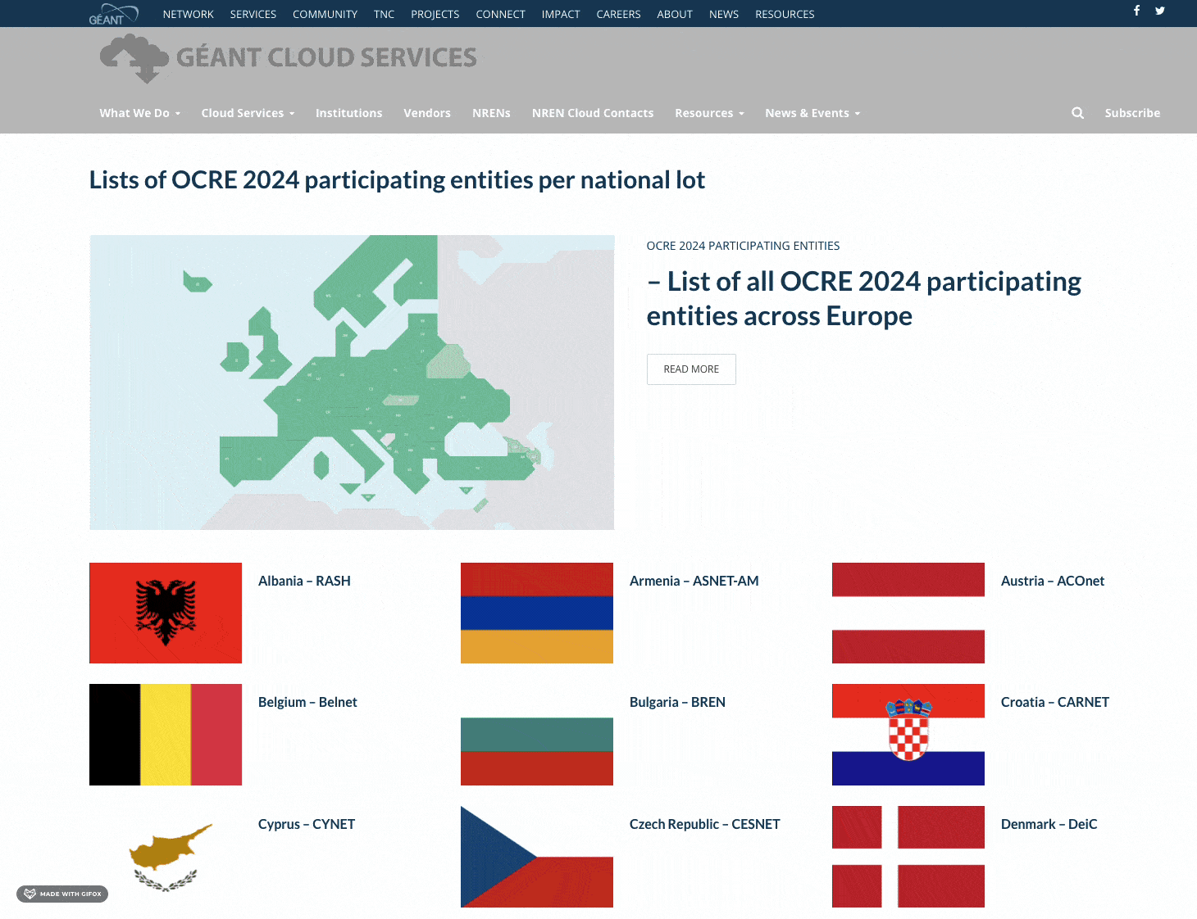
Participating entities

Slide 11
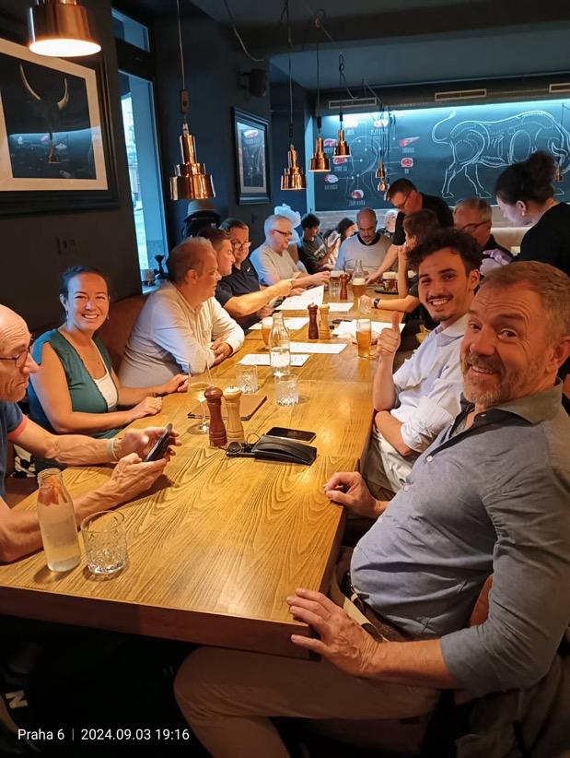
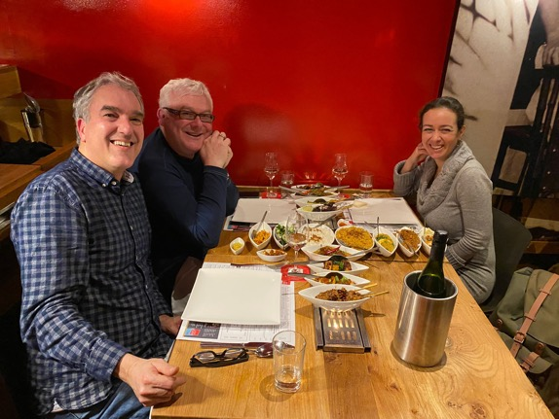
We will be ready for more…
Happy ever after
Notes:
Together, we are not merely procuring cloud services; we are building a stronger, more connected future for research and education across Europe. GEANT’s central role is crucial in harnessing our community’s collective power while honouring the unique needs of each participating entity.

Slide 12
Thank you!
Monique.pellinkhof@geant.org

