Slide 1
The NIS2 Directive
What do you need to know?

Slide 2
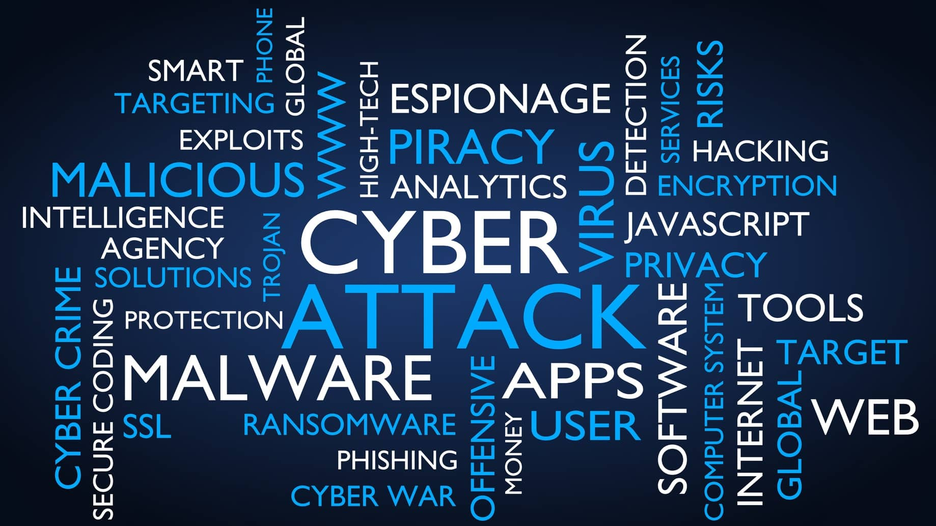

Slide 3
We can pass a law to solve that?
Critical Infrastructure
NIS Directive (2016)
Wider Economy
NIS2 Directive (2022)
First EU-wide cyber directive which aimed to enhance the cybersecurity of critical infrastructure obliging operators of essential services to manage security risks and report significant incidents.
NIS2 expands the scope to more sectors, strengthens security requirements, and introduces stricter supervisory measures and enforcement.
Cyber Certification
Cyber Security Act (2019)
Secure By Design/Default
Cyber Resilience Act (2024)
Establishes a framework for EU-wide cybersecurity certification schemes for ICT products, services, and processes.
Mandatory cybersecurity requirements for products with digital elements, aiming to ensure that hardware and software products are designed, developed, and maintained with robust cybersecurity features throughout their lifecycle.
Skills, Research, Industry
ECCC Regulation (2021)
Monitoring, Detection & Response
Cyber Solidarity Act (2024)
This regulation creates a central EU Cybersecurity Competence Centre to pool resources and expertise, drive research and innovation, and enhance the EU's cybersecurity industrial base and competitiveness.
Creating a European Cyber Alert System for detecting and responding to threats, establishing a Cybersecurity Emergency Mechanism with a reserve of incident response companies, and setting up an EU-wide alert system.

Slide 4
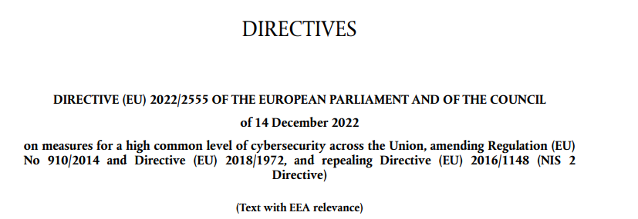
The Network and Information Systems (2) Directive
46 Articles, 142 Recitals & 3 Annexes , 41,696 words.
Notes:
NIS1 was a much more diminutive read at 16k words.

Slide 5
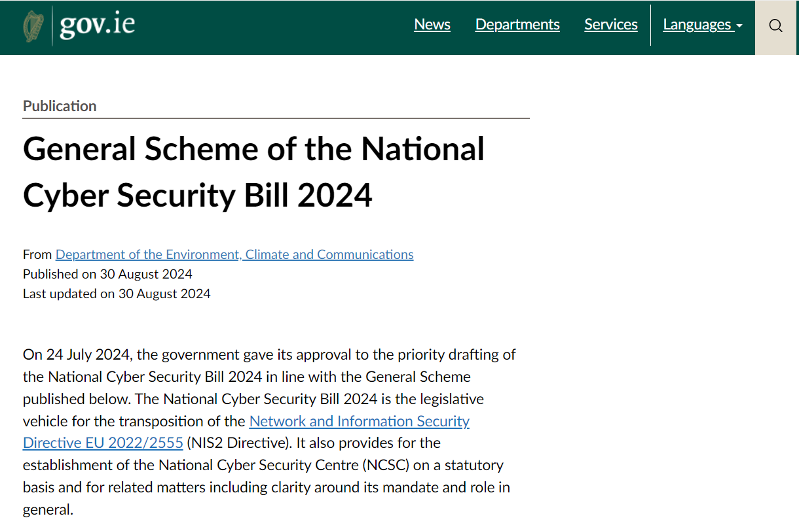

Slide 6
www.gov.ie/pdf/?file=https://assets.gov.ie/303962/aa59bc78-e82d-4e74-9e95-b05c0c5a83a1.pdf#page=null

Slide 7
https://eur-lex.europa.eu/legal-content/EN/TXT/HTML/?uri=OJ:L_202402690#d1e43-1-1

Slide 8
I don’t like the sound of all that…
1
Am I in scope of the NIS 2 Directive?

Slide 9
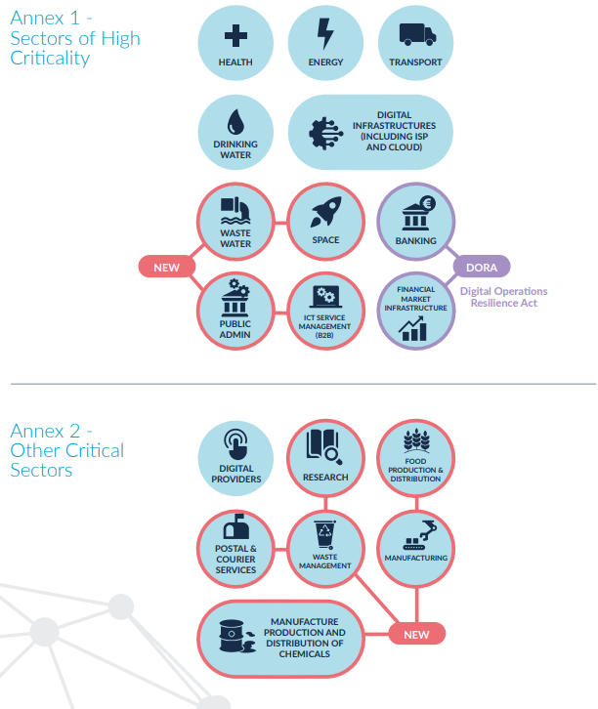
Do I operate in one of the sectors listed in Annex I or Annex II?
Pay close attention the definitions in NIS2 and Annex I & II
You may need to refer to definitions in other directives
You may need legal advice
You know your business best

Slide 10
What size is my organisation?
LARGE
MEDIUM
MICRO/SMALL
< 50 people employed
< €10m revenue or €10m balance sheet
< 250 people employed
< €50m revenue or €43 balance sheet
250+ people employed
€50m+ revenue or €43+ balance sheet

Slide 11
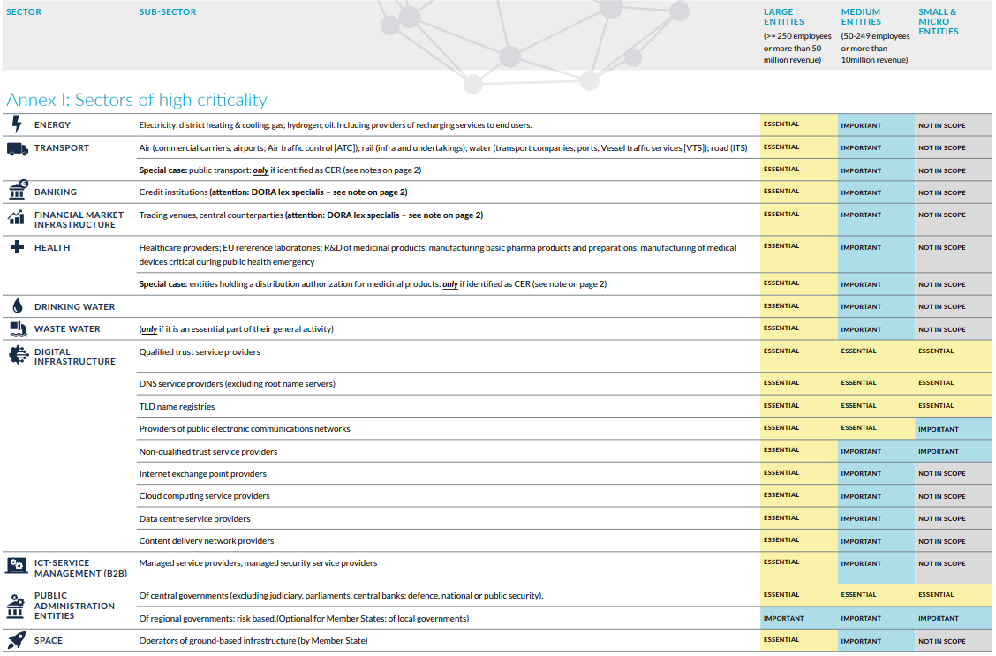

Slide 12
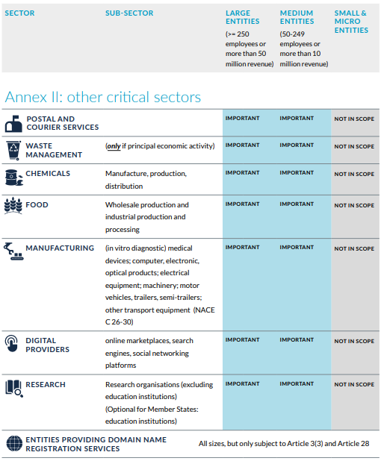

Slide 13
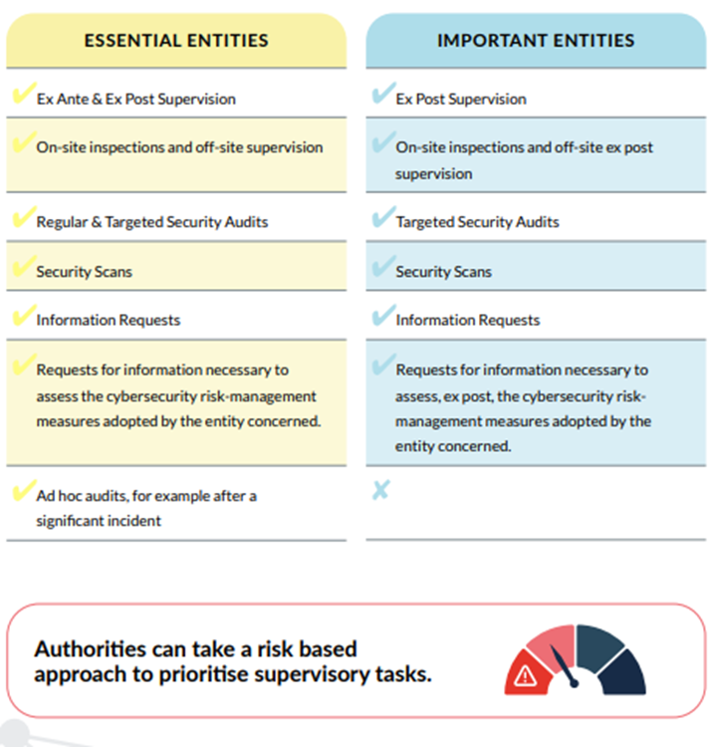
Essential vs Important
Same obligations – supervision requirements are different.

Slide 14
Okay, if we’re in scope …
2
What do I need to do to comply?

Slide 15
Evidence of compliance
Organisations need to meet the following requirements in order to comply with the NIS regulations:
Risk management
Employee training on cybersecurity awareness, technical expertise, and reporting incidents efficiently
Audits conducted regularly
Incident reporting to NCSC
Cooperation and information sharing about cyber attacks

Slide 16
Oversight and Accountability
Cybersecurity is the board’s responsibility
Most important sentence in the Directive
Member States shall ensure that the management bodies of essential and important entities approve the cybersecurity risk-management measures taken by those entities in order to comply with Article 21, oversee its implementation and can be held liable for infringements by the entities of that Article.
Training to gain knowledge and skills to enable them to identify risks and assess cybersecurity risk-management practices.

Slide 17
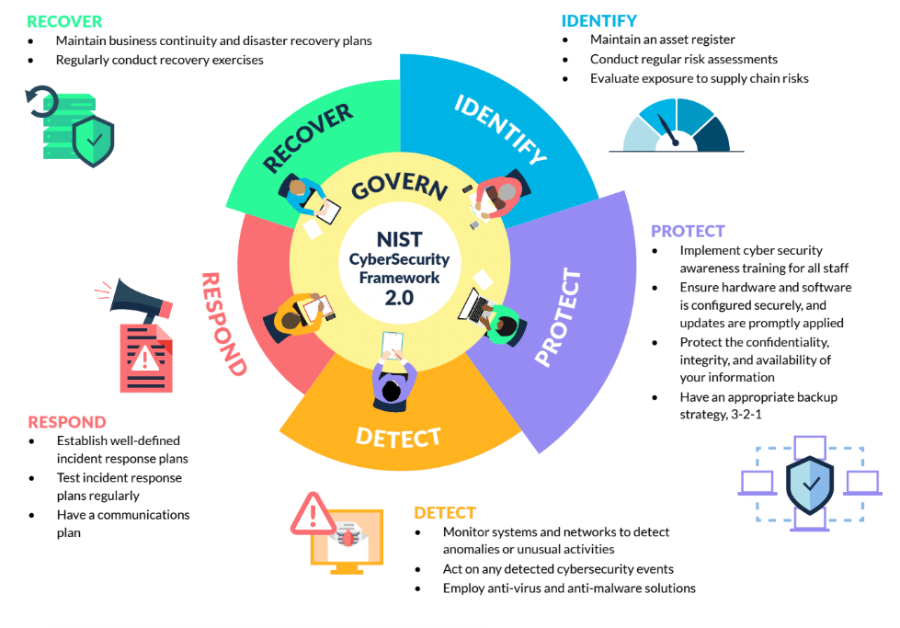
Risk Management Measures
Article 21 - “Cybersecurity risk-management measures” including at least the following...
Risk Analysis
Incident Handling
BCP / DR
Supply Chain Security
System acquisition, development and maintenance (vuln mgmt.)
Security Audit
Basic Cyber Hygiene & Awareness Training
Cryptography & Encryption
HR security & Access Control
MFA
Secure Communications
Assess your current cyber security posture and maturity

Slide 18
National Competent Authorities (NCA)
Federated Model
NCSC will be NCA Coordinator.
Act as National Single Point of Contact (SPOC)
Establish and chair an NCA Forum.
Assist new NCAs to build capacity.
Standardise guidance on Security Measures, Audit Methodology and Incident Reporting.
NCA Coordinator & SPOC
Energy
Transport
Digital Infrastructure
Health
Public Admin
Important Entities

Slide 19
Supervision and Enforcement
More robust powers, larger fines.
Supervision Measures.
On site inspections, off-site supervision, random checks
Regular & targeted security audits, ad hoc audits
Security scans, where necessary with the cooperation of the entity concerned
Access to documentation, policies, data, security audit results.
Enforcement Measures
To issue warnings, binding instructions, orders to cease conduct/implement recommendations
To designate a monitoring officer
Order entities to make public aspects of infringements
To notify those potentially affected by a cyber threat, and remedial measure they can take
To impose administrative fines
Further sanctions include – temporary suspension of service authorisation / temporary suspension of CEO or legal representative – where enforcement measures are ineffective

Slide 20
What about when things go wrong…
3
How do I report incidents, and what can I expect?

Slide 21
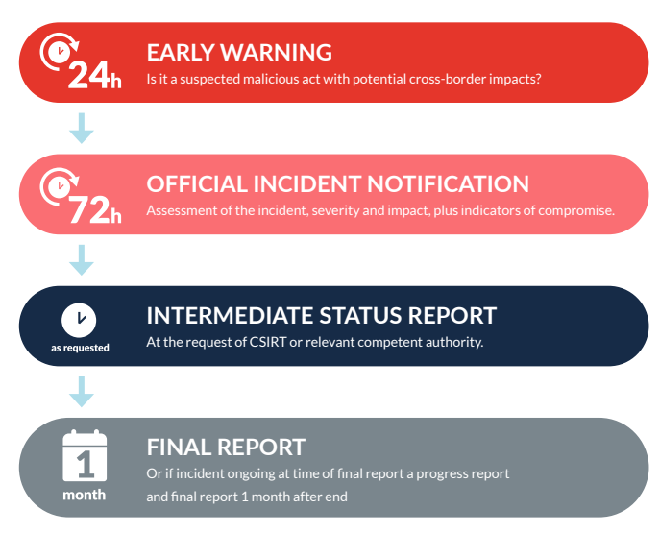
Incident Reporting (Article 23)

Slide 22
Incident Reporting (Art 23)
All significant incidents must be reported to NCSC within 24hrs.
Significant Incident:
Anything which affects or is capable of affecting operations or causing financial loss.
It has affected or is capable of affecting other natural or legal persons by causing considerable material or non-material damage
Early Warning within 24 hours
Initial notification within 72 hours
Intermediate report
upon request of CA or CSIRT
Progress report within one month
Final report within one month of resolution
Notes:
The early warning should only include the information necessary to make the CSIRT, or where applicable the competent authority, aware of the significant incident and allow the entity concerned to seek assistance, if required. Such early warning, where applicable, should indicate whether the significant incident is suspected of being caused by unlawful or malicious acts, and whether it is likely to have a cross-border impact.

Slide 23
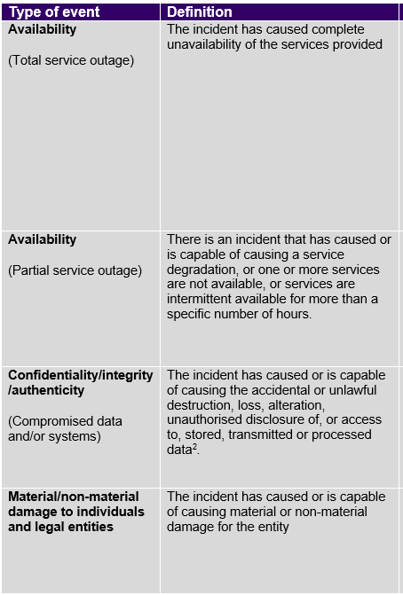
Significant Incidents
‘incident’ means an event compromising the availability, authenticity, integrity or confidentiality of stored, transmitted or processed data or of the services offered by, or accessible via, network and information systems;
Guidance on how to determine a significant incident will be provided (e.g a total outage of the service for >10 mins, or more than 5% of users cannot access the service for more than an hour etc.).
Sector and organisation specific context is very important. If in doubt – report.
“Initial Assessment: Importance of system affected to service, severity and technical characteristics of the cyber threat and underlying vulnerabilities that are exploited.”
Notes:
In making initial assessment: the affected network and information systems, in particular their importance in the provision of the entity’s services, the severity and technical characteristics of a cyber threat and any underlying vulnerabilities that are being exploited as well as the entity’s experience with similar incidents. Indicators such as the extent to which the functioning of the service is affected, the duration of an incident or the number of affected recipients of services could play an important role in identifying whether the operational disruption of the service is severe.
Member States should ensure that the obligation to submit that early warning, or the subsequent incident notification, does not divert the notifying entity’s resources from activities related to incident handling that should be prioritised, in order to prevent incident reporting obligations from either diverting resources from significant incident response handling or otherwise compromising the entity’s efforts in that respect.

Slide 24
What information is required?
Early Warning
24hrs
Incident Notification
72 hrs
A warning that a suspected significant incident has occurred. Whether it was caused by unlawful/malicious actions and whether it has a cross-border impact.
A notification that updates earlier information and also provides an initial assessment of the severity and impact and Indicators of Compromise (IOCs).
A final report that provides:
A detailed description of the incident, including its severity and impact.
The type of threat and root cause likely to have triggered the incident
Applied and ongoing mitigation measures
The cross-border impact (if applicable)
Final/Interim Report
1 month
Notes:
In making initial assessment: the affected network and information systems, in particular their importance in the provision of the entity’s services, the severity and technical characteristics of a cyber threat and any underlying vulnerabilities that are being exploited as well as the entity’s experience with similar incidents. Indicators such as the extent to which the functioning of the service is affected, the duration of an incident or the number of affected recipients of services could play an important role in identifying whether the operational disruption of the service is severe.
Member States should ensure that the obligation to submit that early warning, or the subsequent incident notification, does not divert the notifying entity’s resources from activities related to incident handling that should be prioritised, in order to prevent incident reporting obligations from either diverting resources from significant incident response handling or otherwise compromising the entity’s efforts in that respect.

Slide 25
What next…
4
What can I expect for the remainder of 2024?

Slide 26
Milestones
All NCA designations confirmed – July
NCA Forum Meeting 3 – July
Draft Security Measures Framework published for consultation – September
National Cyber Security Bill enacted – October
National guidelines on incident reporting and security measures – Q4
General Scheme brought to Government for Approval - July
EU-wide cross-border entities security measures and incident notification implementing act published – October
Cross-border entities list sent to ENISA – 17 Jan 2025
Q3/Q4 2024

Slide 27
Register as an Essential/Important Entity
NCSC will provide a single national platform
You need to submit after 17 Oct 2024:
Sector/Subsector
Name
Address
Up to date contact details (email, telephone, IP ranges)

Slide 28
Education Entities
4
Where do we fit in?

Slide 29
NIS2 Education Catagories
Based on the NIS2 Directive, educational institutions fall into several relevant categories:
Higher education institutions that conduct critical research
Research institutions engaged in security-relevant work
Institutions handling sensitive data at scale
Conduct research in critical areas (AI, cybersecurity, biotechnology)
Participate in EU-funded security research
Collaborate with critical infrastructure sectors
The definition of a research organisation in the draft National Cyber Security bill is:
“ ‘research organisation’ means an entity which has as its primary goal to conduct applied research or experimental development with a view to exploiting the results of that research for commercial purposes, but which does not include educational institutions. “

Slide 30
Evidence of compliance
Organisations need to meet the following requirements in order to comply with the NIS regulations:
Risk management
Audits conducted regularly
Employee training on cybersecurity awareness, technical expertise, and reporting incidents efficiently
Incident reporting to NCSC and NCA
Cooperation and information sharing about cyber incidents

Slide 31
Help from the NCSC
COREs
Member States shall facilitate the establishment of cybersecurity information-sharing arrangements.
Exchange on a voluntary basis relevant cybersecurity information among themselves, including:
information relating to cyber threats,
near misses, vulnerabilities, techniques and procedures,
indicators of compromise, adversarial tactics, threat-actor-specific information, cybersecurity alerts,
and recommendations regarding configuration of cybersecurity tools to detect cyberattacks.

Slide 32
CORE Network
Collaboration
To establish, mature and maintain efficient and effective Cyber information sharing groups (COREs) across the Government, Energy, Digital, Health, Local Government, Transport, and Education sectors.

Slide 33
NCSC and Incident Response
What services are available as an essential/important entity?
Preparation
Incident Response Planning & Exercises
Detection and Analysis
Containment, Eradication & Recovery
Post Incident Activities
Cyber Threat Intelligence
MISP
Digital Forensics
Malware Analysis
Network isolation
Crisis Communications
Malware Removal
Compromise Assessment
Data recovery
PIR
Lessons Learned
Report
CSIRT (Computer Security Incident Response Team) can support before during and after an incident alongside your security team or MSSP (Managed Service Security Providers)

Slide 34
Thank you! ncsc.gov.ie/nis2 nis2.gov.ie

