Slide 1
Using GenerativeAI to enhance MS Lists
(Or using prompt engineering to write the code that I can’t write)
Rory O’Toole, Digital Advisory Centre, UCC
Notes:
Hello! My name is Rory O’Toole. I work in the digital advisory centre in UCC.
Over the past few years we have moved quickly from paper based processes to digital processes using tools like Forms, Lists, Power Automate and Power Apps<<click>>

Slide 2
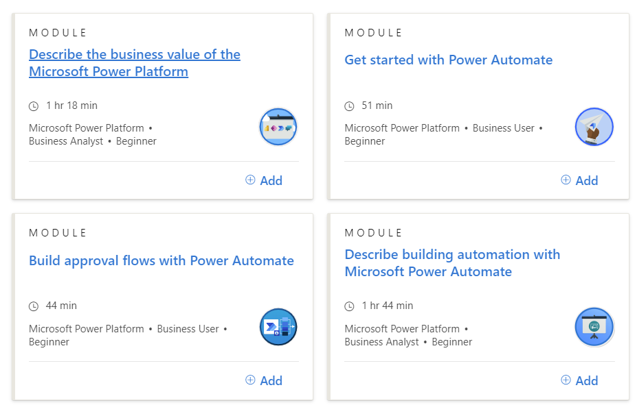
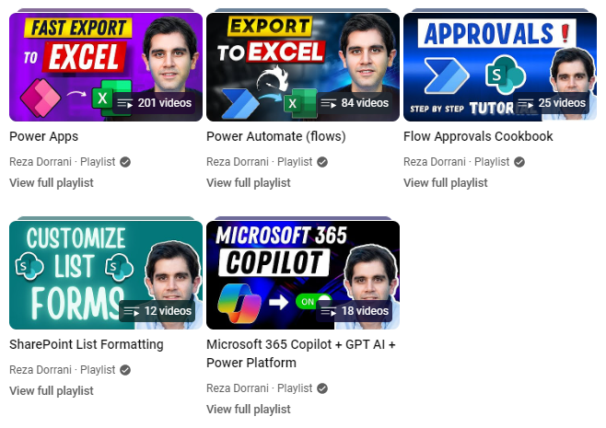
Using GenerativeAI to enhance MS Lists
(Or using prompt engineering to write the code that I can’t write)
Rory O’Toole, Digital Advisory Centre, UCC
Notes:
To help learn these new technologies, we have all gone down the same path of <<CLICK>> youtube videos, google, official training and so on.
Artificial Intelligence, or generative AI, has exploded <<CLICK>>, with chatgpt, Microsoft copilot, google gemini, and many more. Over the next few minutes I want to talk about using Copilot instead of googling and youtube videos.<<CLICK>>

Slide 3
Using GenerativeAI to enhance MS Lists
(Or using prompt engineering to write the code that I can’t write)
“I'm giving a talk on generative AI and copilot. I need an image for the first slide that represents AI / copilot. Can you help?”
Rory O’Toole, Digital Advisory Centre, UCC
Notes:
By the way, you might be wondering about the image on my first slide here. I was trying to find an image that represents AI, so I went into copilot and inputted this prompt: <<CLICK>> “I'm giving a talk on generative AI and copilot. I need an image for the first slide that represents AI / copilot. Can you help?” …And … it produced a picture of a robot copiloting a plane. It’s a cool picture, but the first thing to remember is that AI doesn’t always get it right!
And just another note – I will be referring to Copilot during this talk. Copilot is based on Chat-GPT, and really I am using it as a generic term for generative AI

Slide 4
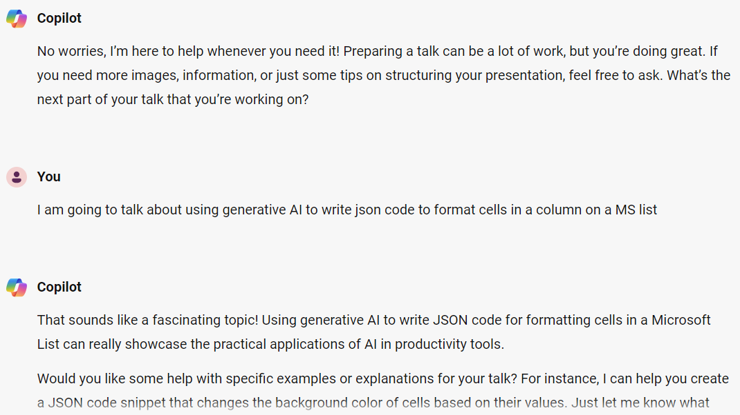
Notes:
OK, so this might sound a bit weird, but I generally interact with copilot as if it was a person. After Copilot produced the image on the previous page I typed Awesome! And it responded, a bit like a human, and asked how the rest of my talk was coming on. I mentioned I might need a bit of help later. <<CLICK>>And whaddaya know, but it asks what the talk is about, and I say I am going to talk about using generative AI to write json code to format cells in a column on a List.
I think they must have programmed some kind of positive encouragement into AI, because as you can see it thought that was a fascinating topic, and offered to help some more!
Joking aside, using natural language to describe what you need works well when working with AI

Slide 5
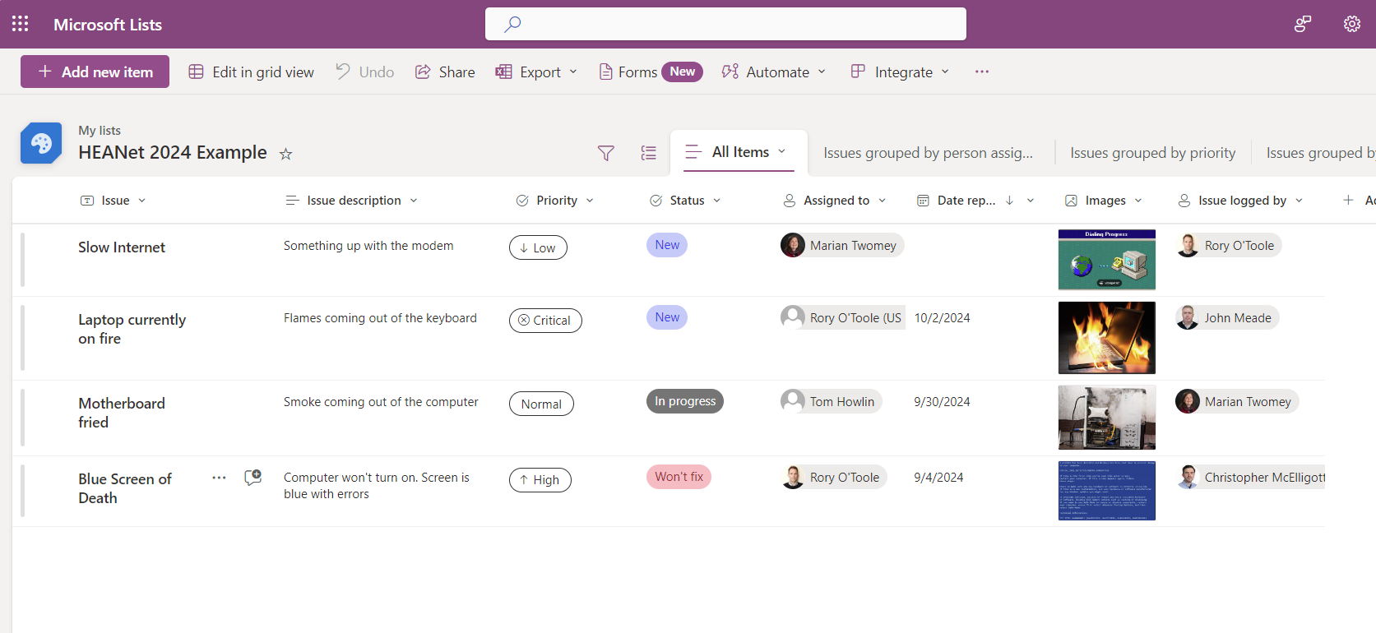
Notes:
OK, so here we have a List. This might be an example of an issue tracker list. We have some status columns, who logged the call, some image files and so on.
What I’d like to do is put a button on the List that I can use to run a Flow. For the sake of this example we are going to create a button that will send an email to the person who logged the issue
Now just to note, I would like to present this as a live demonstration, but I fear the technology might let me down! So I did a few screen capture videos that I will play here
So we switch over to co-pilot <<CLICK>> and ask it for help<<CLICK TO START VID>>. I put in my question, or prompt, explaining that I am looking for a button on my List. It responds with some information, and some code that I can copy.
I switch to my List, create the column that I want the button to appear in, go to Formating – advanced formatting and delete the basic code that is there, and paste in the code that copilot provided. Click save and you can see the buttons appear on the List

Slide 6
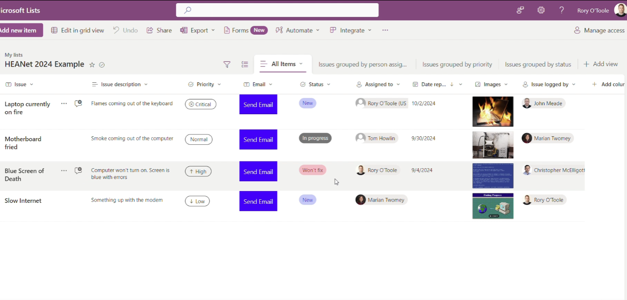
Notes:
Now, I have a button, but it’s not quite what I want. I want to change the colour and text, so I go back to copilot <<CLICK>>, and tell it I want a green button and bold white text <<CLICK to PLAY VID>>.
It gives me the new json code, so I copy that, go back to my list, open advanced formatting on the column again, and now the buttons are green with white text.

Slide 7
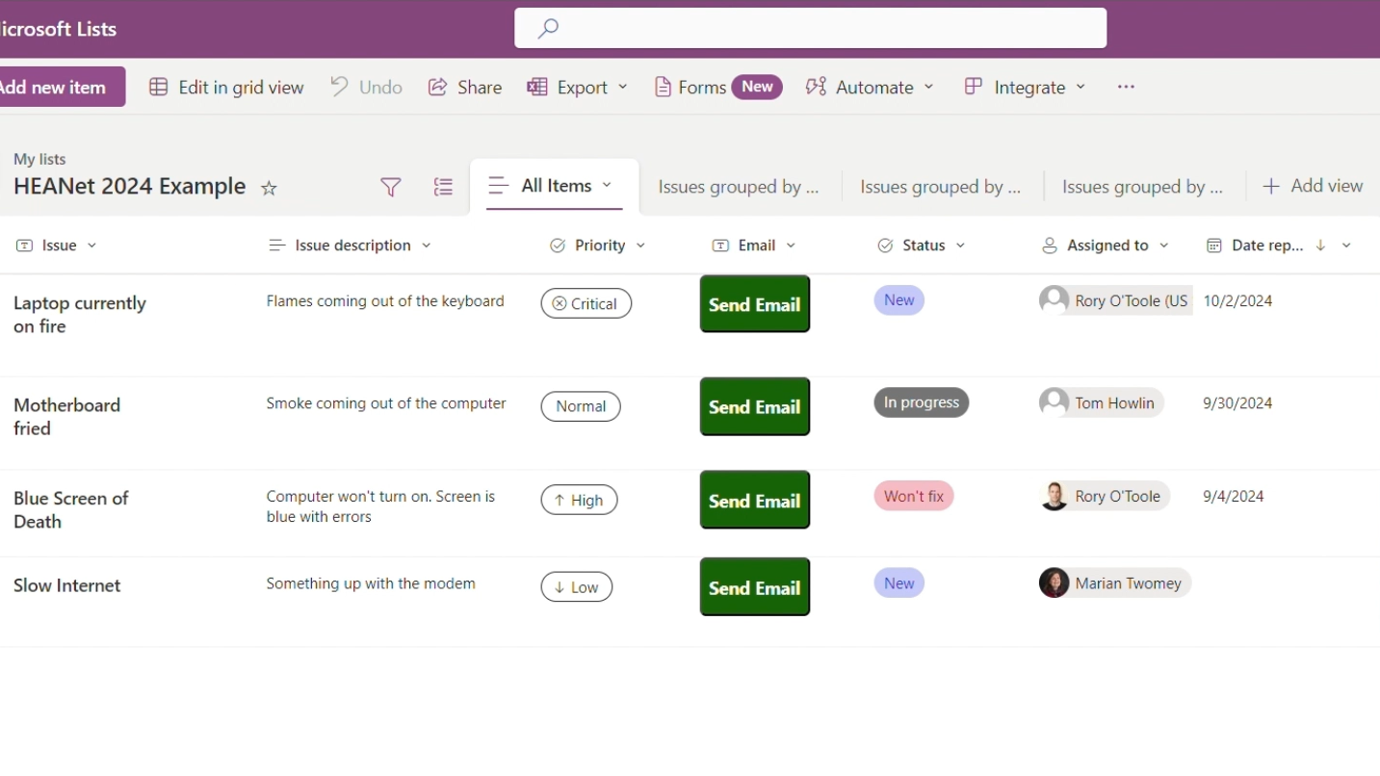
Notes:
So now we have a button, formatted as we want it, but one more thing – I only want the button to be available when the status of the item is ‘New’
We go back to Copilot <<CLICK>><<CLICK>>
I put in a prompt explaining what I want, and it gives me the code
This time it doesn’t work as expected, which is not unusual with copilot. So I go and rephrase what I am looking for and again copy and paste, and this time it works.
With AI there is an art to getting the prompts right, and you shouldn’t expect to get them right first time. <<CLICK>>

Slide 8
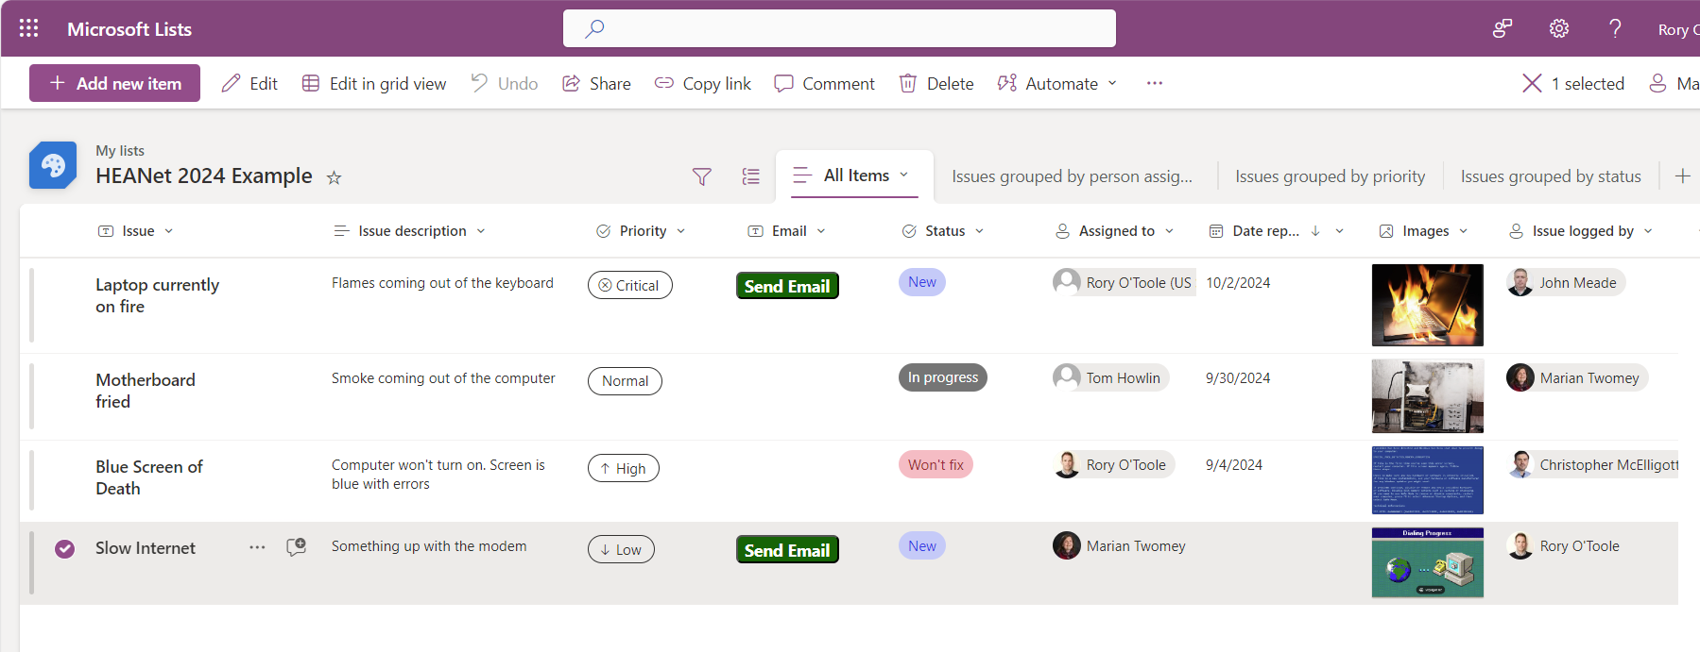
Notes:
So, now what we will do is click the button to run the Power Automate Flow. The Flow updates the Status column in the List so that it changes from New to In Progress, and sends an email. So, we’ll let it run now<<CLICK>><<CLICK>>
We can see that after the Flow is run, the status on the List changes to In Progress, and thus the button disappears

Slide 9
Thank You!
Rory O’Toole, Digital Advisory Centre, UCC
Notes:
THANKYOU!

