Slide 1
The ever changing and challenging role of the University CISO
Ransomware, Research data and everyone has a question about Artificial Intelligence…
Sara McAneney Cyber Security Manager/CISO

Slide 2
The Threat landscape
What are the hot topics on Campus?
Trinity's Cyber Security Programme 24-25
What are the emerging challenges
Questions on Artificial Intelligence…

Slide 3
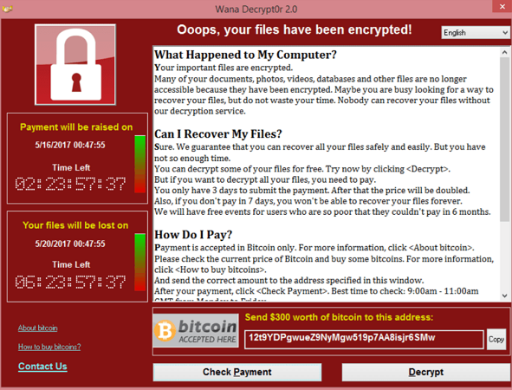
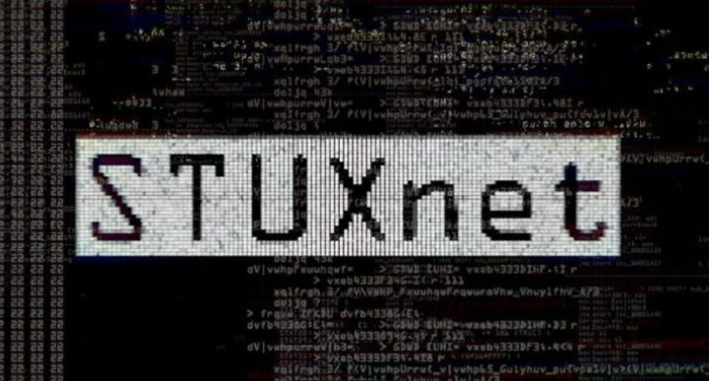
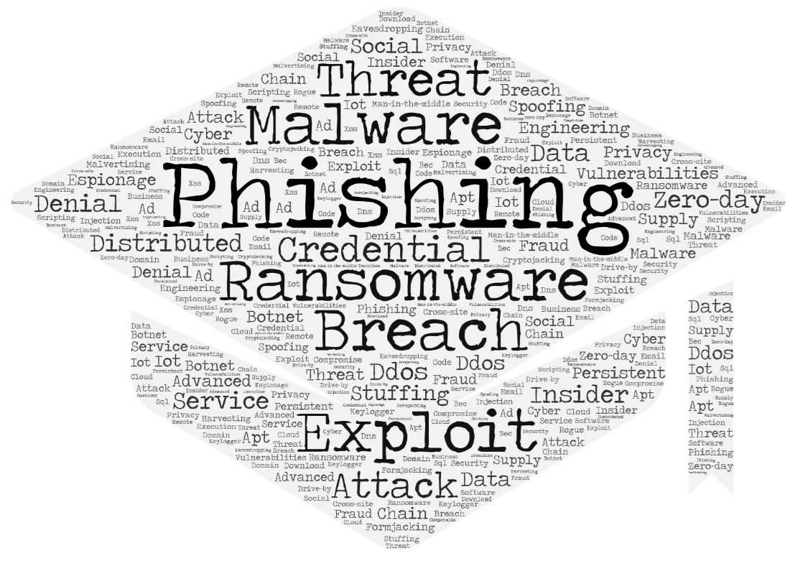
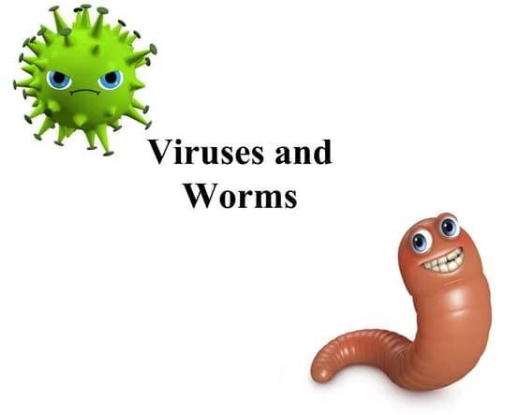
Evolution of Cyber Threats
Worms & Viruses Script kiddies DDoS
Increasingly sophisticated cyber attacks State Sponsored Threats Advanced Persistent Threats
Supply chain Attacks Cloud Vulnerability Exploitation
Internet of Things Quantum computing AI Enhanced Cyber Attacks
Cybercrime Expansion Identify theft Ransomware Online fraud Phishing

Slide 4
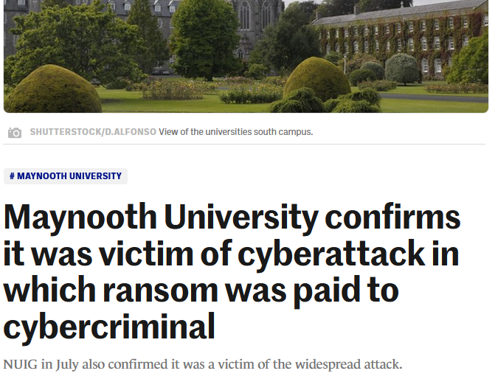
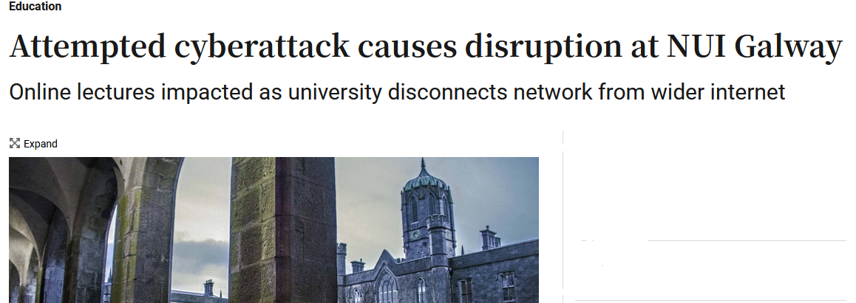
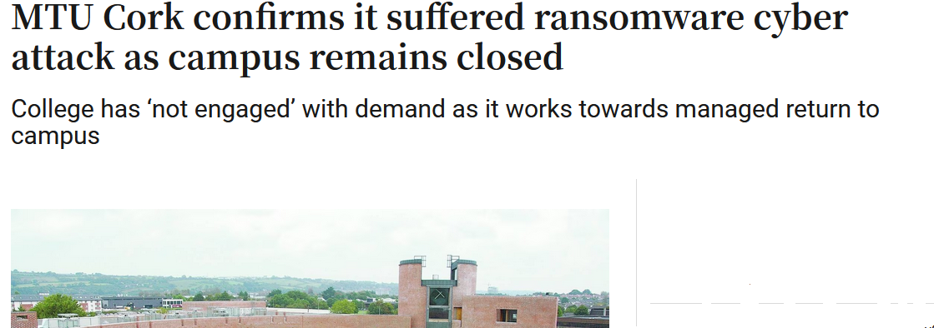
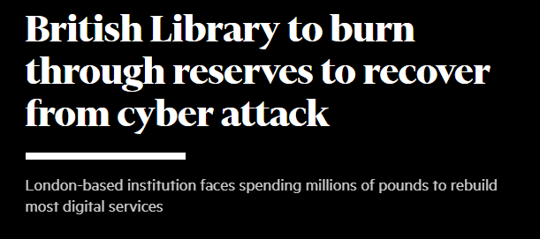
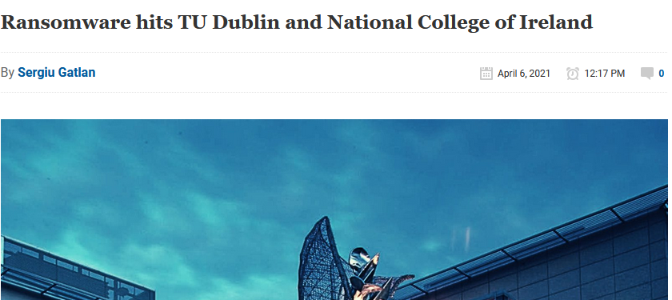
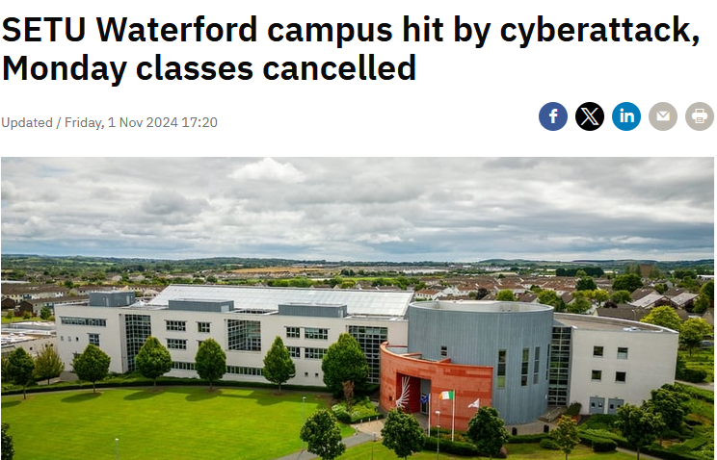
Higher Education Cyber Attack Timeline
May 2020 Software Vendor “Blackbaud” Ransomware attack affects Maynooth University and Galway University
September 2021 University of Galway attempted Cyber Attack
April 2021 National College of Ireland Ransomware attack
February 2023 Munster Technical University Ransomware attack
April 2021 Technological University of Dublin Ransomware Attack
March 2021 Queens University Belfast attempted cyber attack
October 2023 British Library Ransomware Attack
November 2024 SETU Waterford Campus Cyber Attack
May 2021 Health Service Executive Cyber Attack
Trinity College Dublin, The University of Dublin
4

Slide 5
Why did Higher Education/Health Systems/Libraries find themselves so vulnerable to Ransomware and Cyber Attack?
Flexibility and autonomy valued over centralised control and security
Large open networks connections to collaborating organisations
Autonomy and diversity in Schools and Research Units to operate computing environments
Rapid Growth - Numbers of Staff/Students/Devices/Accounts/Applications
Organisational Information made publicly available
Insufficient investment in security controls, monitoring & detection capabilities
Playing catchup, investment required
However the environment is not static…

Slide 6
What are the hot topics on Campus?
Digital Transformation
Data Management and Analytics
Hybrid Working and learning
Infrastructure for Research
Knowledge Security
Artificial Intelligence

Slide 7
Trinity Cyber Security Programme Mission
Ensure a resilient secure IT and data infrastructure which enables University digital activities and prevents disruption from cyber security events

Slide 8
Cyber Resilience depends on People, Processes and Technology
Resilience
Operations
Engagement
Policies, Education, Audit & Governance
Tools and Configurations
Monitoring, detecting and Responding

Slide 9
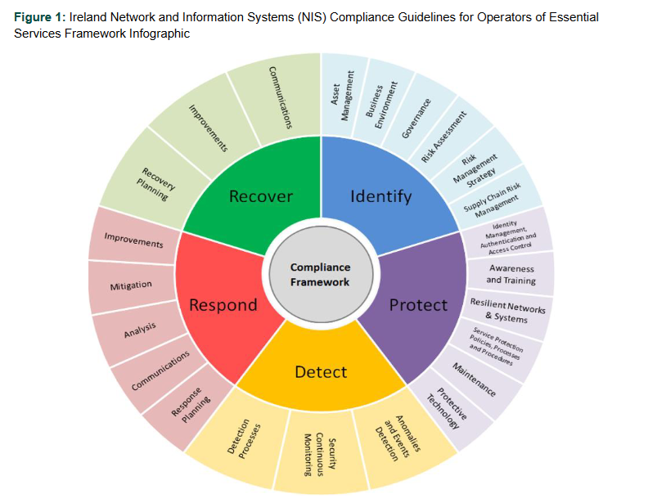
Aligning with Global Best Practices and Guidelines

Slide 10
Trinity Cyber Security Programme 23-25
Enhanced Governance
Updated IT and Cyber Policies
Risk Assessment Compliance with Legislation Vendor/supply chain Risk Management
Next Gen Network Redesign
Infrastructure Firewalls WAF
Research Data Storage
Identity/Access control
Endpoint Management
Enterprise Data Backup
End user Awareness and Training
Testing and Training simulation exercises
Malware and anomaly detection Enhancements
SIEM Implementation
24x7 SOC
Ongoing programme of Vulnerability Management and Testing
Third Party Penetration Testing
Focus on Incident Readiness Incident Response plans Cyber Runbooks Tabletop Exercises Business Continuity Planning Unit Communications Cyber Insurance

Slide 11
Cyber Programme Timeline
Category | Model Layer | Status | Team | Element | 2023 | 2024 |  |  |  | 2025
 |  |  |  |  | Q4 | Q1 | Q2 | Q3 | Q4 | Q1 | Q2 | Q3 | Q4
Technology | 5 | In Progress | DTI Programme | Network Redesign / Segmentation
Technology | 5 | In Progress | DTI Programme | Immutable Backups
Technology | 5 | In Progress | Infrastructure Ops | Additional Firewalls
Technology | 5 | In Progress | DTI Programme | VPN
Technology | 5 | In Progress | DTI Programme | Web Access Firewalls
Technology | 5 | In Progress | Infrastructure Ops | DR as a Service
Technology | 4 | In Progress | Desktop Team | Endpoint Management
Technology | 2 | In Progress | Research IT | Research Secure Data Storage
Technology | 5 | Additional | ITS Strategic Project | Identity & Access Management
Technology | 4 | Additional | Infrastructure Ops | Intrusion Detection
Technology | 4 | Additional | Infrastructure Ops | Privileged Access Management
Technology | 3 | Additional | Cyber / GRC Team Activity | Asset Management Solution
Technology | 2 | Additional | Desktop Team | Virtual Desktops for PhDs
Technology | 2 | Additional | Desktop Team | Virtual Desktops for Remote Workers
Service | 4 | In Progress | Cyber / GRC Team Activity | SOC/SIEM
Service | 4 | In Progress | Cyber / GRC Team Activity | Phishing Testing & Governance
Service | 4 | In Progress | Cyber / GRC Team Activity | Updated Cyber Training Course
Service | 4 | Additional | Cyber / GRC Team Activity | SOC/SIEM Additional services and logs
Service | 4 | Additional | Cyber / GRC Team Activity | Cyber Maturity Assessment, Non-ITS
Service | 4 | Additional | Cyber / GRC Team Activity | Cyber Programme Management
Service | 4 | Additional | Cyber / GRC Team Activity | Cyber Operations Team
Policy | 5 | In Progress | EA | Policy Approval - Technology Strategy
Policy | 5 | In Progress | Cyber / GRC Team Activity | Policy Update - Cloud Policy
Policy | 4 | In Progress | Cyber / GRC Team Activity | Policy Update - IT Security Policy
Policy | 5 | Additional | Cyber / GRC Team Activity | Policy Update - Storage Use
Policy | 4 | Additional | HR Policy Committee | Policy - Mandatory Training

Slide 12
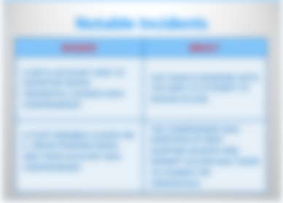
Cyber Security Threat Dashboard October 2024
2 Live Awareness Sessions for Staff Cyber Security and Data Protection. Promotion of the new IT and Cyber Security Policy and Cheat sheet resources. Release of new Data Protection and Cyber Security Training Module for all Staff

Slide 13
Identify
Board
Critical Infrastructure Committee
Driving Cyber Security Programme of Works
Audit & Risk
Institutional Advice & Cyber Reporting
Managing ITS Cyber and Risk Teams
FIT Digital and Cyber Group
Cyber Programme Manager/CISO
Governance Structures
Reporting to Committees and Board
Compliance with Legislation
IT and Cyber Policies
Risk Assessment and Management

Slide 14
Federated IT Governance -Closing the Cyber Security Gap
Ensure a uniform standard of security control implementation across the University
Encourage engagement with Training and awareness initiatives
Consultation on new policies and initiatives
Annual Sign off on compliance with IT and Cyber Security policy at the Faculty/Unit level

Slide 15
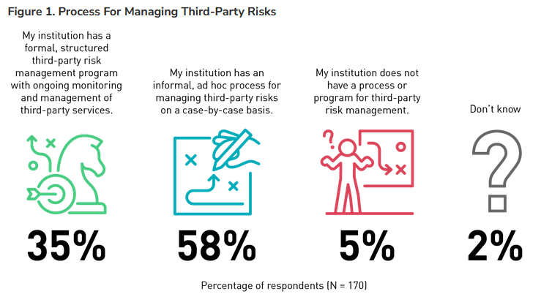
Supply Chain/Vendor Risk Management
Vendor Security Posture Assessment
Ongoing Compliance
Business area administrator policies and assistance
Contractual clauses risk and compliance
EDUCAUSE Quick Poll Results- August 2024: Third-Party Risk Management Practices in Higher Education

Slide 16
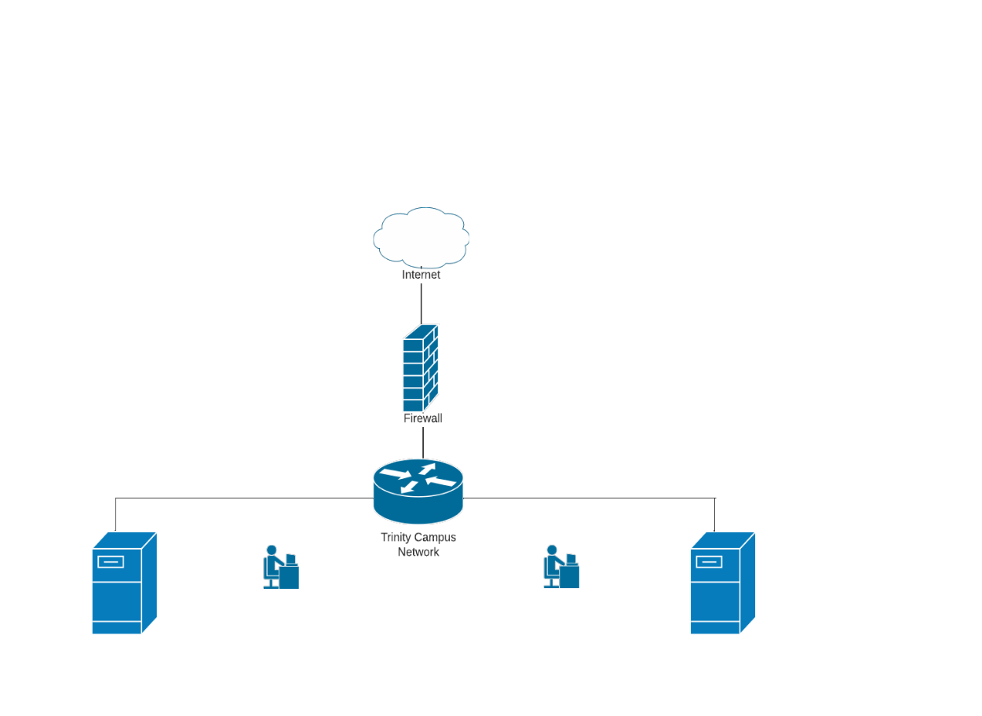
Third Party Risk Management – Where is our data?
Other Cloud Vendors managed by Local IT Teams and Business Areas and Individuals
Cloud Vendors – Managed by IT Services
On campus – IT Networks and Systems managed by IT Services and distributed IT Teams

Slide 17
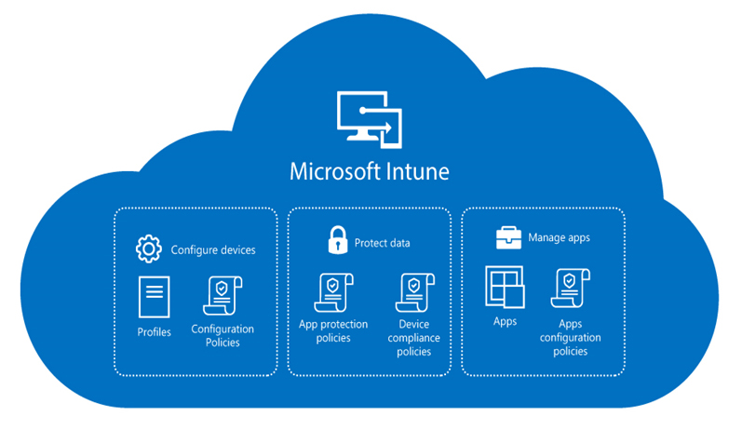
Protect
NGN Design Principles
Design principles validated by Gartner; designed to maintain our network's relevance in a continuously evolving landscape while proactively strengthening our defences against potential security risks.
Architecting a comprehensive HEI Design
Role-Based Access Control
Robust security
Future-Ready Scalability
Digital User Experience (UX)
Seamless integration between wired and wireless networks
Centralised Network Management (CNM)
High Availability Network
Energy-Efficient Practices
Technical Initiatives
Next Generation Network Project
Secure Research Data storage
Ransomware Resilience and hardening
Endpoint Management – Move to Intune/Defender
Enterprise Data Backup
End user Awareness and Training
Testing and Training simulation exercises

Slide 18
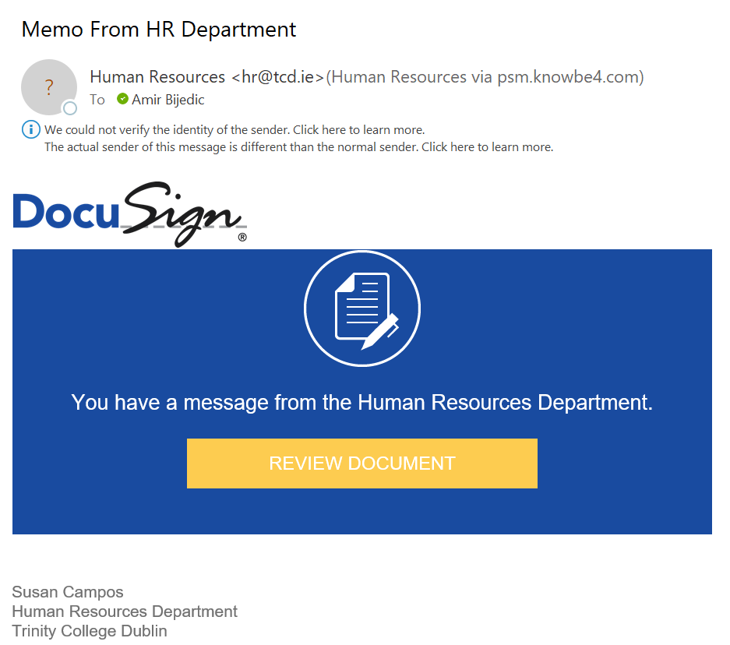
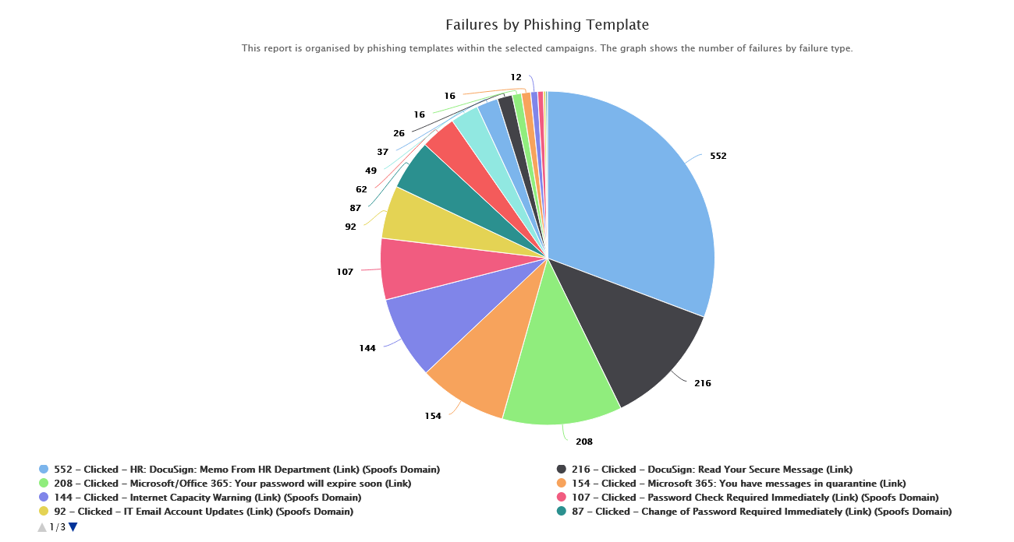
Phishing Testing and Training

Slide 19
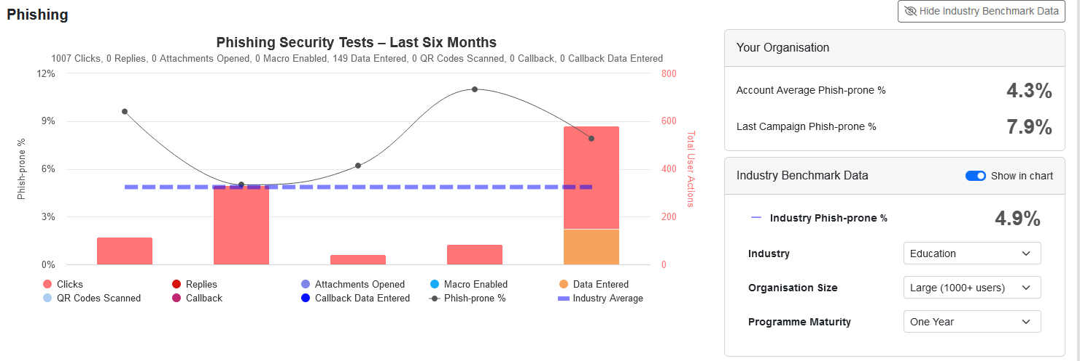
Phishing Testing and Training

Slide 20
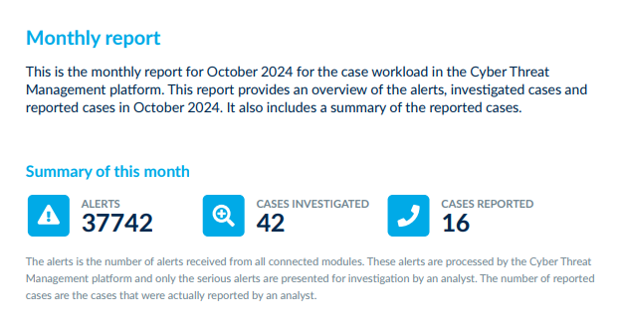
Detect
SOC Report October 2024
Logging and Monitoring
Anomaly Detection
SIEM
24x7 SOC
Vulnerability Management and Testing
Third Party Penetration Tests

Slide 21
Respond & Recover
University Incident Readiness Team
Crisis Communications Team
Unit Business Continuity Planning
University Emergency Management Team
Cyber Security Programme of Work
Incident Response plans
Cyber Runbooks
Tabletop Exercises – Test Readiness
Business Continuity Planning
Communications Internal/Public
Cyber Insurance
Incident Readiness Connected Streams

Slide 22
Emergency Response, Business Continuity, Crisis Management & Disaster Recovery
Response, Business Continuity, Crisis Management & Disaster Recovery
Emergency Response | Immediate response to, and management of, a major incident.
Business Continuity Management | ‘Plan B’ – continuing priority activity despite full or partial loss of key resource enablers (People, Premise, Process, Partners) & the Business Continuity Plan is activated prior to Maximum Acceptable Outage as per the Business Impact Analysis.
Crisis Management | A complex situation needing significant resources and time to manage with widespread, prolonged impact across the organisation.
Disaster Recovery | Restoration of ‘Plan A’ – returning to business as usual

Slide 23
The Future Challenges
Scale and speed of digital adoption
Diverse heterogenous environment
Conflicting priorities
Volume of institutional data outstripping the availability of secure data storage
Funding models and constraints
Third Party Risk Management – number of vendors increasing exponentially
End user Skill Gap -persistent vulnerability to phishing
New legislation and compliance requirements not well understood NIS2, AI Act
Rapid AI Adoption scramble for policies and procedure

Slide 24
Artificial Intelligence Concerns on Campus (FYI ChatGPT wrote this slide ☺)
Academic Integrity
The potential for AI to facilitate cheating or plagiarism, especially with tools that can generate essays or solve problems.
Bias and Fairness
AI systems can perpetuate or amplify biases, which raises concerns about fairness in admissions, grading, and other decision-making processes.
Data Privacy
Job Displacement
Ethical Use of AI
Quality of Education
Intellectual Property
Skill Gaps
Regulatory Compliance:
The collection and use of student data for AI applications may pose privacy risks, especially if sensitive information is involved.
Faculty and staff may worry about AI replacing certain roles, particularly in teaching and administrative tasks.
There are concerns about how AI technologies are developed and used, including issues related to surveillance, consent, and the ethical implications of AI-driven decisions.
Questions about whether AI can adequately replace traditional teaching methods and the potential loss of critical thinking skills among students.
Resource Allocation:
Universities may face challenges in managing resources and funding for AI initiatives, particularly in ensuring equitable access to technology.
Concerns about ownership of work created with AI assistance and the implications for research and academic publishing.
There’s a need for curriculum updates to prepare students for a workforce increasingly influenced by AI technologies.
Navigating evolving regulations around AI and ensuring compliance can be complex and resource-intensive

Slide 25
NCSC UK – Prediction for the near-term impact of AI on the cyber threat landscape
Evolution and enhancement of existing tactics, techniques and procedures.
Capability uplift in reconnaissance and social engineering,
Enable threat actors to analyse exfiltrated data faster and more effectively
Lowers the barrier for novice cyber criminals, hackers-for-hire and hacktivists
Enhanced access to tools will contribute to the global ransomware threat.
Commoditisation of AI-increases capability available to cyber-crime actors.
Increase the volume and heighten the impact of cyber-attacks

Slide 26
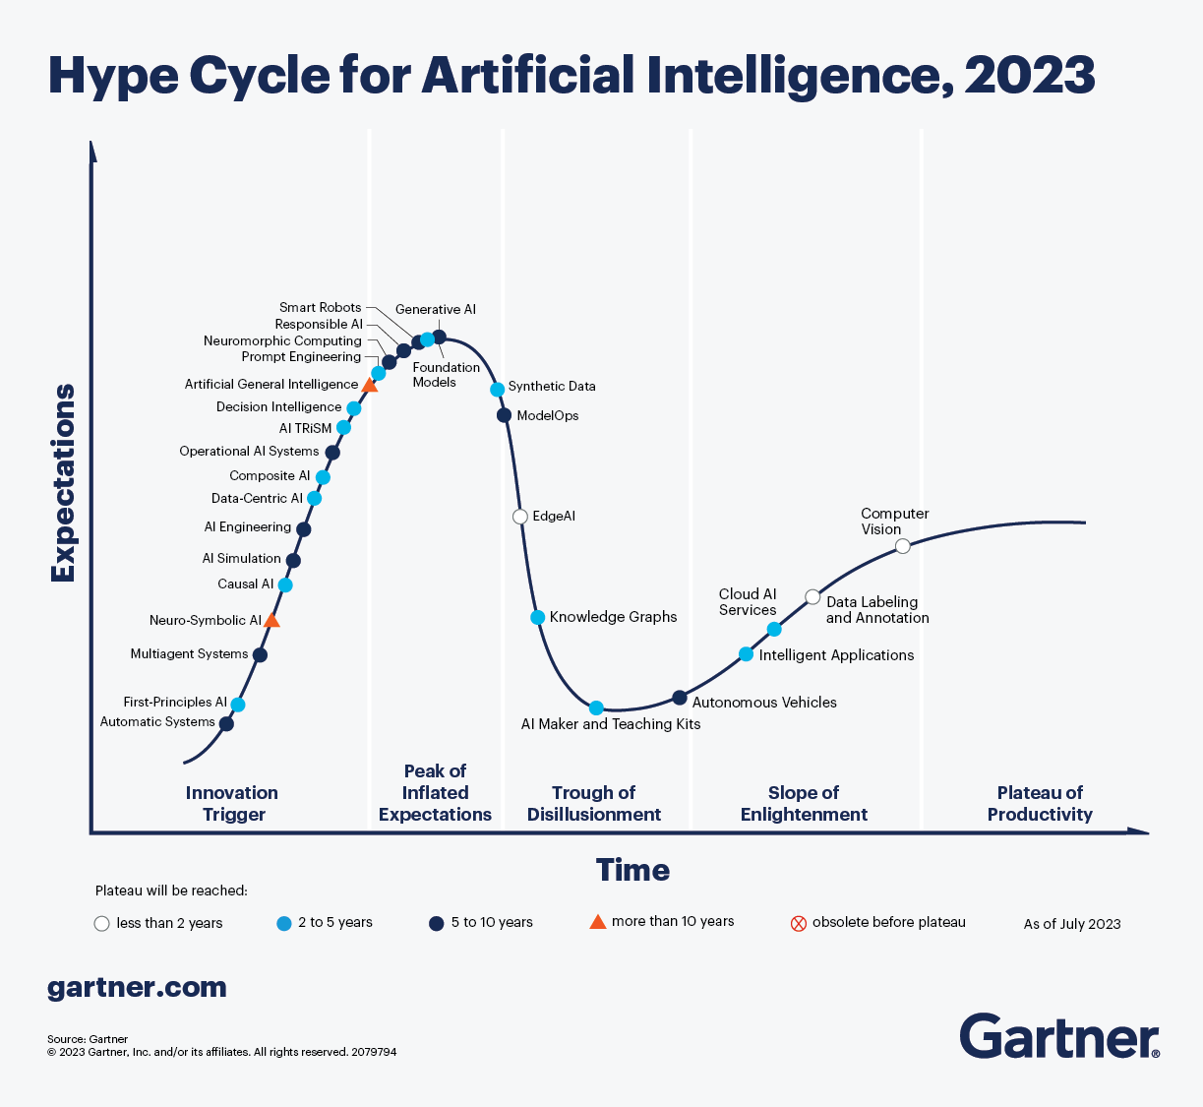
AI and the University IT Department
Keeping on top of the What/Where/Why/How of AI in our Infrastructure and Software Portfolios
Implementing policies, practices and procedures
Educating Users, providing useful guidance
Answering all those questions….

Slide 27
Questions?

