Slide 1
A brief dive into general cybersecurity awareness Threat modeling
Christo Butcher ◂ Executive Consultant ◂ Fox-IT (NCC Group)

Slide 2
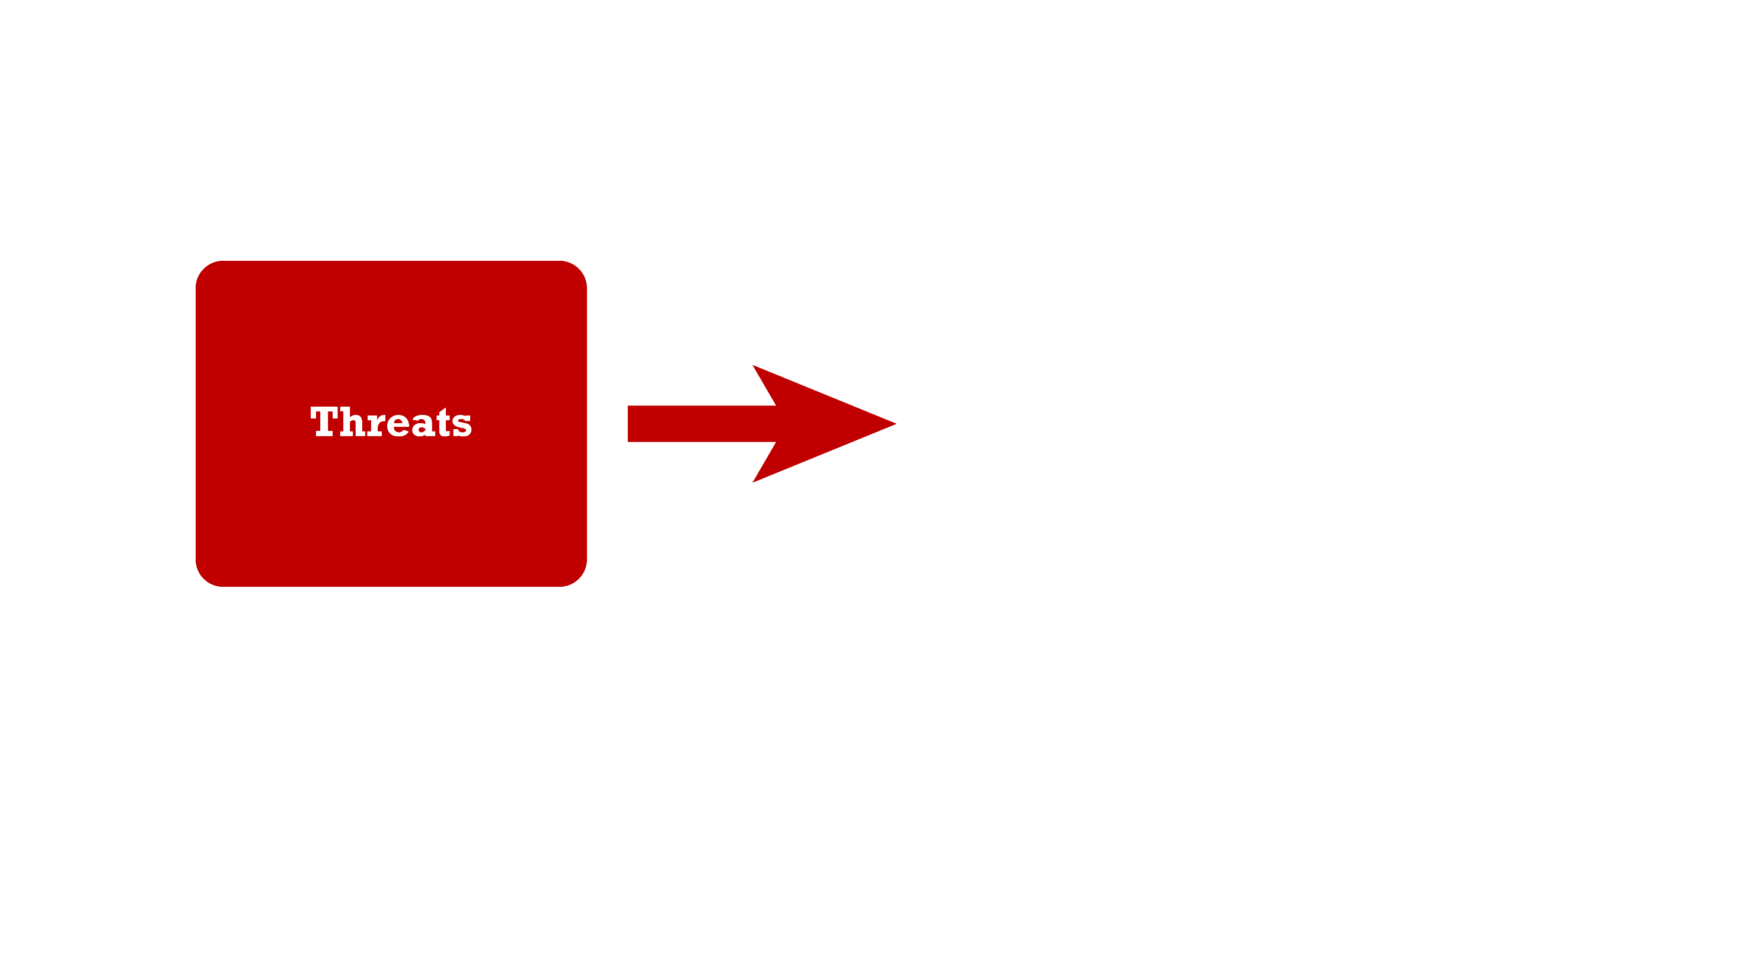

Slide 3
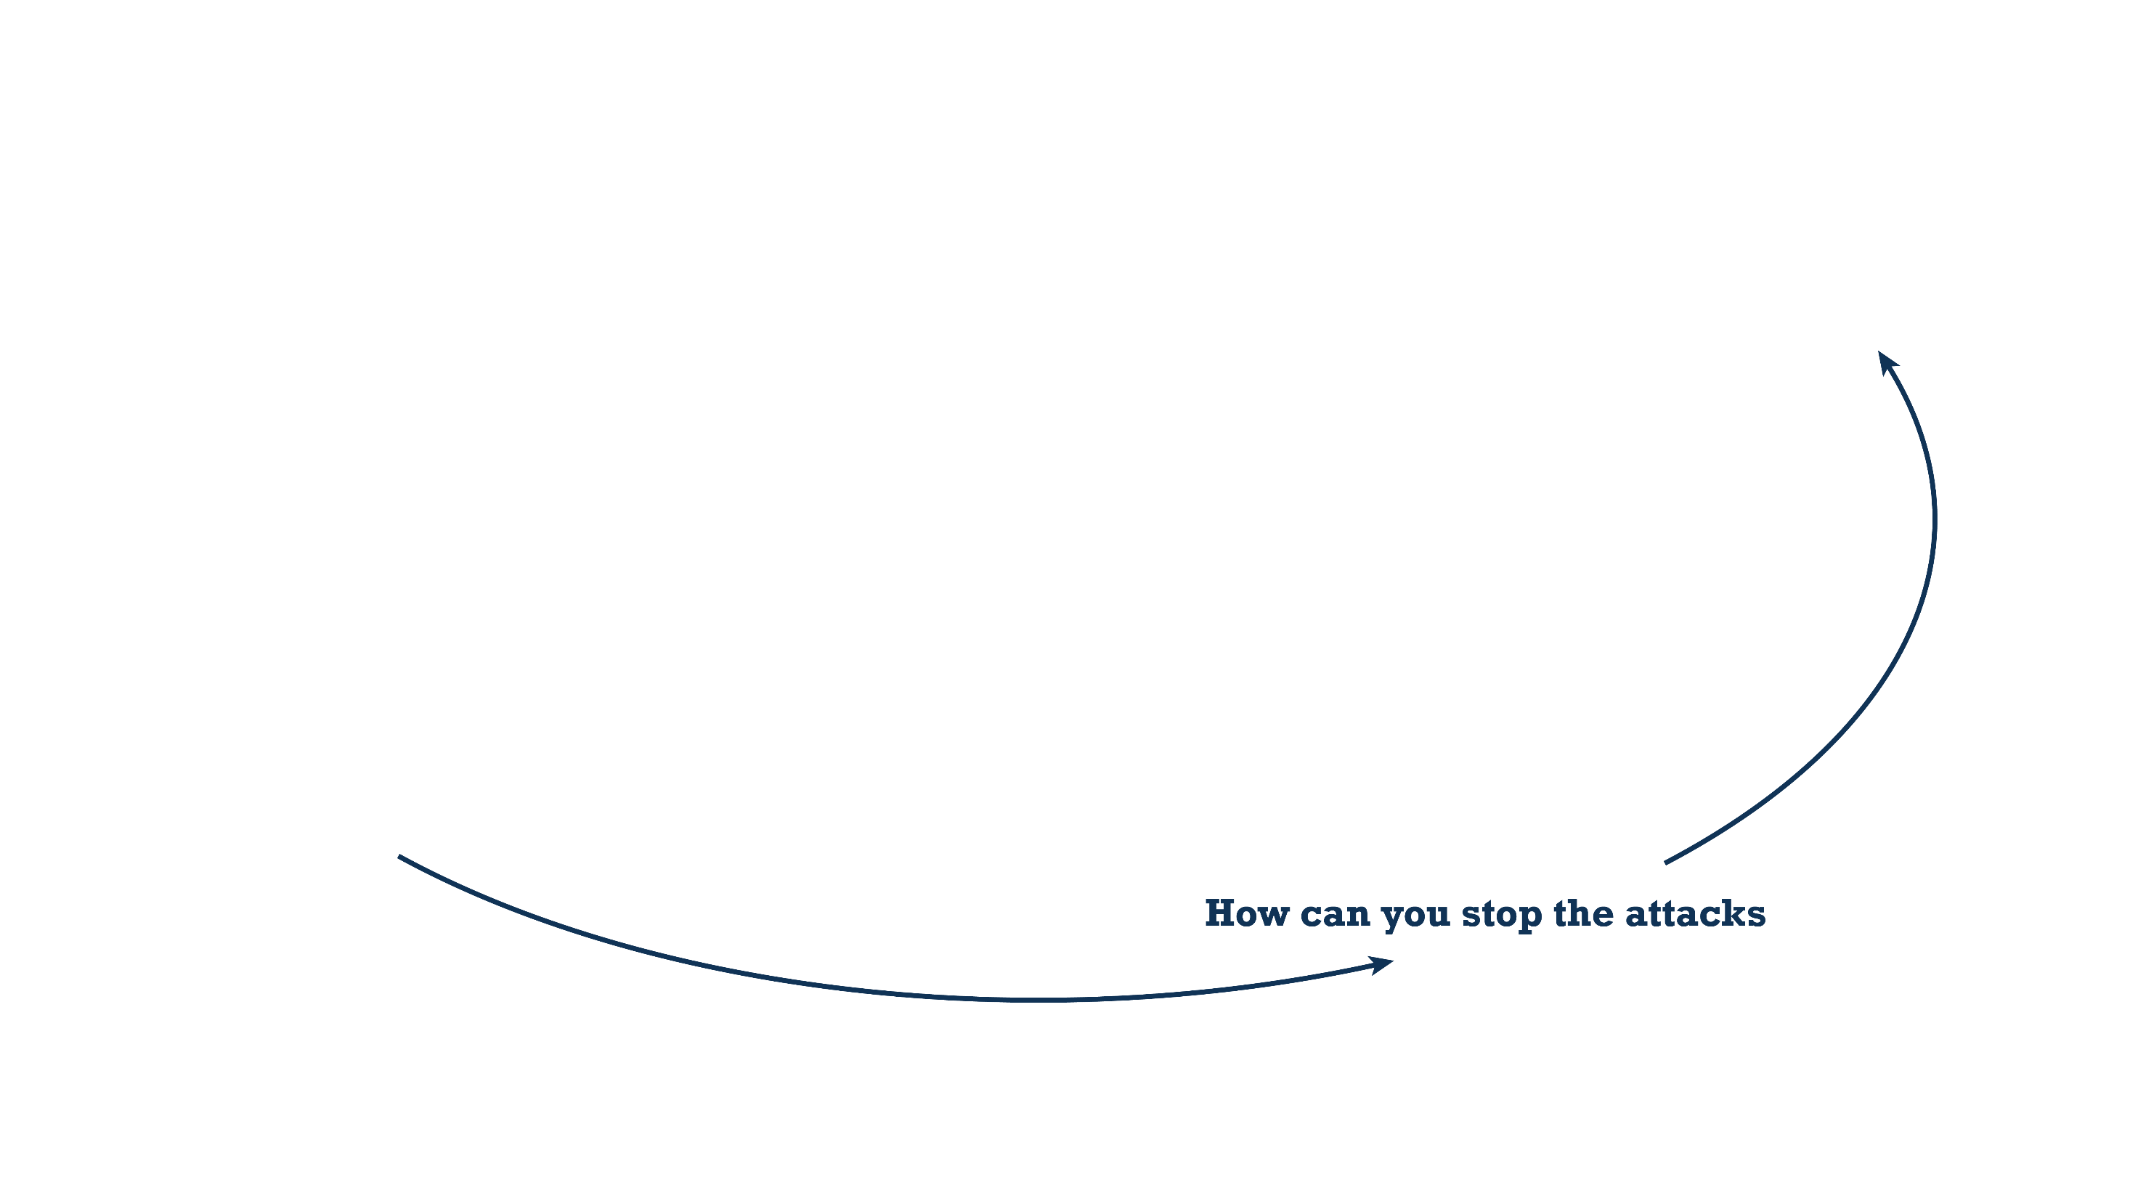
Notes:
Key messages:
Security only has value in the context of these two things:
What we want to secure (the system);
The threats (kind of risk) that system faces.
So we should optimize security based on the threats we must protect it against.
The system and threats (and risk appetite) change over time, so we should have a cycle to maintain optimal security.

Slide 4
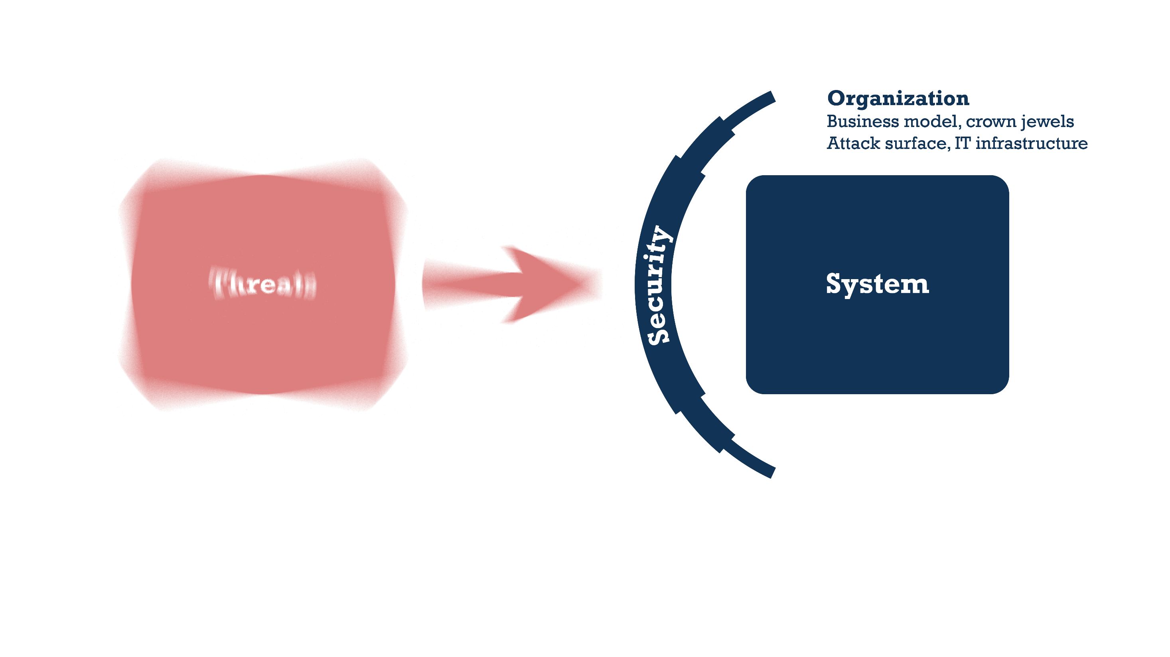
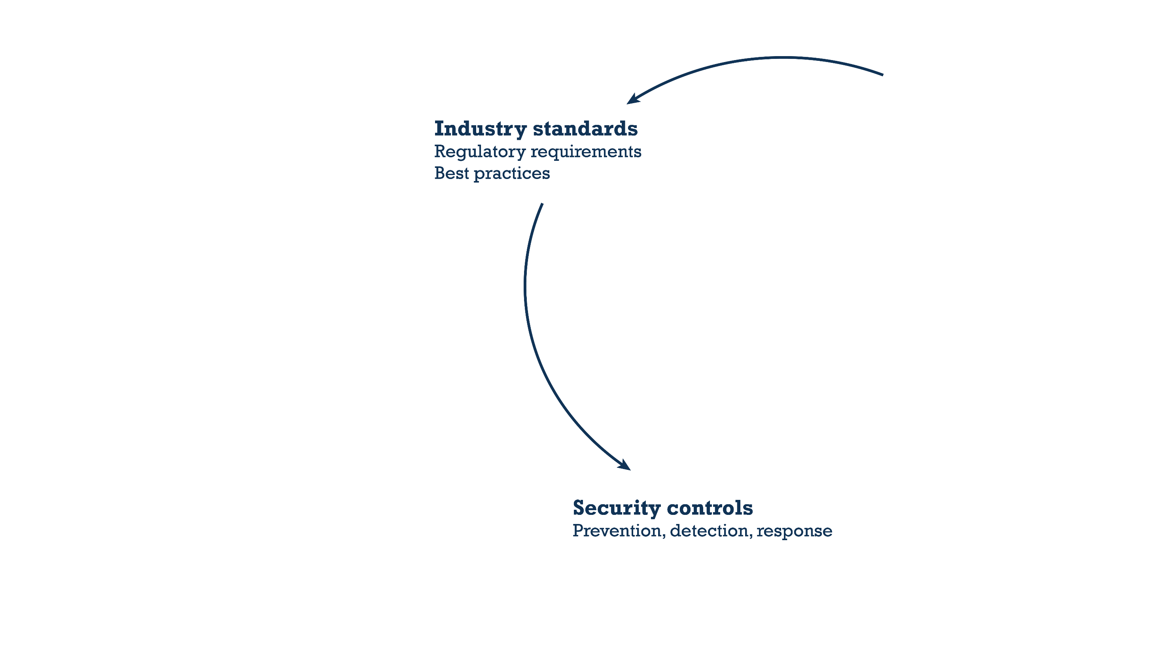

Slide 5
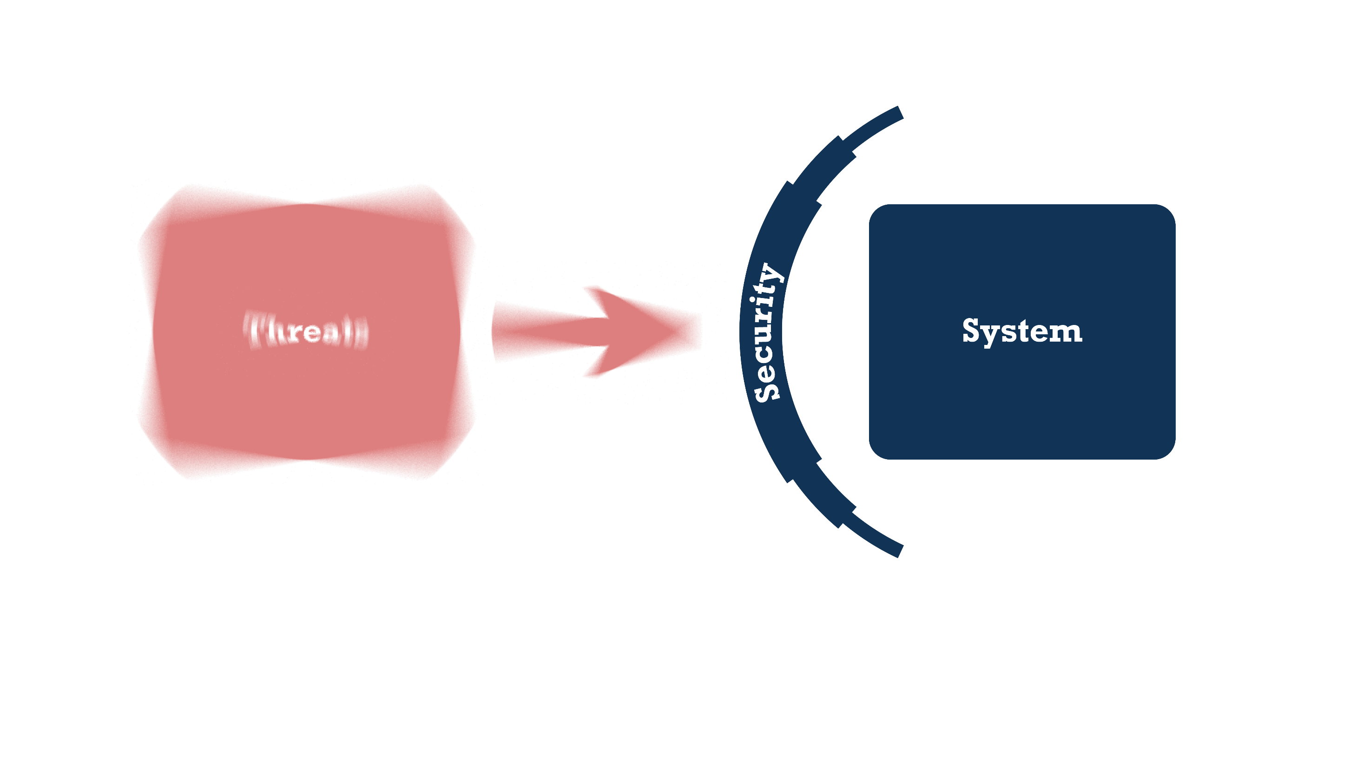

Slide 6
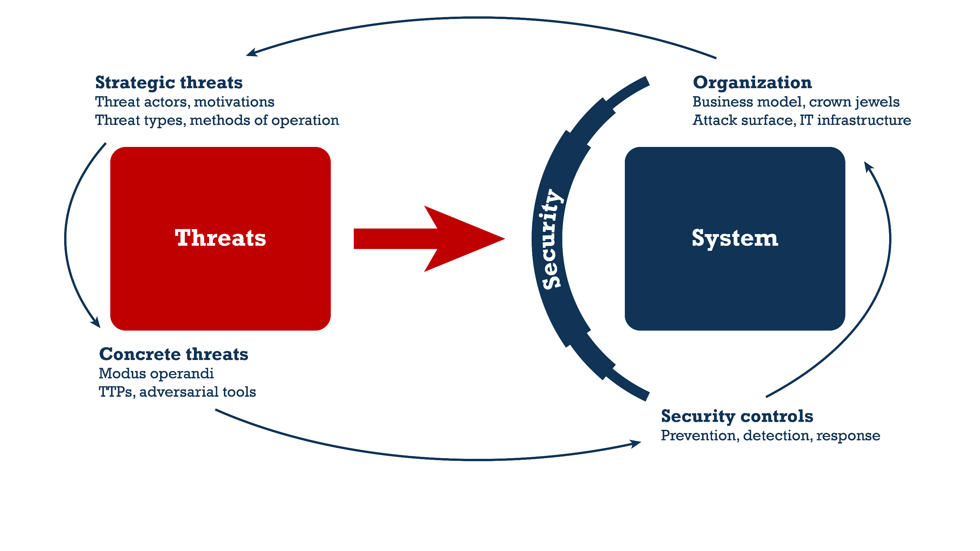
Notes:
Key messages:
Security should be optimized based on a threat model that is:
Up-to-date; (covers current threats, attack types, TTPs, adversarial tools, etc.)
Detailed and actionable; (the people responsible for security can reliably determine whether the system is protected against a specific threat)
Relevant.
The threat model covers both threats and the system to achieve the above, but its focus lies more heavily on threats (red). The system side (blue) is primarily used to filter and prioritize threats to achieve optimal relevancy.
The red side can be split into two distinct levels:
Strategic threats, these help prioritize and filter what’s relevant, but don’t give enough (technical) detail to design effective security controls.
Concrete threats, these are chosen based on the strategic threats, and give enough (technical) detail to design effective security controls.

Slide 7
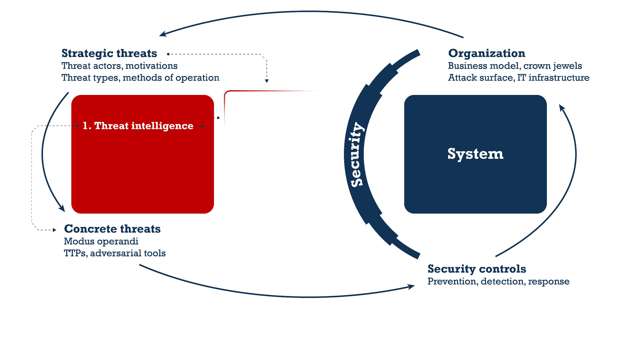
Learn from others
External sources of actionable threat intel
Apply own creativity
Threat modeling workshops and mindset
Use experts’ creativity
Red teamers, pen testers, white hat hackers

Slide 8
Learn from others
External sources of actionable threat intel
Apply own creativity
Threat modeling workshops and mindset
Use experts’ creativity
Red teamers, pen testers, white hat hackers

Slide 9
Photo by Michael Jeffrey
on Unsplash

Slide 10
Photo by Jordan Beltran
on Unsplash

Slide 11
Collect threat intelligence relevant to the organization
Understand how threat actors work, their tools, techniques, and MOs
Filter based on organization profile and its IT landscape
Ensure threat intelligence is actionable: helps make decisions and/or test security
Track threat landscape as it evolves over time

Slide 12
Learn from others
External sources of actionable threat intel
Apply own creativity
Threat modeling workshops and mindset
Use experts’ creativity
Red teamers, pen testers, white hat hackers

Slide 13
Learn from external sources, what others see
Generic threats, not specific to the organization
Often focusing on technical details of cyber attacks
Apply threat intelligence to the organization and its IT landscape Be creative: don’t be limited by what’s known, but do stay realistic
Identify potential threats and associated business impact Closer to the business than standard threat intelligence
Help prioritize threats based on potential business impact

Slide 14
Learn from others
External sources of actionable threat intel
Apply own creativity
Threat modeling workshops and mindset
Use experts’ creativity
Red teamers, pen testers, white hat hackers

Slide 15
Photo by Reno Laithienne on Unsplash

Slide 16
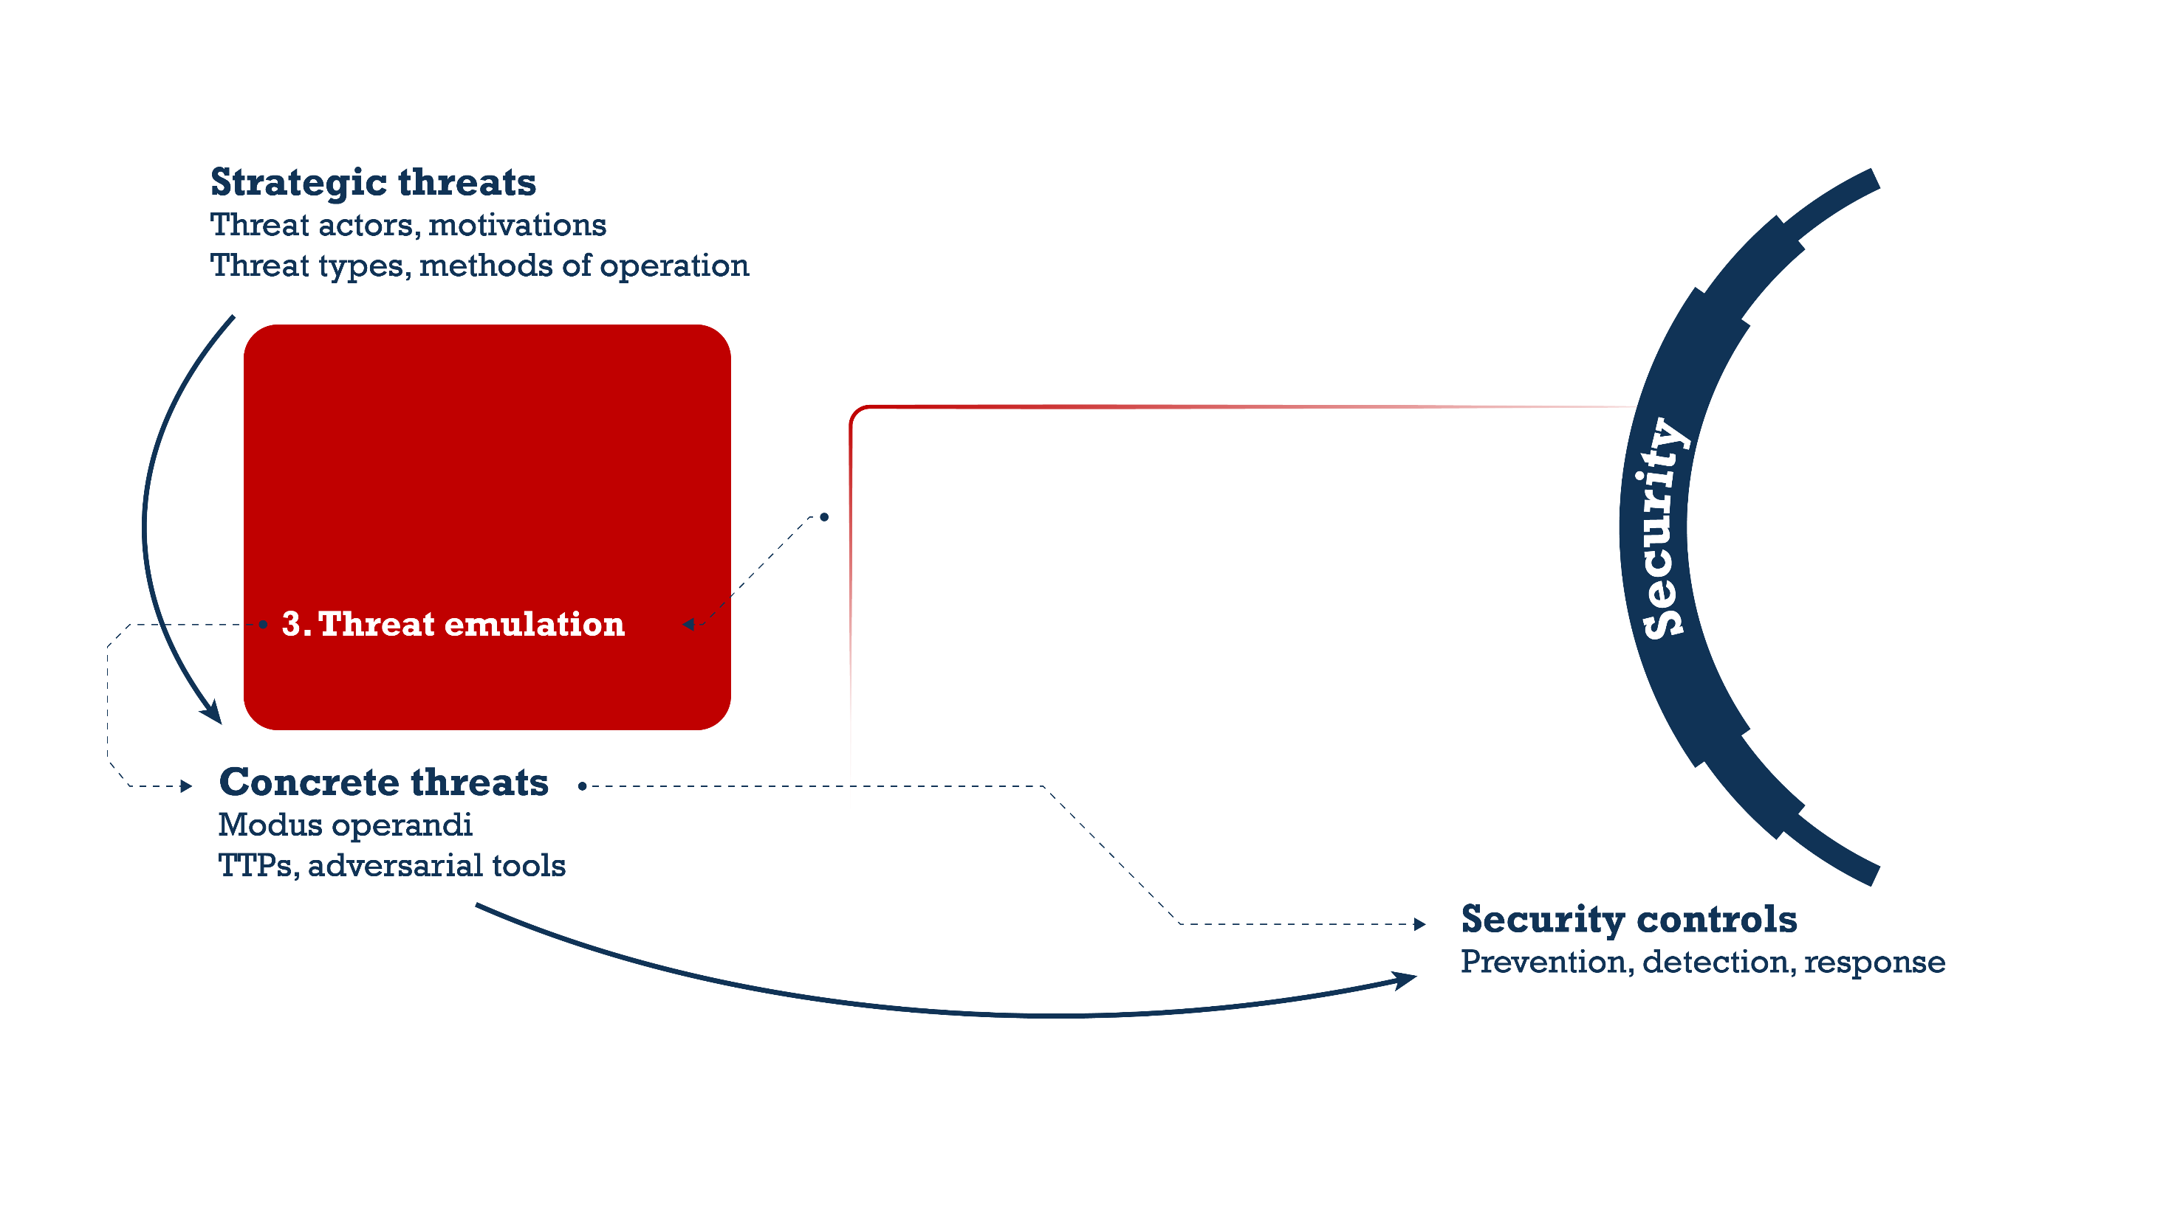
Test whether security controls actually work
Train the organization’s response capabilities
Raise awareness of the reality of cyber threats
Identify weaknesses to improve

Slide 17
1 + 2 ≈ 3

Slide 18
Learn from others
External sources of actionable threat intel
Apply own creativity
Threat modeling workshops and mindset
Use experts’ creativity
Red teamers, pen testers, white hat hackers

Slide 19
Photo by Alice Dietrich on Unsplash

Slide 20
Threats
System

Slide 21
Availability of
Education
Threats
Confidentiality of
Data
Conftinuity of
Operations
Integrity of
Research

Slide 22
Data breach
Insider threats
Ransomware
Hacktivists
Availability of
Education
Hacking
Confidentiality of
Data
Phishing
Conftinuity of
Operations
Integrity of
Research
Malware
Info stealers
Business e-mail compromise
Account compromise
Fraud
Sabotage
DDoS
Espionage

Slide 23
Data breach
Insider threats
Ransomware
Hacktivists
Availability of
Education
Hacking
Confidentiality of
Data
Phishing
Conftinuity of
Operations
Integrity of
Research
Malware
Info stealers
Business e-mail compromise
Account compromise
Fraud
Sabotage
DDoS
Espionage

Slide 24
Playing field
People, technology, third-parties

Slide 25
“Outside-in” Threat-led modeling
How do threat actors commonly attack?
What goes wrong often?
“Inside-out” Business-led modeling
What must be protected?
Where is the pain?
Playing field
People, technology, third-parties

Slide 26
“Outside-in” Threat-led modeling
How do threat actors commonly attack?
What goes wrong often?

Slide 27
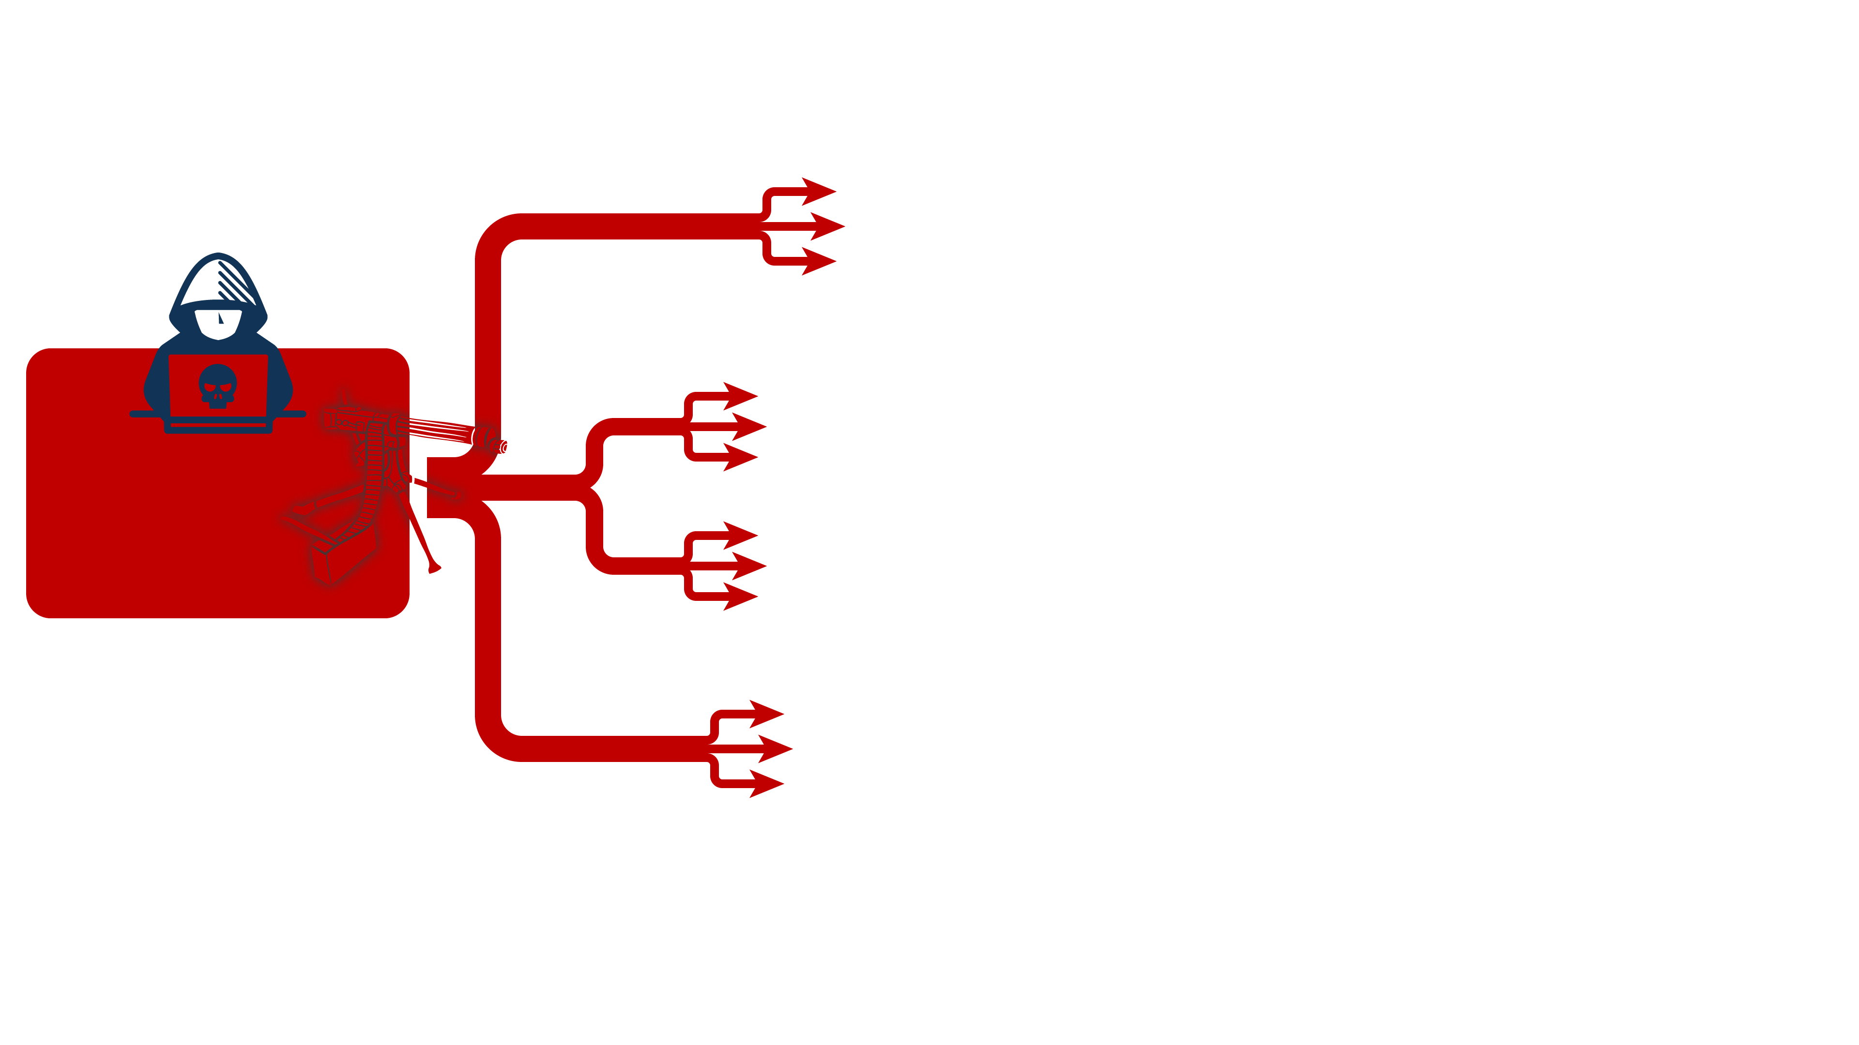
“Outside-in” Threat-led modeling
Phishing
Compromise accounts
Perimeter devices
Vulnerability scanning
Supply chain attacks

Slide 28
Citrix
Juniper
SonicWall
Ivanti
ConnectWise
Ivanti
Cisco
Cisco
Ivanti
Ivanti
Cisco
F5
Ivanti
Citrix
Fortinet
Fortinet
Palo Alto
Check Point
SonicWall
Fortinet
Fortinet
Oct
Nov
Dec
Jan
Feb
Mar
Apr
May
Jun
Jul
Aug
Sep
Oct
2023
2024

Slide 29
Lessons
All internet facing systems are targets Don’t rely on their security
Patching is important! But doesn’t stop zero-days
Assume breach Defense in depth, zero trust
Threat model
Known vulnerabilities get exploited Patch systems asap, but also prepare for breach
Unknown vulnerabilities get exploited Can’t patch! What would an adversary do next?
Common post-exploitation steps Discovery, lateral movement, privilege escalation, …
Citrix
Juniper
SonicWall
Ivanti
ConnectWise
Ivanti
Cisco
Cisco
Ivanti
Ivanti
Cisco
F5
Ivanti
Citrix
Fortinet
Fortinet
Palo Alto
Check Point
SonicWall
Fortinet
Fortinet
Oct
Nov
Dec
Jan
Feb
Mar
Apr
May
Jun
Jul
Aug
Sep
Oct
2023
2024

Slide 30
“Outside-in” Threat-led modeling
How do threat actors commonly attack?
What goes wrong often?

Slide 31
“Inside-out” Business-led modeling
What must be protected?
Where is the pain?

Slide 32
“Inside-out” Business-led modeling
Data
How sensitive is it?
Where is it?
Reputation
What could damage it?
Operations
Which systems do you rely on?
Alternate ways to operate?

Slide 33
Photo by benjamin lehman on Unsplash

Slide 34
Data theft
Get in
Take over the environment
Steal data

Slide 35
Data theft
Photo by Marcin Simonides on Unsplash

Slide 36
Lessons
Threat actors like stealing and breaking Collect, exfiltrate, encrypt, erase, …
Users and threat actors both access data But generally in very different ways
Prevention is not always possible Leverage detection and response
Threat model
Which assets must be protected? Where are the crown jewels?
How can those assets be impacted? Loss of confidentiality, availability, integrity; abuse of identities, abuse of computing resources
How can that impact be avoided/reduced? Stronger prevention? Faster detection and response? Faster recovery?
Photo by Marcin Simonides on Unsplash

Slide 37
Learn from others
External sources of actionable threat intel
Apply own creativity
Threat modeling workshops and mindset
Use experts’ creativity
Red teamers, pen testers, white hat hackers

Slide 38
Threat modeling
Informed creativity Builds awareness and understanding
Helps focus and prioritize Actionable risk-based approach
More valuable than generic threat intelligence
Cheaper than hiring external penetration testers
Learn from others
External sources of actionable threat intel
Apply own creativity
Threat modeling workshops and mindset
Use experts’ creativity
Red teamers, pen testers, white hat hackers

Slide 39
Christo Butcher ◂ Executive Consultant ◂ Fox-IT (NCC Group)
①
A brief dive into general cyber security awareness
When: Thu November 7, 2024, 13:30
Where: Silent Presentation Area (track C)
②
Lessons from the trenches on managing cybersecurity, gaining control by breaking it down
When: Thu November 7, 2024, 16:00
Where: Frederick's (track D)

