Slide 1
Cybersecurity Threats Facing the Educational Sector in 2025 – an ICT Security Services Perspective
HEAnet Conference 2024
Notes:
LOS

Slide 2
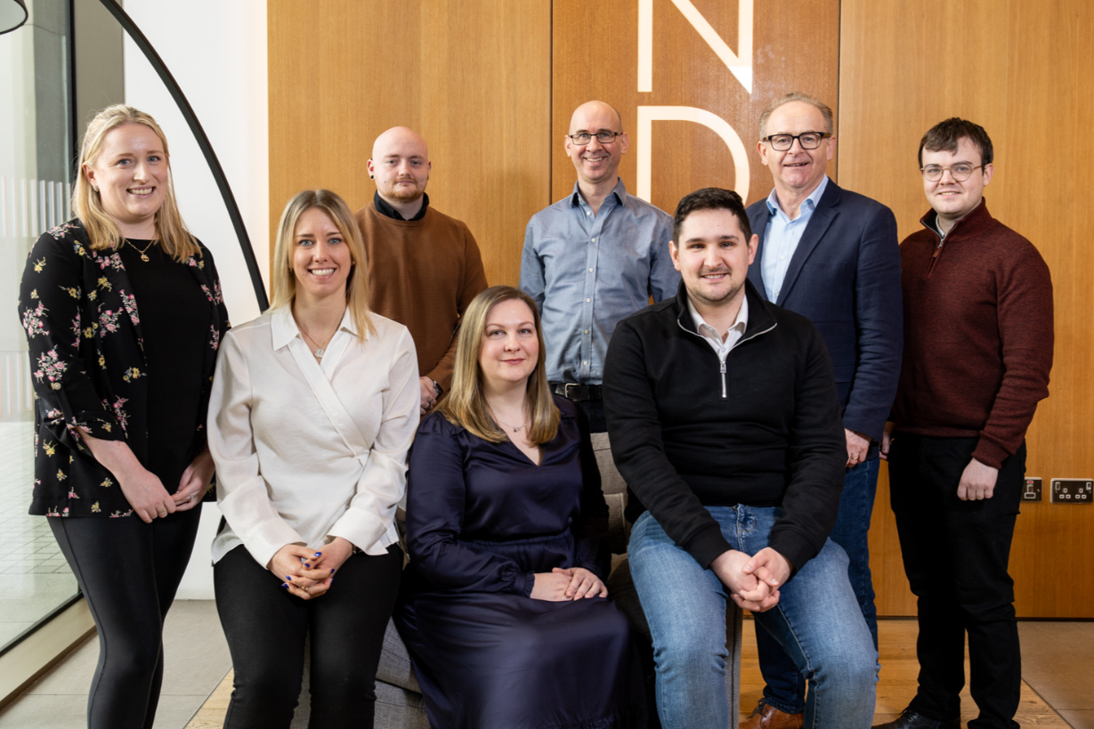
ICT Security Services
Notes:
LOS
HEAnet provides a range of ICT Security services.
The objective of ICTSS is to provide a standardised set of core security services which are common to all clients.
These are provided using a dedicated HEAnet team to augment the Institutions IT Department resources, whilst using a suite of services which are common, sharable and repeatable across HEAnet clients.

Slide 3
ICT Security Services - Offering
Notes:
LOS

Slide 4
Current Cybersecurity Landscape
Notes:
ND

Slide 5
Current Cybersecurity Landscape
Ransomware Attacks
Phishing Attacks
IoT Vulnerabilities
Insider Threats
Notes:
ND

Slide 6
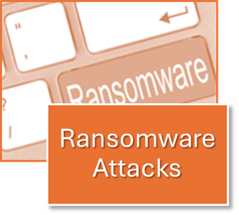
Ransomware Attacks
The average ransom in 2024 was found to be over $2.7 million in 2024
Ransomware attacks have surged by 77%, with over 4,374 new victims recorded across 75 countries in 2024
A survey conducted in 2024 with 1,263 companies found 80 percent of victims who submitted a ransom payment experienced another attack soon after
Notes:
Ref: https://www.varonis.com/blog/ransomware-statistics#:~:text=Here%20are%20the%20top%20ransomware,been%20encrypted%20got%20it%20back.

Slide 7
Phishing Attacks
Financial impact of phishing attacks worldwide has reached an estimated $3.5 billion in 2024
Phishing attacks grew by 58% last year
The success rate of phishing attacks has increased from 14% last year to 18% this year
Notes:
Phishing attacks grew by 58% last year, marking it as one of the fastest-growing cyber threats for all organisations.

Slide 8
Internet of Things (IoT) Vulnerabilities
IoT security is an emerging concern, especially as campuses become more connected.
Such devices can include
Smart Boards, learning Tablets, Security Cameras, Sensors and Alarm systems that connect directly to the internet
Insecure authentication controls
Such as leaving the vendor’s default password in place for device authentication, offer an easy access point for many attackers looking to gain access to IoT devices and attackers would often look to target the valuable personal information on students and school staff,.

Slide 9
Insider Threats
Securonix’s Insider Threat Report 2024 revealing that 90% of organisations interviewed expressing that they find insider attacks more difficult to deal with than external attacks.
From 2019 – 2024 the number of organizations reporting insider attacks increased from 66% of organizations to 76%.
Stationx found that the vast majority of malicious insider breaches was motivated by personal financial gain, with 89% of all cases studied being motivated by this.
In general, IoT devices carrying vulnerabilities have increased by 136% from 2023 to 2024 according to Forescout’s “The Riskiest Connected Devices 2024” Report.

Slide 10
ICT Security Services
Key Areas of note in 2024
Notes:
ND

Slide 11
Network Vulnerabilities An ICTSS Perspective
Unsupported Systems: Operating Systems, Software, or Service that have reached End of Life
Unencrypted Communications : Applications running over HTTP, Telnet, Basic Auth over HTTP
Outdated Software: Apache, PHP, OpenSSH version missing patches.
Web Server Misconfigurations : Information Leakage, Directory Listings, Username Enumerations
Notes:
LoS: Here are some of the key trends we have found over the past two

Slide 12
Phishing Simulations Key Statistics
11285
3240
1182
Total Results (Jan 2024 – November 2024)
Emails Sent
Emails Opened
Links Clicked
Key Points:
Convincing phishing emails are getting easier to create.
87% of links clicked come less than 1 minute after the email was opened.
Regular Security Awareness training is required.

Slide 13
IT Compliance – Educational Sector Statistics
Across the Education Sector in 2024:
57 percent of Institutes surveyed indicated that they have experienced a data breach in the past five years.
61 percent of respondents say they are either very or somewhat prepared to respond to a cybersecurity incident and minimize the resulting downtime, while 28 percent are very or somewhat unprepared
74 percent of respondents cite Cloud Security Management and Identity and Access Management as the most important controls for improving visibility into their environment.
Three in five (60%) teachers claim to have integrated AI into their daily teaching practices.
71% of secondary schools reported a breach or attack in the past year, compared to 52% of primary schools, likely due to improper monitoring and detection controls.
Notes:
Ref: https://edtechmagazine.com/higher/article/2024/06/survey-reveals-top-cybersecurity-issues-education
https://www.aiprm.com/en-ie/ai-in-education-statistics/
Some Compliance based stats from the education sector in 2024, key stats to highlight are:
61 percent of respondents say they are either very or somewhat prepared to respond to a cybersecurity incident and minimize the resulting downtime, while 28 percent are very or somewhat unprepared
74 percent of respondents cite Cloud Security Management and Identity and Access Management as the most important controls for improving visibility into their environment.
Three in five (60%) teachers claim to have integrated AI into their daily teaching practices.

Slide 14
ICTSS - Policy Review and Development Offering
Key Policies 2024 – ICTSS Compliance Statistics
Vendor Management Policy
Acceptable Usage
BYOD Policies
IT Security Policy
Cloud Services Policy
Incident Response Policy
Server Hosting Policy
Information Security Policy
Anti Virus and Malware Policy
AI Usage Policy
Top policies requested to be reviewed / developed by ICTSS clients
Notes:
LOS
Linking the previous slide to a sample of what the Compliance team has offered to client’s so far in 2024, we can see some of the key policies we have developed during the year hits upon some of the stats discussed previously, i.e. Incident Response Policy, Cloud Services Policy, AI Policy.
Highlights how we are looking at trends in the industry to develop policies that are relevant with what is going on in the industry as well as with the challenges that our clients in Education may face

Slide 15
Security Awareness
Over 1,700 Staff Trained in 2024 to date
Attendance: approx. 40 attendees per session
Satisfaction: 4.89/5
93% confident in knowledge after training
44% confident in knowledge prior to training

Slide 16
Case Studies of Notable Cyber Incidents
Notes:
Conor covering case studies

Slide 17
An International Perspective
Some examples:

Slide 18
Maastricht University (2019)
Ransomware Attacks
In December 2019, Maastricht University was hit by the Clop Ransomware via a phishing email
Nearly all Windows systems within the university, including email servers, databases, and student portals are compromised
Attackers demand 30 bitcoin (€200,000) in return for a decryption key
University pays the ransom, receives the decryption key and begins the recovery process
Notes:
Ref: https://www.bitdefender.com/en-gb/blog/hotforsecurity/dutch-university-pays-220000-ransom-to-infamous-russian-cybercrime-ring/
https://www.maastrichtuniversity.nl/news/remarkable-development-investigation-maastricht-university-cyberattack
https://www.bleepingcomputer.com/news/security/maastricht-university-wound-up-earning-money-from-its-ransom-payment/

Slide 19
Maastricht University Impact:
Ransomware Attacks
This Ransomware attack had major ramifications for the University as a whole, including:
The university was effectively shut down, with IT systems being disabled for all students and staff.
Communication channels were limited even email services were affected.
The attack revealed several vulnerabilities, such as Insufficient Network Segmentation and Inadequate monitoring activity on the network.
The timing of the attack, during the holiday season, exacerbated the response delay, giving the attackers more time to encrypt data.
Notes:
Ref: https://www.bitdefender.com/en-gb/blog/hotforsecurity/dutch-university-pays-220000-ransom-to-infamous-russian-cybercrime-ring/
https://www.maastrichtuniversity.nl/news/remarkable-development-investigation-maastricht-university-cyberattack
https://www.bleepingcomputer.com/news/security/maastricht-university-wound-up-earning-money-from-its-ransom-payment/

Slide 20
Lessons Learned from the Ransomware Case Study
There is a need for robust cyber defenses (including strong patching and firewalls, antivirus, and anti-malware systems)
Well defined and tested Incident Response Plans
Employee Training
Regular Access Control Reviews
Strong Email and Web Security capabilities
Notes:
Some of the lessons that were learned and main take aways as a consequence of the case studies:
There is a need in Universities for more robust cyber security defenses including strong patching and firewall, antivirus and anti malware systems
Employee Training, making sure that employees know what ransomware is how to identify and ultimately what to do if a ransomware incident occurs
Well Defined and tested Incident Response Plans, especially making sure that your Incident Response plans contain a ransomware
scenario plan of some kind
Strong Email and Web Security Capabilities, so this could be email and web filters at gateways
And regular Access Control reviews (who has access to the most critical data in your org)

Slide 21
University of West Scotland (2023)
Phishing Attacks
In July of 2023, UWS became the target of a phishing attack executed by the Rhysidia ransomware gang
The emails prompted recipients to verify their account information by clicking a link, leading to a fraudulent site designed to capture their login credentials.
The incident was reported to police on 6 July
Rhysida demanded 20 bitcoin (£450,000) for the confidential data they harvested and threatened it will be sold to the highest bidder.
Notes:
Ref: https://www.bbc.com/news/uk-scotland-glasgow-west-66327336

Slide 22
University of West Scotland Response and Impact:
Phishing Attacks
Following the attack, UWS would look into implementing several key cybersecurity enhancements including:
The university mandating MFA for all accounts to add an extra layer of security.
UWS would consider upgrading its email security systems to better detect and block phishing attempts before they reached users’ inboxes.
The university launched an ongoing cybersecurity awareness program.
Notes:
Ref: https://www.bbc.com/news/uk-scotland-glasgow-west-66327336

Slide 23
Lessons Learned from the previous Case Study
Heightened need for security awareness training across the organization
More investment in anti-phishing tools
Stronger Network Segmentation and Access Controls
More emphasis on public awareness campaigns to raise awareness of phishing attacks in the universities ("Think Before You Click")
Notes:
Heightened need for security awareness training across the organization , particularly around phishing
More investment in anti-phishing tools such as those that can analyse a sender’s domain, attachments, and URLs in emails
Stronger Network Segmentation and Access Controls
More emphasis on public awareness campaigns to raise awareness of phishing attacks in the universities ("Think Before You Click")

Slide 24
IoT Vulnerabilities
Rutgers University (2016)
Between 2014 and 2016 a number of Rutger Universities IoT devices are targeted by Mirai botnet leading to mass DDoS attacks
Targeted services include email, online course registration and university research platforms
Attacker was sentenced to pay 8.6 million dollars and perform 2,500 hours of community service for the attack
Notes:
Ref: https://www.justice.gov/usao-nj/pr/computer-hacker-who-launched-attacks-rutgers-university-ordered-pay-86m-restitution
https://spectrum.ieee.org/mirai-botnet
https://cyberscoop.com/mirai-botnet-rutgers-sentencing/

Slide 25
Lessons Learned from the previous Case Study
More proactivity to be placed on how to protect and secure university’s IoT devices
Review how IoT devices are connected to the university network, segmenting them if possible
Further security awareness training for users on how they can secure their personal devices if connecting to the university network

Slide 26
Insider Threats
Grinnell College (2023)
Employee working at Grinnell College accidently moved information stored in a private folder to a public one
Personal student and faculty information such as Payroll, Social Security and other PII data accessible to all students and staff
University ITS team is alerted, and the data was removed from public view later that day
Notes:
Ref: https://thesandb.com/44216/news/grinnell-college-students-informed-compromised-payroll-information/

Slide 27
Lessons Learned from the previous Case Study
More emphasis on the importance of security awareness training
Regular review of your employee access controls
Proactive Monitoring
Well defined Incident Response Plans

Slide 28
Countermeasures
Notes:
Louise speaking about this

Slide 29
Countermeasures that can help you from an ICTSS perspective
Security Awareness Training
Threat Intelligence
Network Scanning
Risk Assessments (IT Environment)
Anti-phishing Protection
Simulated Phishing Attacks
';--have I been pwned?
Policies
Information Sharing
Patching
Regular back ups
Incident Response

Slide 30
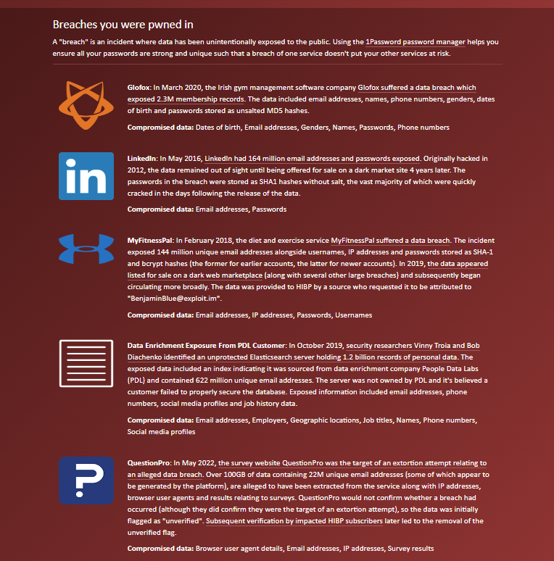
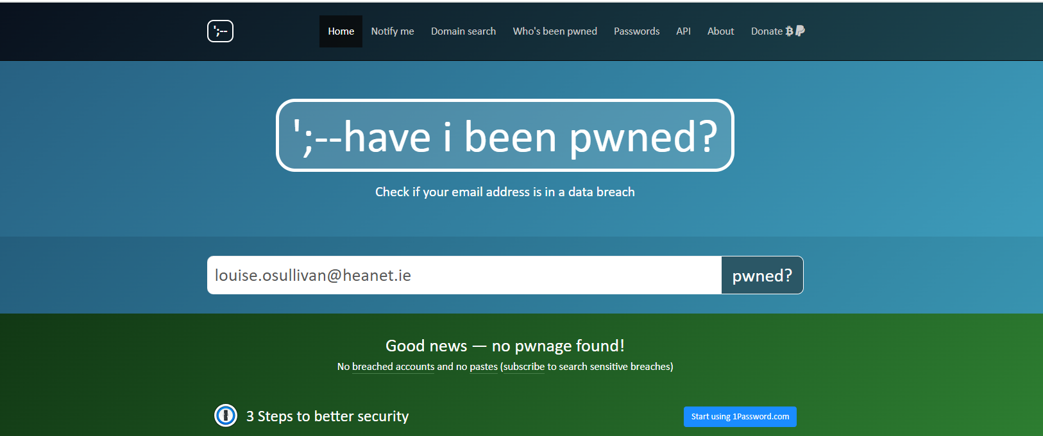
Have I been Pwned?

Slide 31
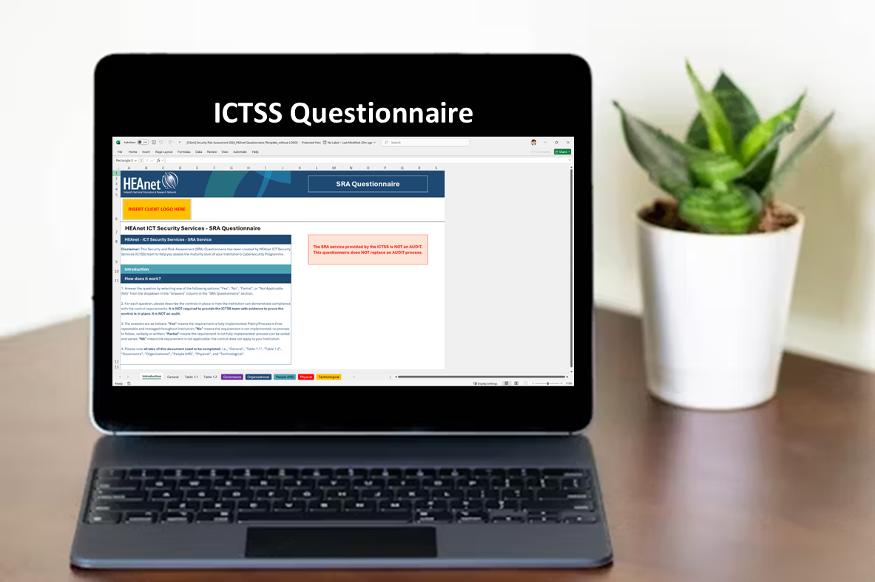
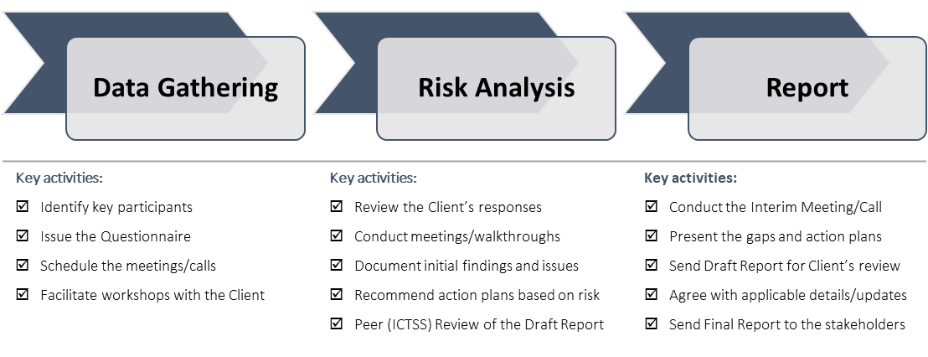
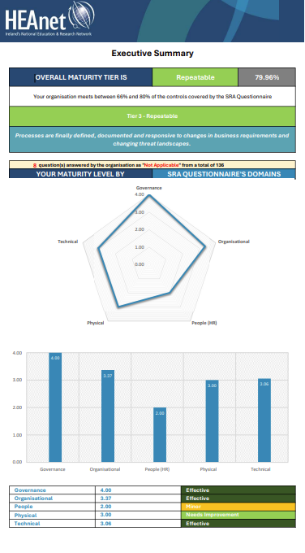
ICTSS - Security and Risk Assessment (SRA) Offering
Service Methodology
It NOT an AUDIT. It does NOT replace an AUDIT process.
ICTSS Methodology by Tiers
How cybersecurity risks and processes are viewed within your organization:
Sophistication
Partial
Risk Informed
Repeatable
Adaptable
Notes:
LOS

Slide 32
ICTSS - Security and Risk Assessment (SRA) Offering
What to expect
Benefits of a Security Risk Assessment (SRA)
Our offering will help you:
Cyber risk goals aligned with your business goals
Determine your target state of cyber preparedness
Important questions can be answered by SRA:
Does everyone know their role?
Are you adequately managing 3rd party risks?
Who oversees your cyber security programs?
Are you keeping abreast of the latest threat intelligence?
Are you partnering with law enforcement and industry peers?
Do you have response teams inside and outside the University?
Are you assuming a breach or other successful attack is inevitable?
Who conduct risks analysis, when and with what assets or 3rd parties?
What are you doing to manage and minimize your legal risks and exposures?
Measure the maturity of your existing cyber security programs
Identify cyber security gaps
Determine short-term, long-term and ongoing security priorities
Develop evidence of “reasonable” cyber security measures
Notes:
Key (fact/ finding/ observation) that has come through as we look at statistics, breaches and security concerns today is that in each example it becomes evident, that organisational policies had not worked well/.
That the business continuity was in some way inadequate/ lacking and recovering from security incident wasn’t as simple.
Having developed a good policy suite is only the first step; regular review and testing of policies is key.
Having a well functioning ISMS is ideal!
And what that means, is having a structure in place that works, that is regularly checked, verified and tested. And when its tested, all is documented and adjusted from the point of view of CONTINUITY.
Frameworks like ISO27k, NIST and regulations all have one thing in common – they provide structure around business continuity and Continual Improvement.
In a minute we will also look at a list of common policies that would (insert what objective they would achieve in preventing breaches etc.)

Slide 33
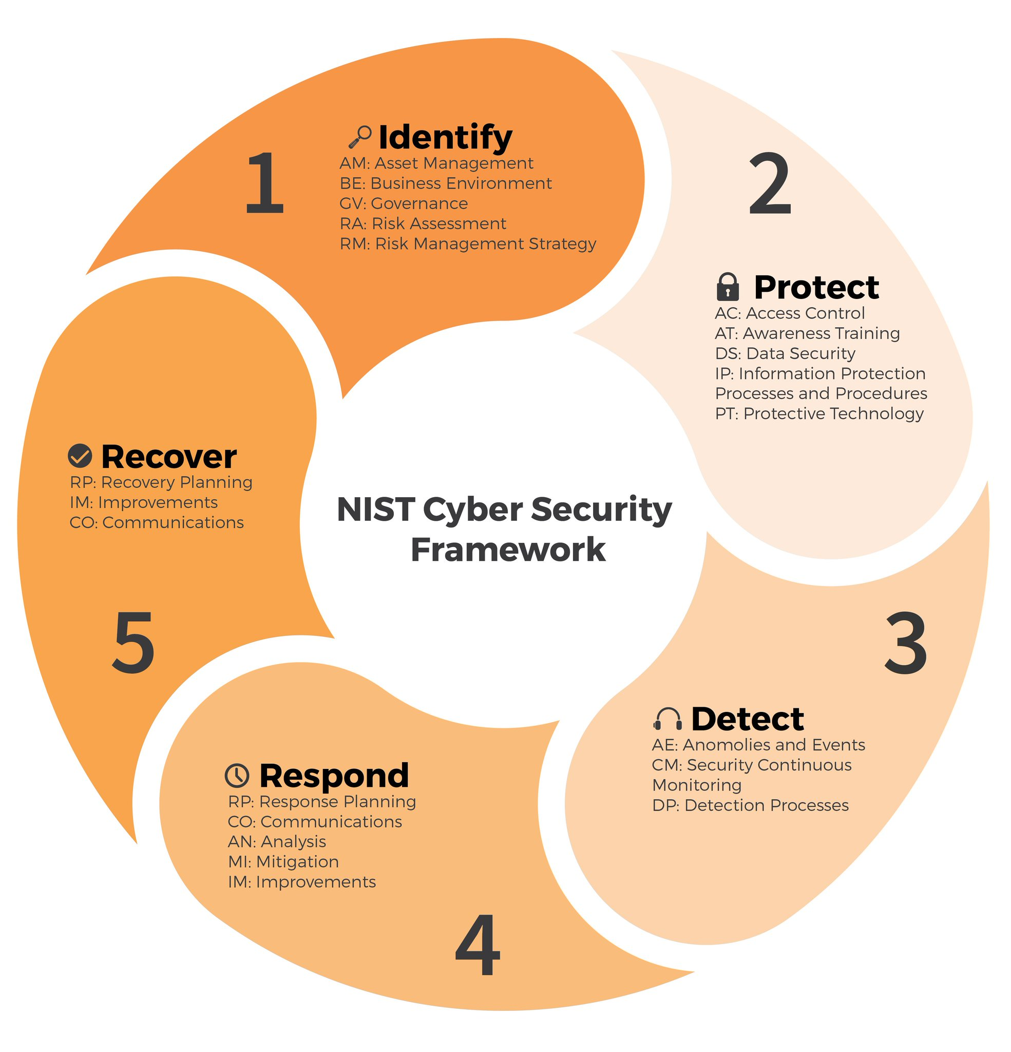
ICTSS - Security and Risk Assessment (SRA) Offering
What to expect
Compare your cyber security program to proven, cyber security frameworks and models such as NIST CSF, ISO 27001, GDPR, and NIS2 Directive. This includes evaluating against industry best practices and regulations.
CIS Controls
ISO 27001
NIST Cyber Security Framework
Notes:
Key (fact/ finding/ observation) that has come through as we look at statistics, breaches and security concerns today is that in each example it becomes evident, that organisational policies had not worked well/.
That the business continuity was in some way inadequate/ lacking and recovering from security incident wasn’t as simple.
Having developed a good policy suite is only the first step; regular review and testing of policies is key.
Having a well functioning ISMS is ideal!
And what that means, is having a structure in place that works, that is regularly checked, verified and tested. And when its tested, all is documented and adjusted from the point of view of CONTINUITY.
Frameworks like ISO27k, NIST and regulations all have one thing in common – they provide structure around business continuity and Continual Improvement.
In a minute we will also look at a list of common policies that would (insert what objective they would achieve in preventing breaches etc.)

Slide 34
Focus on continuous improvement is key
Continuous Compliance
Threat and risk aware
NIS 2
EU GDPR
3rd Party, Vendor and Supplier Management
Security Awareness Training
Risk and Threat Management
Incident Handling and Incident Management
Continuous Improvement
NIST CSF
ISO 27001:2022 Cyber Security Baseline Standards
CIS Controls
Resilient Organisation
Technical security controls, encryption, MFA
Policies, Processes, Procedures
Secure Systems
Business Continuity,
Disaster Recovery and Cyber Security Plans
Risk Informed Decisions
Notes:
LOS
Key (fact/ finding/ observation) that has come through as we look at statistics, breaches and security concerns today is that in each example it becomes evident, that organisational policies had not worked well/.
That the business continuity was in some way inadequate/ lacking and recovering from security incident wasn’t as simple.
Having developed a good policy suite is only the first step; regular review and testing of policies is key.
Having a well functioning ISMS is ideal!
And what that means, is having a structure in place that works, that is regularly checked, verified and tested. And when its tested, all is documented and adjusted from the point of view of CONTINUITY.
Frameworks like ISO27k, NIST and regulations all have one thing in common – they provide structure around business continuity and Continual Improvement.
In a minute we will also look at a list of common policies that would (insert what objective they would achieve in preventing breaches etc.)

Slide 35
ICT Security Services - Offering
Notes:
LOS

Slide 36
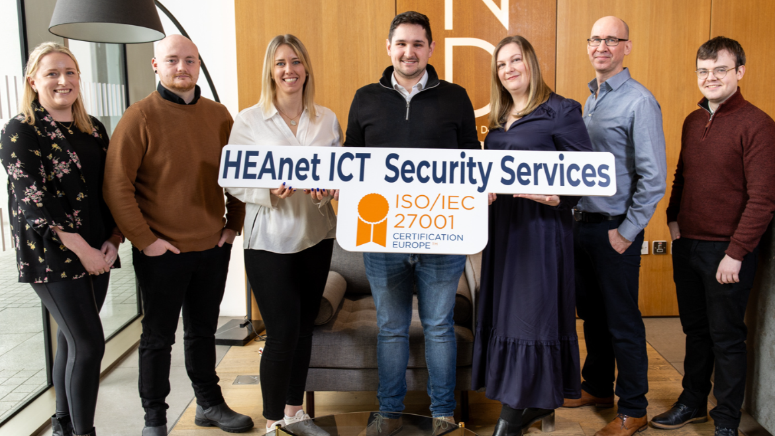
Thank you for your time
Notes:
robbiepcord@gmail.com

