Slide 1



Empowering Academic Excellence:
AI-Driven Connectivity Solutions
John Gilvarry
CTO, Enet & Speed Fibre Group

Slide 2

Introduction
AI is revolutionizing network infrastructure, moving beyond consumer applications to reshape connectivity across industries. This presentation explores AI's impact on next-gen networks, the foundational principles of 6G, and opportunities for cloud and AI-native networks as a service.

Slide 3
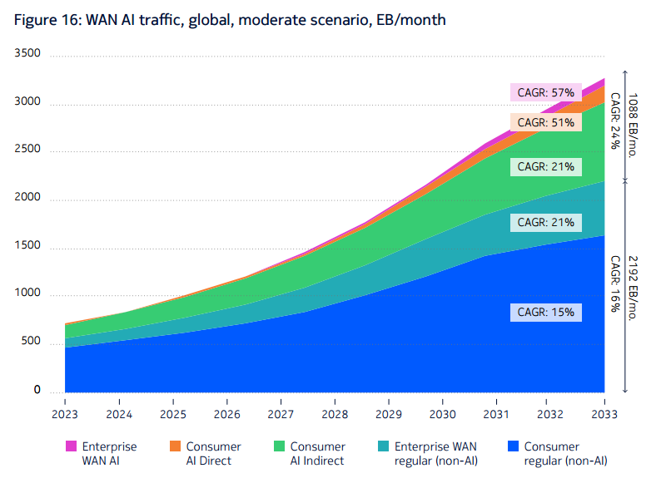
AI’s Impact on Global Traffic
  AI will drive 33% of global traffic, with 83% of this traffic indirect.
Nokia Global Traffic Outlook

Slide 4



AI Use Cases Beyond Consumer and Business: Impact on Networks
Consumer
Industry
Networks
  Recommender Systems
  Gen AI
  Augmented Reality
  Speech Recognition
  Industrial IoT
  Robotics
  Autonomous Vehicles
  Smart Cities
  Medicine
  Air Interface config
  Spectrum Management
  O&M
  Customized on Demand
  Traffic Management

Slide 5

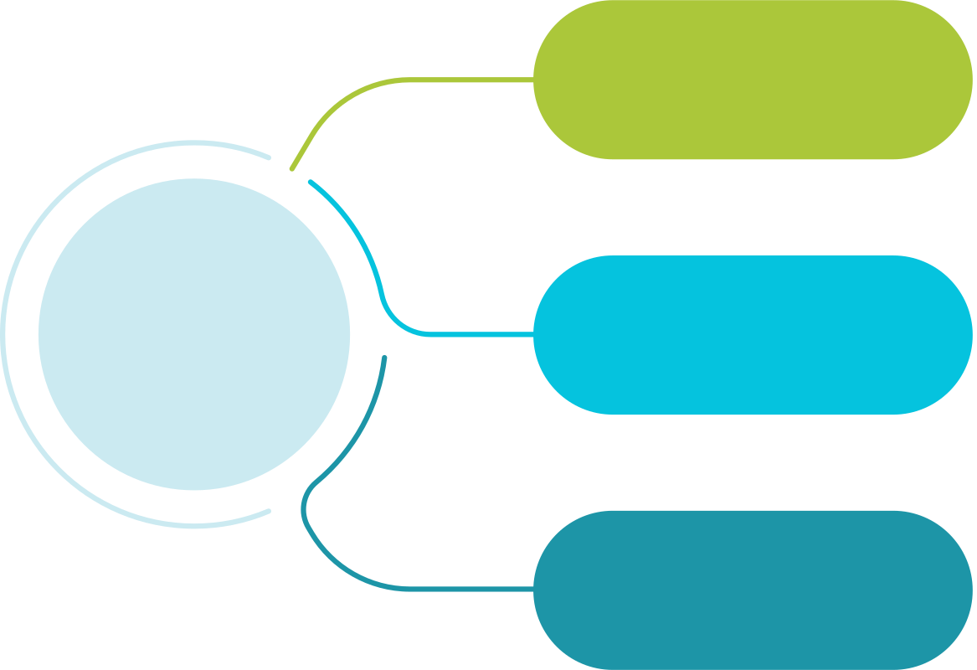
6G Benefits Over 5G:
  10-100x more energy efficient
  2-3x higher spectral efficiency
  10-100 Gbps user speeds
Sustainable
Core Principles of 6G
AI-Centric Operations:
  Seamless AI integration across all network functions, moving from add-ons to a fully embedded AI framework
AI Native
Cloud Native Functions:
  CNFs will replace VNFs, enabling a fully distributed data and compute architecture for scalable and efficient operations
Cloud Native

Slide 6



Prevailing Thoughts and Questions
Is latency low enough? How low can it go?
Are networks fast
enough?
Will Edge Computing solve future challenges?
Is there enough capacity for the future?
How should we approach security with quantum computing?
Where is the Edge? And what about Fog?

Slide 7






Distributed Functions in
Next-Generation Networks
Networking
Big Data
Security
Sensing
Compute
AI

Slide 8

Shifting from AI for Networks
Communication Plane
Service and Application Layer
Business Requirements
Network Function Layer
Network Capability Provisioning
Resource Layer
Channel State Perception

Slide 9

Enabling Networks for AI
Communication Plane
Data Plane
Compute Plane
Intelligence Plane
Service and Application Layer
Business Requirements
Business Demand Perception
Demand Perception and Computing Orchestration
Big Data Analysis,
AI/ML Algorithm
Network Function Layer
Network Capability Provisioning
Network State Awareness
Routing with Compute awareness
Resource Layer
Channel State Awareness
Resource State Awareness
Computing modelling and state perception

Slide 10
Cloud and AI Native Networks Delivered as a Service
Communication and Sensing
Communication and Compute
Communication and AI
  These enhanced capabilities, offered as-a-service, enable an evolved platform for AI-driven applications.
  The future network: A platform for advanced applications.

Slide 11

Key Benefits of AI-Integrated Networks
Eliminates Competing AI Use Cases (e.g. siloed air interface optimizations)
Introduces QoAIS for Standardized AI Quality Evaluation, adding security and autonomy metrics to complement traditional QoS.02
Enables fully integrated AI lifecycle management, moving beyond offline implementations

Slide 12
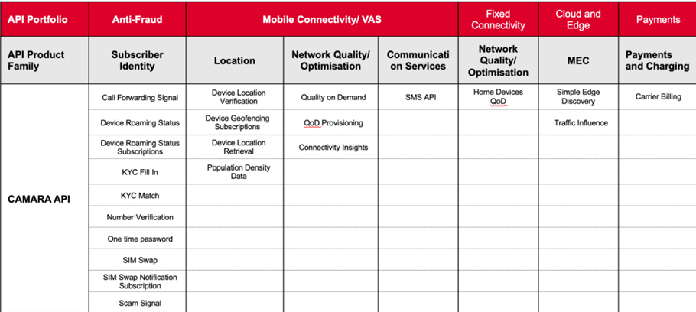
Closing Remarks
How do CSPs and the R&D community best capatilise on this emerging opportunity?
• Industry has recognized the need for broad collaboration to succeed in transformation telco->techco
• The vendor-operator balance changing with e.g. OpenRan, but extending to 6G with drive for removal of ‘closed’ AI
• However evidently the collaboration must widen further to include wider industry and academia.
• API exposure ranking with AI and security as the key evolutions within telco ecosystem.
• Future of the telco industry depends on attracting external innovation.
• New opportunity for R&D and entrepreneurship now that the traditional barriers of the closed ecosystems are coming down.

Slide 13


Thank You!
  John Gilvarry
  CTO, Enet & Speed Fibre Group

