Slide 1
IRLDAT: Operational experience of running Nextcloud as a shared storage service Section: IRLDAT on AWS Lessons Learned
Workshop
7th November 2024
IRLDAT team speakers: Brian Clayton (UCC) Niall Guerin (ICHEC)

Slide 2
Agenda for Nextcloud on AWS
Operating Nextcloud on AWS
Overview of IRLDAT pilot instance on AWS
Software Components and Services supporting the IRLDAT pilot instance on AWS
B2ACCESS and Centralized User Management for IRLDAT
Lessons Learned – Nextcloud on AWS
Case Study Demo
Upgrading Nextcloud
Dos and Don’ts

Slide 3
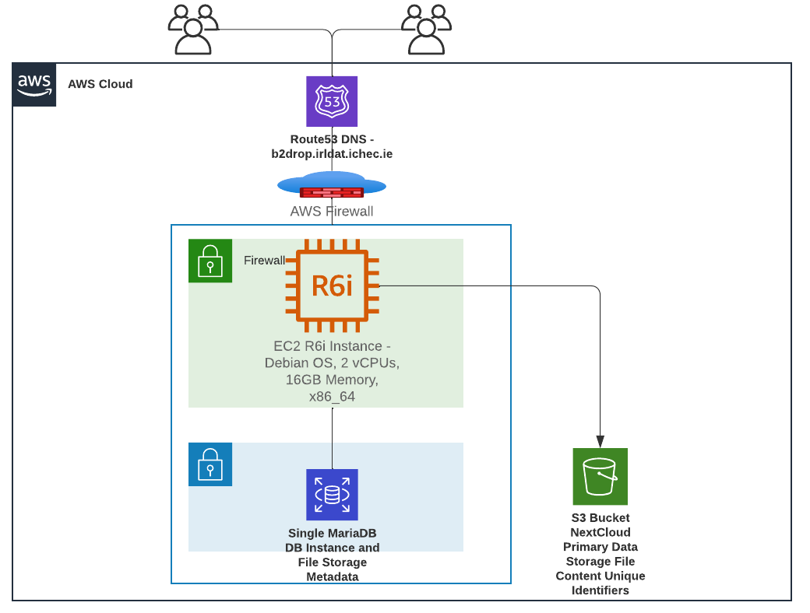
IRLDAT National Pilot Infrastructure Architecture: ICHEC instance
AWS Cloud Nextcloud instance
Firewalls at VPC EC2 instance layer and at Debian OS-level (iptables) layer
Debian Linux OS single VM running both the Nextcloud application server and MariaDB DB server on single instance
Nextcloud data files are stored in an S3 bucket as the primary storage container
Users from UCD, ICHEC, Galway, and Yale onboarded via B2ACCESS using their own organization Identity Provider (IDP)

Slide 4
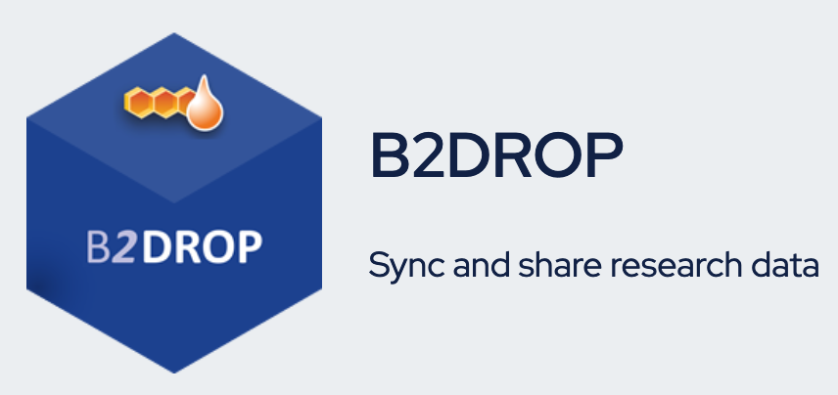
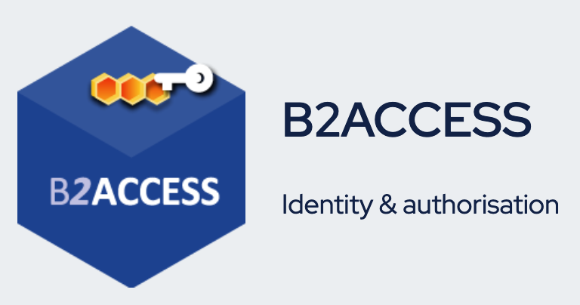
Software Components and Services
Notes:
The software components involved are relevant later when you need to tune parameters for data file syncs using the Desktop Client (e.g. Apache (or nginx if using). Not just a single setting that will do the job. Refer to Nextcloud big file upload configuration in the server admin guide.

Slide 5
B2ACCESS and User Authentication
B2ACCESS (federated authorisation and authentication proxy service)
The ICHEC AWS instance like the UCC and SETU IRLDAT sites offered users single sign on using organisation credentials via B2ACCESS service hosted by EUDAT
The configured workflow for ICHEC AWS instance with B2ACCESS uses SAML

Slide 6
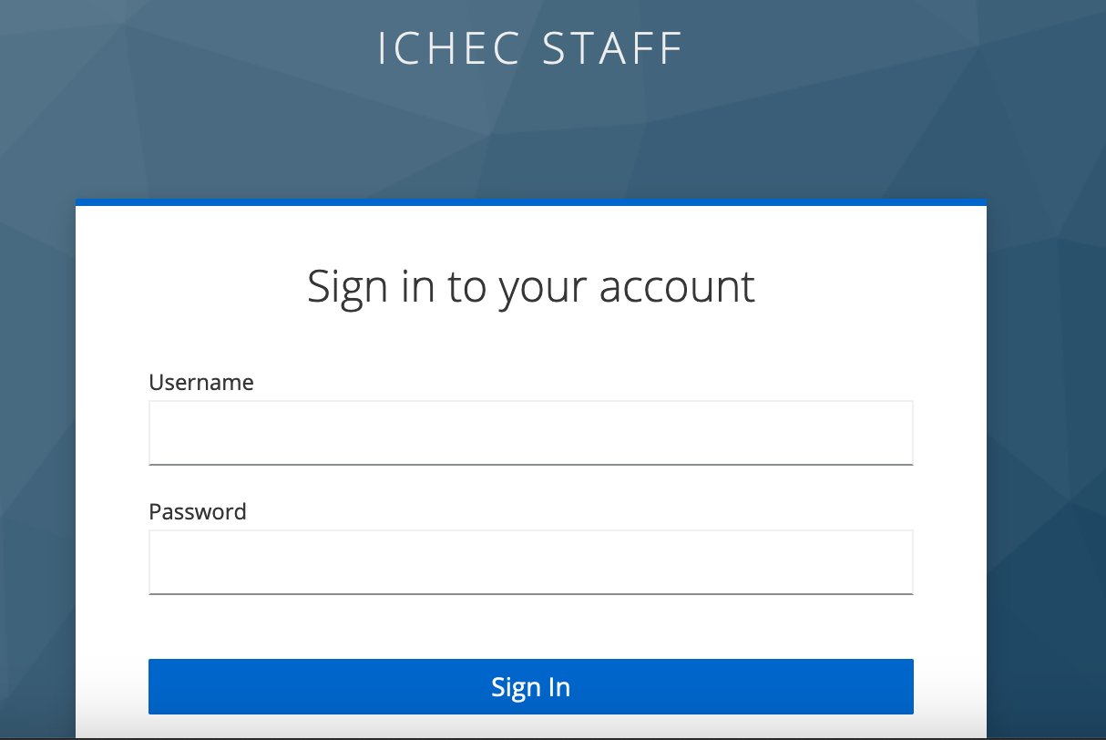
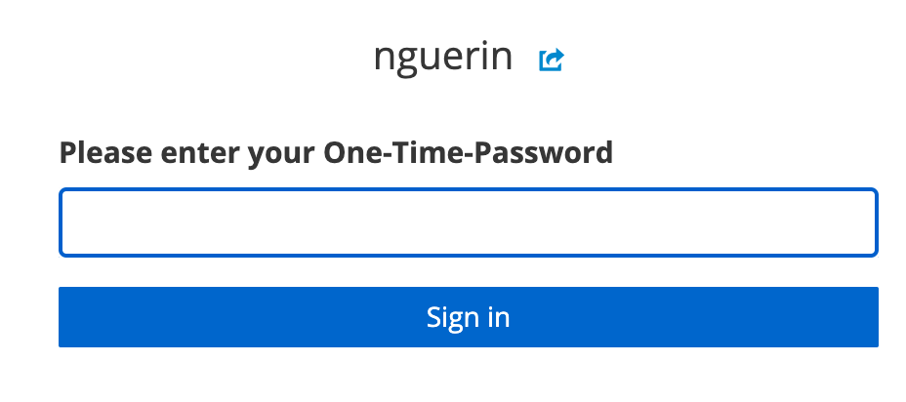
B2ACCESS and User Authentication
1
2
4
3
Notes:
B2ACCESS central landing page for IRLDAT users on national pilot (ICHEC, SETU, UCC).
Enter Staff institute credentials using the institute identity provider (IDP) – Keycloak in this example.
Enter MFA second factor (HSM) or Software Application soft token (e.g. Google Authenticator).
Redirect user to Nextcloud IRLDAT landing page.

Slide 7
Lessons Learned - Nextcloud on AWS
Problem | Comment
Transferring files to ICHEC AWS instance > 16-20GB | Root cause was Nextcloud AWS properties on server side rather than Desktop Client settings. One user found laptop power settings helped though in the larger file syncs, we found this less of an issue versus the server-side AWS properties for Nextcloud. Currently we have single desktop client sync transfers with 180GB working without issue and continuing tests. These properties were found researching in GitHub issue trackers often through long discussion chains, but not in the main Nextcloud admin guide documentation.
Desktop Client bug introduced early in pilot only affected ICHEC AWS IRLDAT instance users, not UCC or SETU on-premise solutions. | This bug was introduced accidentally by Nextcloud developers, but it’s noted here because there was much confusion in GitHub issue tracker with multiple users opening duplicates while others were dealing with a completely different problem to do with general Nextcloud file chunking parameter sizing, not the bug that was only affecting AWS instances. The users who did report this one were Nextcloud AWS instance users only and when the developer rolled back the change in an unofficial release patch, we found our issue was resolved.
Notes:
Refer users to section “Isolating other issues”, second bullet point, from the Nextcloud Desktop Client user guide. https://docs.nextcloud.com/desktop/latest/troubleshooting.html#isolating-other-issues

Slide 8
Case Study Example
Demo case study Nextcloud AWS scenario with 16-20GB failed file transfer and how to resolve it. Show this on the AWS Nextcloud system
Notes:
Have offline slides with the test case problem visual path and solution with all GitHub issue tracker references included for audience members who want to do their own implementations on AWS as PoC or for own development activity.

Slide 9
Upgrading Nextcloud
Step | Upgrade Action
1 | Create a backup (file system and execute database backup).
2 | In the existing Major release version, run the Web Updater UI to bring you up to the latest step version of Nextcloud in that major release. DO NOT JUMP MULTIPLE MAJOR RELEASES AT ONCE.
3 | Once you are on highest version of current major release, e.g. 26.0.13. then go to the next major release. Web Update UI should be fine for the major release upgrade too; I used the CLI for the major release upgrades and had no issue but both should do the same task so it’s down to preference. Never upgrade to 0.0 or 0.1 version based on feedback from colleagues in EUDAT.
4 | Run DB commands – columns, indices, primary-keys. Update the B2Drop theme if using EUDAT B2Drop UI theme.
5 | Log in as Administrator and run system health checks and basic test cases for file syncs with Desktop and Web Client and verify workflows executing normally.
6 | Notify users of status and ask end users to validate workflows and report back any issues.

Slide 10
Case Study Example
Demo showing typical Nextcloud upgrade path errors and resolution steps for Nextcloud administrators
Notes:
Have offline deck and reference web updater and CLI via demo system.

Slide 11
Thank you
Any questions?

